Slide 1




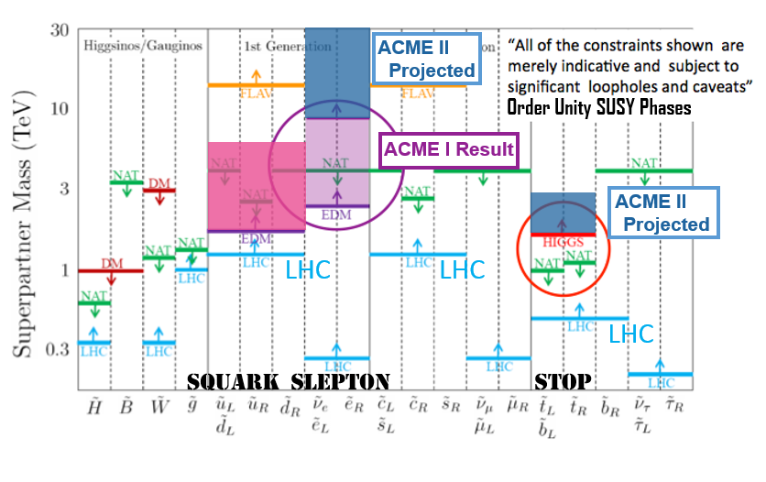
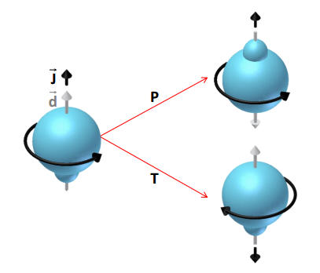
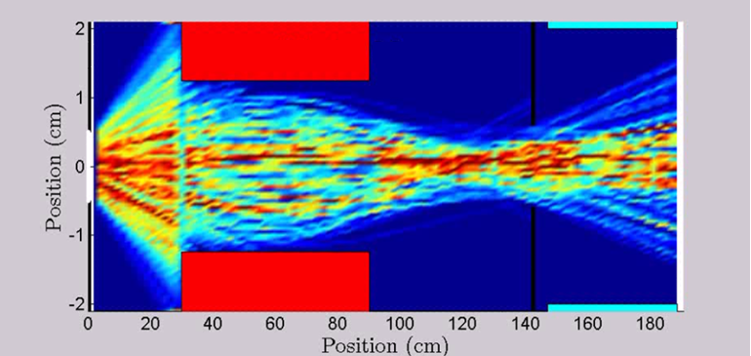
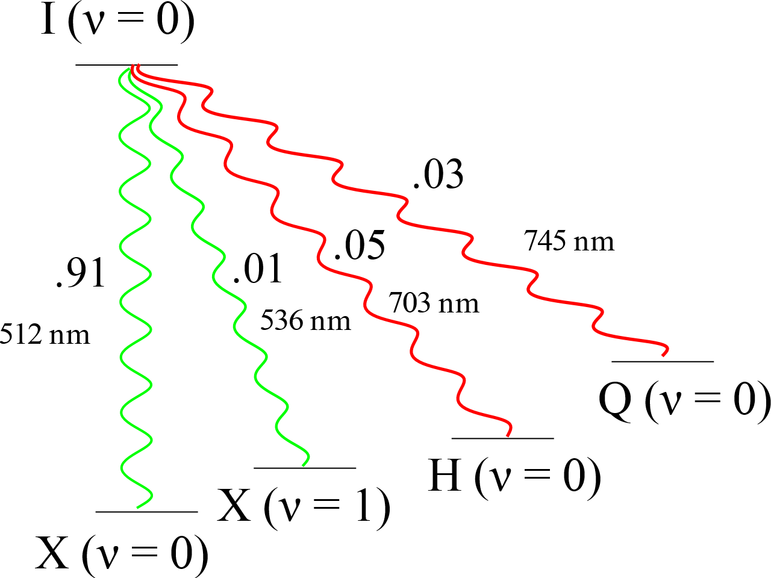
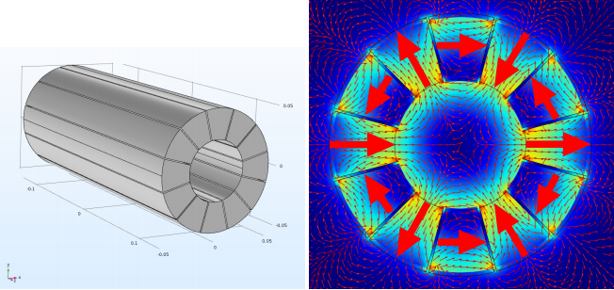
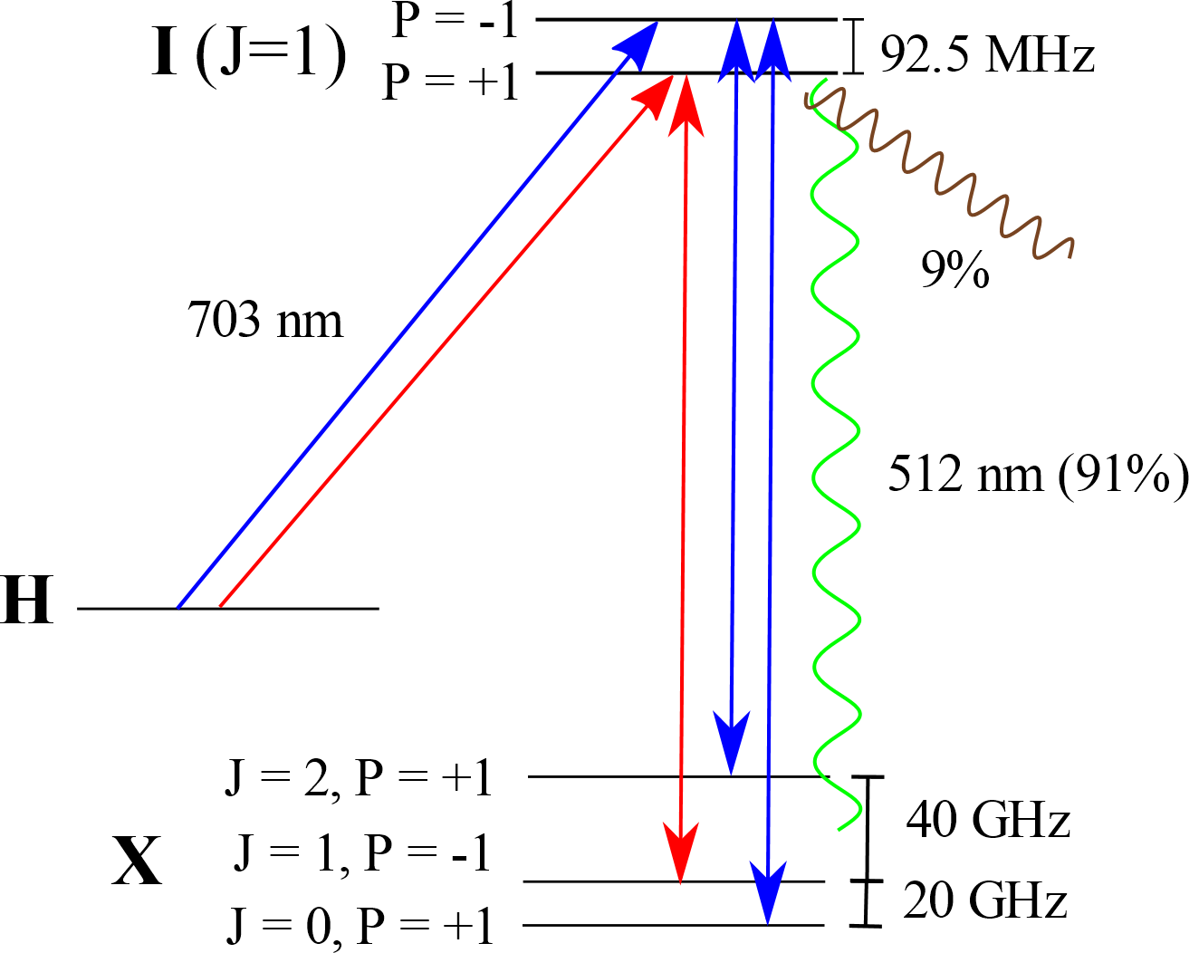
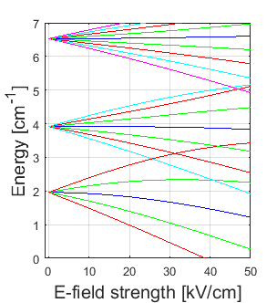
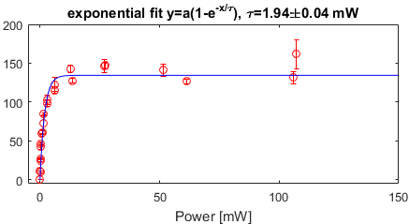
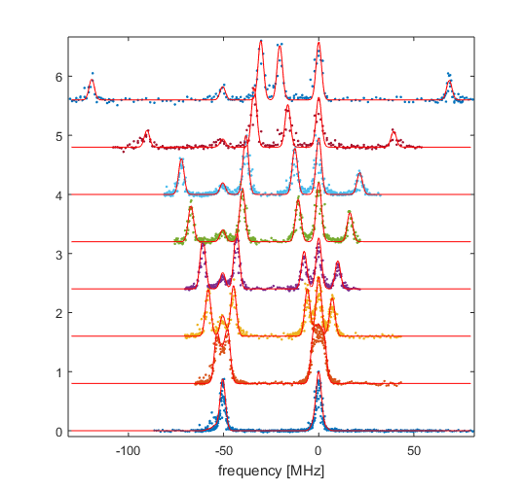
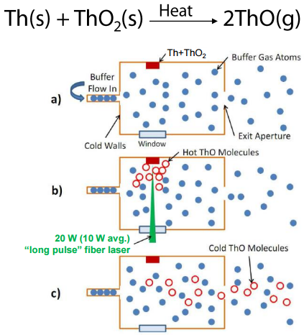
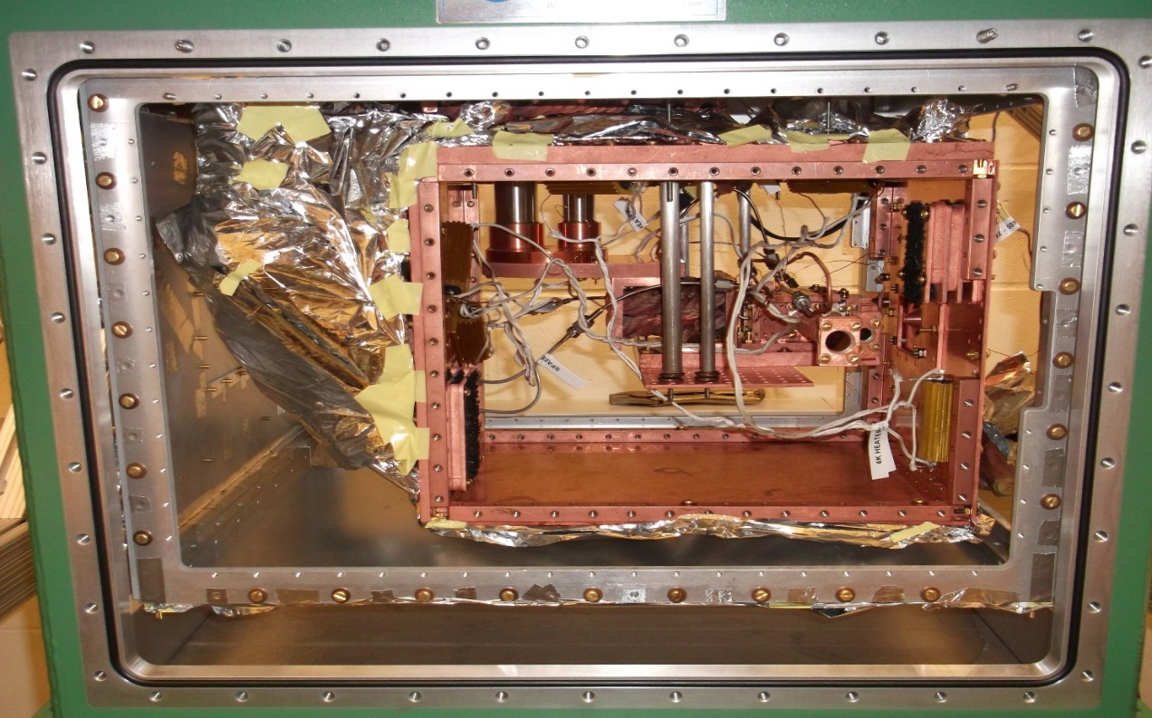
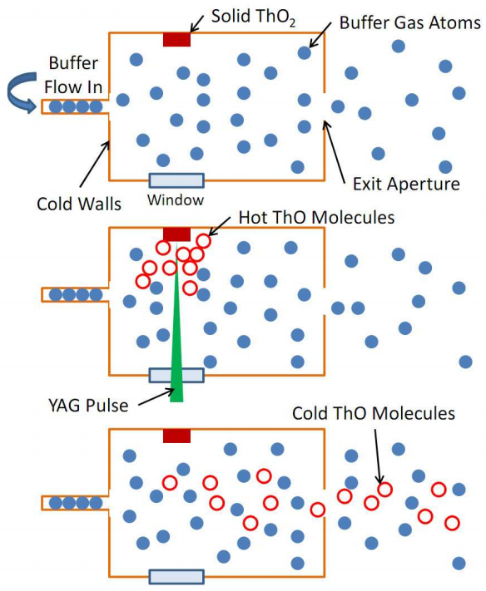
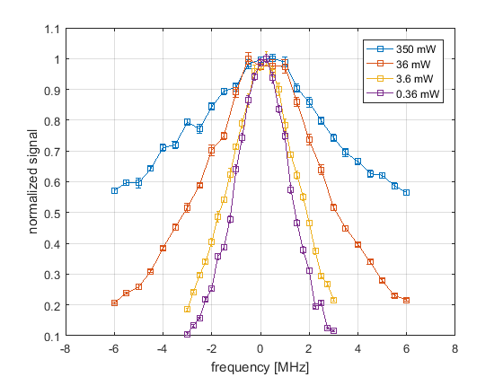
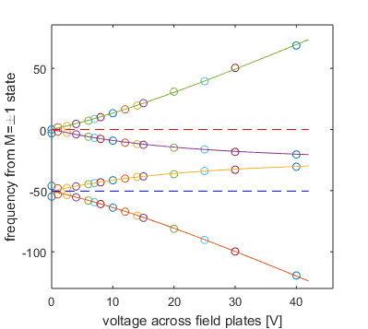
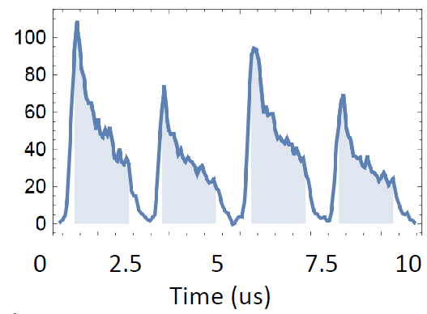
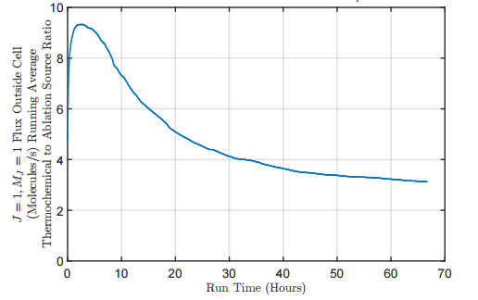
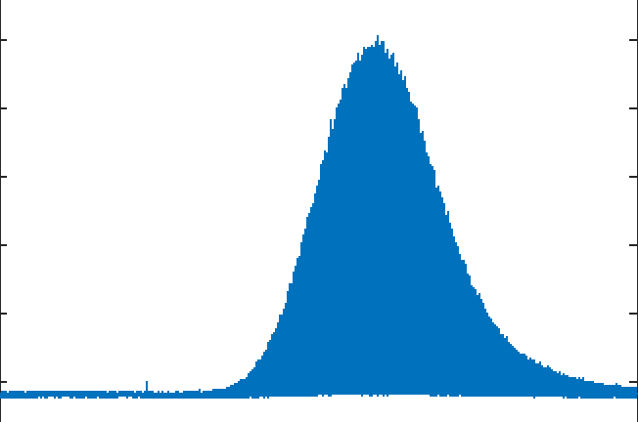


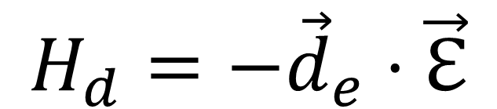




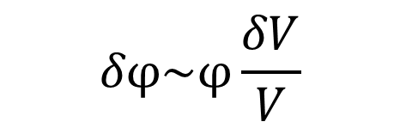

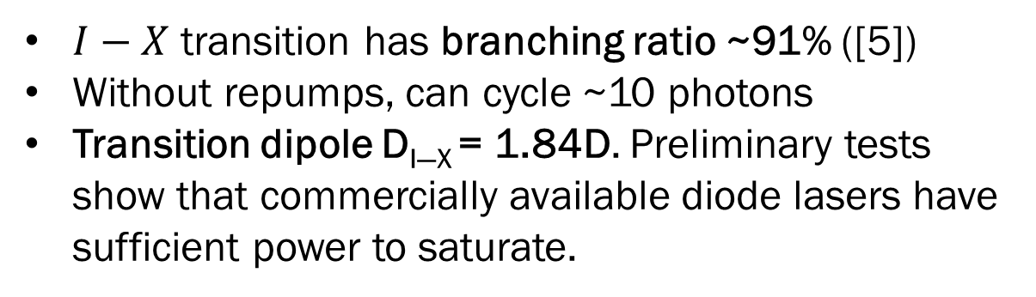
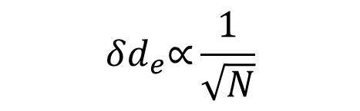
Prospects for a 3rd Generation ACME Search for
an Electron Electric Dipole Moment
ACME Collaboration:
Xing Wu^{1,2}, Daniel Ang¹, Xinyi Chen², David DeMille², John Doyle¹, Gerald Gabrielse¹, Jonathan Haefner¹, Nicholas Hutzler³, Zack Lasner², Cole Meisenhelder¹, Cristian Panda¹, Adam West⁴, Elizabeth West⁴
Affiliation: ¹Harvard University, ²Yale University, ³California Institute of Technology, ⁴University of California, Los Angeles
Motivation
Increase useful molecule flux with beam focusing
Increase detection efficiency with optical cycling
$$H_{d}=−{\vec{d}}_{e}⋅\vec{ℇ}$$
Permanent EDMs violate time reversal (T) and parity (P) symmetry.
Many theories beyond the Standard Model predict T-violation and associated EDMs at current experimental precision
eEDM sensitivity of ACME II is at
~10⁻²⁹ e•cm.
We optimize the sensitivity by maximizing the detected molecule number:
Molecules exiting the beam source have high divergence – solid angle subtended by EDM measurement region ~0.05%
Lensing-state of ThO: X-C-Q STIRAP to a single M=2 or -2 level in Q (J=2) state
Currently, detect fluorescence from ~5% of all available molecules
  ~20% solid angle in light collection
  ~25% quantum efficiency of PMTs at 512 nm detection wavelength
Possible factor of ~10 improvement in detected molecule number through optical cycling: detect molecules using an approximately closed transition to multiply number of emitted photons
Electric hexapole lens
Electrode voltage ±30 kV, 1” radius: ≈1.8K trap-depth
Control and minimize possible X-ray production (see [5])
Expect factor of ~10 increase in signal (molecular flux)
I—X transition (512nm)
$I−X$ transition has branching ratio ~91% ([5])
Without repumps, can cycle ~10 photons
Transition dipole D_{I—X} = 1.84D. Preliminary tests show that commercially available diode lasers have sufficient power to saturate.
A permanent electric dipole of a fundamental particle violates both T- and P-symmetry
LHC, ACME, and naturalness bounds on superpartner masses (see [1, 2])
$$δd_{e}\text{∝}\frac{1}{\sqrt{N}}$$
Alternative approach
Simulation of molecule focusing with electrostatic lens. Red is lens, black is collimator
Proposed optical cycling scheme
Branching ratios of 𝐼(𝜈=0) to other states, based on [6].
Property of Q (³∆₂) state of ThO
DC Stark shift of Q state
Magnetic lens
Step 1: Shelving. In spin presession region, transfer population from H state spin quadrature into $\left|X, J=0, 1, 2\right\rangle$ states (subject to parity selection rules).
Step 2: Cycling. After exiting spin presession region, optical cycling detection using the I—X transition.
Necessary: efficient clean-out of residual X(J) population before shelving.
— Use Q state to increase molecule flux & suppress systematics
Electric dipole of Q state: measured to be D_{Q}=4.1D
Permanent-magnet Halbach array for hexapole configuration is commercially available
Typical 1.6 Tesla magnets, gives 1.4K trap-depth
Expect factor of ~7 increase in signal
Shelving
ThO energy levels and
transitions
Q state:
Paramagnetic, g_{Q} ≈ g_{L} Λ + g_{S} Σ = 2, compared to g_{H} =4.4x10⁻³ & g_{X} 10⁻³ allows magnetic lensing & co-magnetometer
Long lived (~400 ms lifetime predicted)
Linear Stark shift due to Ω-doublet, efficient electrostatic lensing
H state: for EDM measurement
X-C-H STIRAP: EDM state preparation
I state: read out via 512nm LIF detection
Cycling
<
512nm
~91%
I
$$\sim$$
703nm
690nm
C (77% ¹$Π$, 20% ³Π)
~75%
1090nm
1196nm, ~10%
Prospective hexapole lens and associated magnetic field
Schematic for optical cycling, assuming no repump lasers.
H (98% ³∆)
Q (95% ³∆)
Increase quantum efficiency
X (¹Σ⁺)
Suppress excess measurement noise with fast switching
Silicon photomultipliers (SiPMs) for more efficient fluorescence detection
PMTS ~25% efficient. SiPMs ~ 50%, giving factor ~2 increase in signal
Challenge: large dark current, large capacitance (slow), unstable gain
Solution:
│Ω│
1.8 K trap-depth at 35.4kV/cm
Motivation
Characterization of Q—C transition
large-area SiPM array
Fluorescence [a.u.]
Saturation behavior (0.3 cm²)
Differential Stark shift of Q—C transition
ACME II observed excess phase noise in spin presession data: reduced Chi-square χ²_{r} ~3
However, uncertainty in phase from ~20 polarization cycles still consistent with shot noise.
Possible source of excess noise: pulse-to-pulse fluctuations in molecule beam property resulting from laser ablation.
Example: fluctuations in beam velocity introduce fluctuations in precession time, which in turn introduce noise in phase from magnetic presession:
Custom high-gain, low-noise, high-bandwidth amplifiers
moderately low temperature (-20 Cº) suppresses dark current sufficiently
with nonimaging optical concentrator (Winston cone)
dynamically adjust bias voltage and temperature for stable gain
C state:
Quadratic
Stark shift
Fluorescence [a.u.]
65 V/cm
J=1
50.4MHz
40 V/cm
Increase molecule beam flux
25 V/cm
$$φ \text{∝} t \text{∝} 1/V$$
$$δφ\sim φ\frac{δV}{V}$$
V = velocity
t = precession time
Th+ThO₂
Q state:
Linear
Stark shift
π
20 V/cm
J=2
13 V/cm
Old scheme
Proposed fast switching scheme
Power broadening
M: -2 -1 0 +1 +2
10 V/cm
One polarization
cycle
N=+1
N=-1
Normalized signal
4 V/cm
Read-out laser polarization basis
0 V/cm
Switch N every 25 pulses
Switch N within one molecule pulse
50 W “long pulse” fiber laser
Extracted molecule frame dipole: D_{Q}=4.07D (Q state), D_{C}=2.60D (C state)
2-point measurement demonstrates: lifetime of Q state, τ 100 ms.
$\hat{X}$ $\hat{Y}$ $\hat{X}$ $\hat{Y}$
$\hat{X}$ $\hat{Y}$ $\hat{X}$ $\hat{Y}$
N=+1
N=-1
Uses heat from a high-power laser to drive a chemical reaction to create ThO
Preliminary tests give a factor of ~6 in signal compared to current source.
Targets degrade quickly relative to ablation source
>
N switch:
flip molecule orientation
Frequency [MHz]
$$\sim$$
Eliminating systematic errors: birefringence reduction
2ms
One molecule pulse
2ms
See [8] for further detail
The third generation ACME will require accounting for subtle systematics that appear when precision is increased. Many systematics are mediated by birefringence. Hence, measures such as ensuring high-quality windows, improved mechanical engineering of field plates and vacuum window supports to reduce stress and the associated birefringence, etc. will be essential.
References
More information: www.electronedm.org
[1] Naturalness and Supersymmetry: J Feng, https://arxiv.org/pdf/1302.6587.pdf
[2] Electric dipole moments in natural supersymmetry: Nakai, Y. & Reece, M. Journal of High Energy Physics 2017 (2017)
[3] ACME I result: J Baron et al.,Science 343, p. 269-272 (2014)
[4] ACME I detailed report: J Baron et al., New J. Phys. 19, 073029 (2016).
[5] Branching ratios for cycling: Kokkin, Steimle, DeMille, Phys. Rev. A 90 (6 Dec. 2014), p. 062503.
[6] X-ray production hazard: A West et al., Health Physics 112, 33-41 (2017)
[7] Silicon Photomultiplier basics: An Introduction to the Silicon Photomultiplier, SensL Documentation Library
[8] Elizabeth Petrik West thesis: E P West, A Thermochemical Cryogenic Buffer Gas Beam Source of ThO for Measuring the Electric Dipole Moment of the Electron
[9 For further detail on current generation: DAMOP 2018 poster M01.00079

