Slide 1
Controlling magnetic field for next-generation electron EDM search
Background picture:
Siyuan Liu x (DALL·E x GPT-4)
PAECRS
January 24, 2024

Slide 2
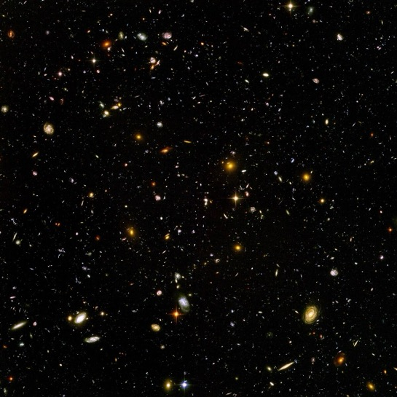
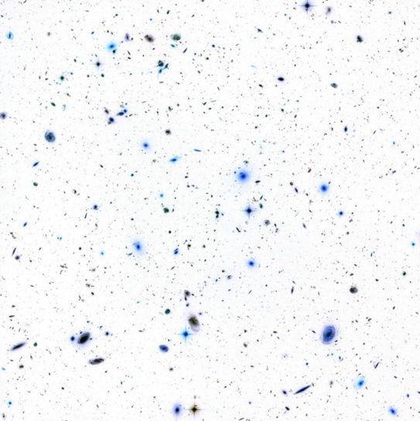
Our Universe
At the beginning of big bang
“Matter”
“Antimatter”
=
Introduction
The search for
electron EDM
Magnetic fields
Summary

Slide 3

Our Universe
After the big bang
“Antimatter”
“Matter”
>
${\sim 10}^{−9}$
Introduction
The search for
electron EDM
Magnetic fields
Summary

Slide 4
Our Universe
After the big bang
“Antimatter”
“Matter”
HOW?
>
${\sim 10}^{−9}$
Introduction
The search for
electron EDM
Magnetic fields
Summary

Slide 5
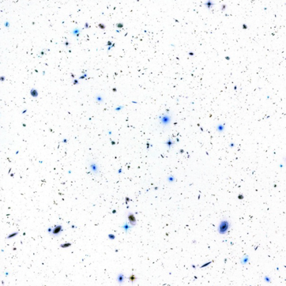
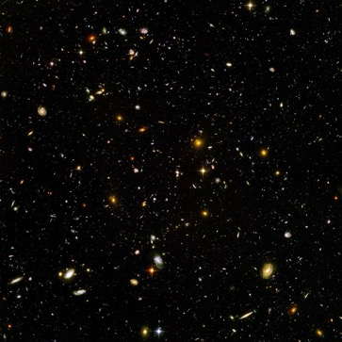
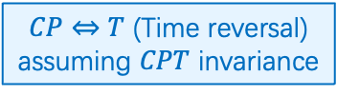
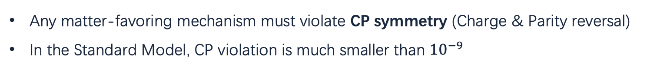

Our Universe: consequence of symmetry violation
“Antimatter”
“Matter”
>
${\sim 10}^{−9}$
$CP⇔T$ (Time reversal)
assuming $CPT$ invariance
Any matter-favoring mechanism must violate CP symmetry (Charge & Parity reversal)
In the Standard Model, CP violation is much smaller than ${10}^{−9}$
(Sakharov conditions)
(Cabbibo-Kabayashi-Maskawa mechanism)
Call for new physics!
Introduction
The search for
electron EDM
Magnetic fields
Summary

Slide 6
Outline
Probe new physics with the search of electron EDM
  Electrons: the quantum sensor for new physics
  Better measurements: the intrinsic quantum shot noise
  Excess noise from magnetic fields
Magnetic field control
  Magnetic shielding
  Self-shielding coils
  Combine two system together
Toward the next-generation electron EDM measurement
Introduction
The search for
electron EDM
Magnetic fields
Summary

Slide 7





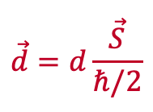

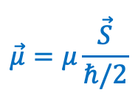


Electrons: the quantum sensor for new physics
An Electric Dipole Moment (EDM) is the sign of $T$ violation
$$\vec{μ}$$
-
$$\vec{μ}=μ\frac{\vec{S}}{ℏ/2}$$
$$P$$
$$\vec{d}$$
$$\vec{μ}$$
+
$$\vec{d}$$
+
-
$$\vec{d}$$
EDM: “offset” between
center of mass and center of charge
+
$$\vec{d}=d\frac{\vec{S}}{ℏ/2}$$
$$T$$
-
$$\vec{μ}$$
Introduction
The search for
electron EDM
Magnetic fields
Summary

Slide 8
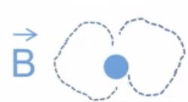

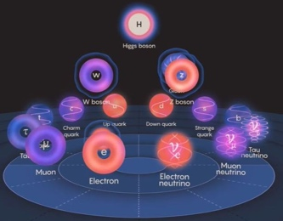

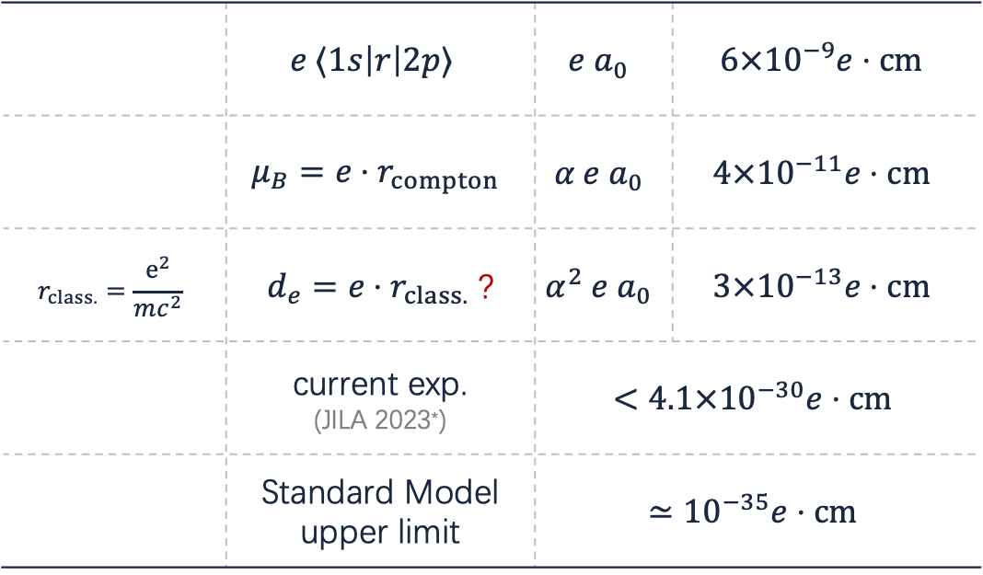
Electrons: the quantum sensor for new physics
How large is this “offset”?
 | $$e ⟨1s\left|r\right|2p⟩$$ | $$e{ a}_{0}$$ | $$6×{10}^{−9}e⋅cm$$
 | $$μ_{B}=e⋅r_{compton}$$ | $$α e a_{0}$$ | $$4×{10}^{−11}e⋅cm$$
$$r_{class.}=\frac{e^{2}}{mc^{2}}$$ | $d_{e}=e⋅r_{class.}$ ? | $$α^{2} e a_{0}$$ | $$3×{10}^{−13}e⋅cm$$
 | current exp. (JILA 2023*) | $$<4.1×{10}^{−30}e⋅cm$$
 | Standard Model upper limit | $$≃{10}^{−35}e⋅cm$$
$$\vec{d}$$
$$\vec{μ}$$
+
-
EDM: “offset” between
center of mass and center of charge
*Roussy, T. et al. . Science 381, 46-50 (2023)
Introduction
The search for
electron EDM
Magnetic fields
Summary

Slide 9

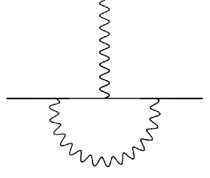






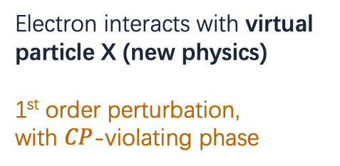

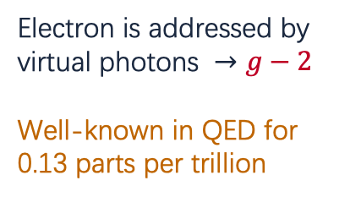

Electrons: the quantum sensor for new physics
Electrons sense the nearby “virtual particles” and reflects into its moment
Standard Model
Beyond the Standard Model
magnetic dipole moment anomaly
electric dipole moment (?)
$$γ$$
$$γ$$
$$f$$
$$fe^{iφ_{CP}}$$
$$e$$
$$e$$
$$e$$
$$e$$
$$γ$$
$$X$$
Electron is addressed by virtual photons $→g−2$
Well-known in QED for 0.13 parts per trillion
Electron interacts with virtual particle X (new physics)
1st order perturbation,
with $CP$-violating phase
Introduction
The search for
electron EDM
Magnetic fields
Summary

Slide 10
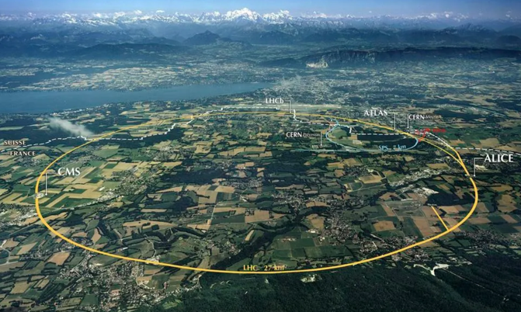
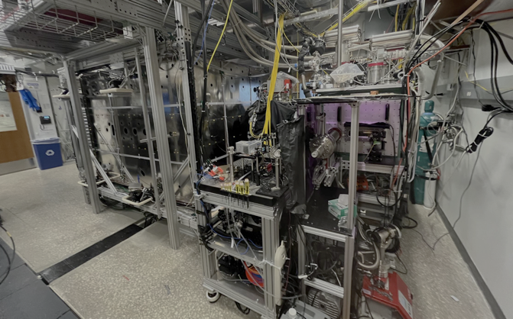

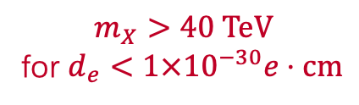

Electrons: the quantum sensor for new physics
LHC
$$13TeV$$
30km
~$5 billion
Beyond the Standard Model
electric dipole moment (?)
$$γ$$
$$f$$
$$fe^{iφ_{CP}}$$
$$e$$
$$e$$
EDM search
$$\sim 40TeV$$
$$0.005km$$
~$5 million
$$X$$
Electron interacts with virtual particle X (new physics)
1st order perturbation,
with $CP$-violating phase
$$m_{X}>40 TeV$$
for $d_{e}<1×{10}^{−30}e⋅cm$
Introduction
The search for
electron EDM
Magnetic fields
Summary

Slide 11

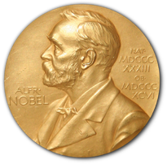
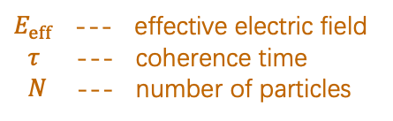
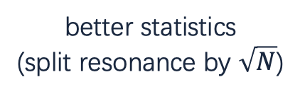


How to make a good EDM measurement?
Measurement are intrinsically limited by the quantum shot noise:
$$δ{\left(d_{e}\right)}_{stat}=\frac{ℏ}{2E_{eff}τ\sqrt{N} }$$
$E_{eff}$ --- effective electric field
$τ$ --- coherence time
$N$ --- number of particles
E. Cornell
Physics 2001
Long coherence
(narrow resonance)
better statistics
(split resonance by $\sqrt{N}$)
Big $E$ field
Introduction
The search for
electron EDM
Magnetic fields
Summary

Slide 12
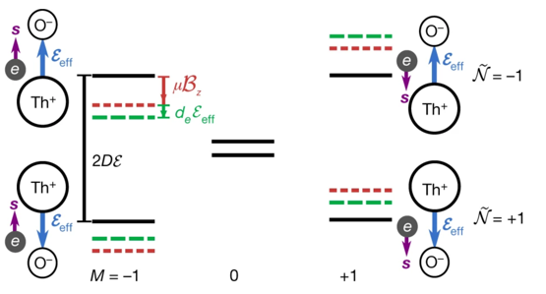
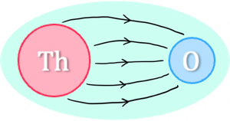


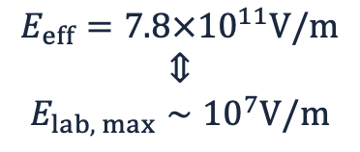
The ACME approach
$$\vec{d}$$
$$\vec{μ}$$
+
-
$$E_{eff}=7.8×{10}^{11}V/m$$
$$⇕$$
$$E_{lab, max}∼{10}^{7}V/m$$
To fully utilize this field:
$$E_{polarize}\sim {10}^{4}V/m$$
Introduction
The search for
electron EDM
Individual projects
Summary

Slide 13
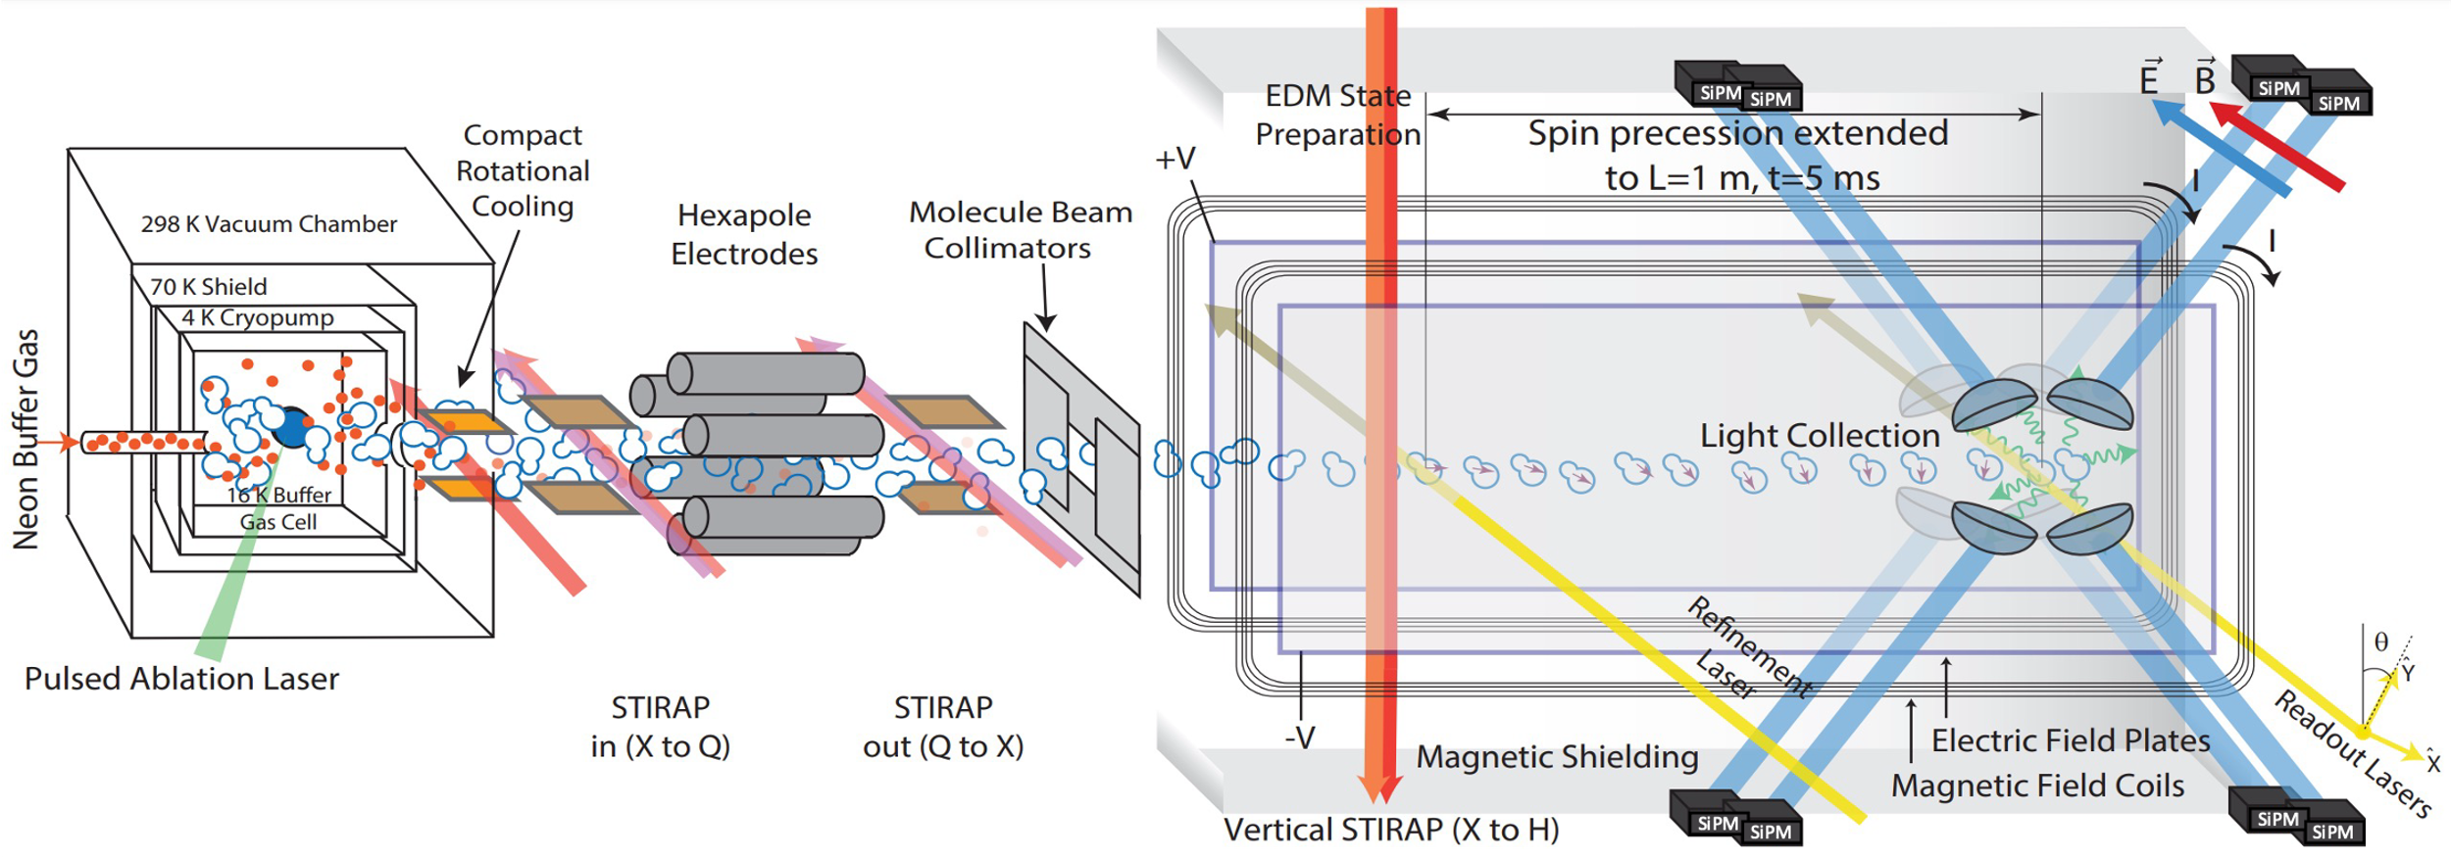
The ACME approach
$$\vec{d}$$
$$\vec{μ}$$
+
-
Introduction
The search for
electron EDM
Individual projects
Summary

Slide 14

The ACME approach
$$\vec{d}$$
$$\vec{μ}$$
+
-
Spin-precession region
$$1m×4.2cm$$
Introduction
The search for
electron EDM
Individual projects
Summary

Slide 15
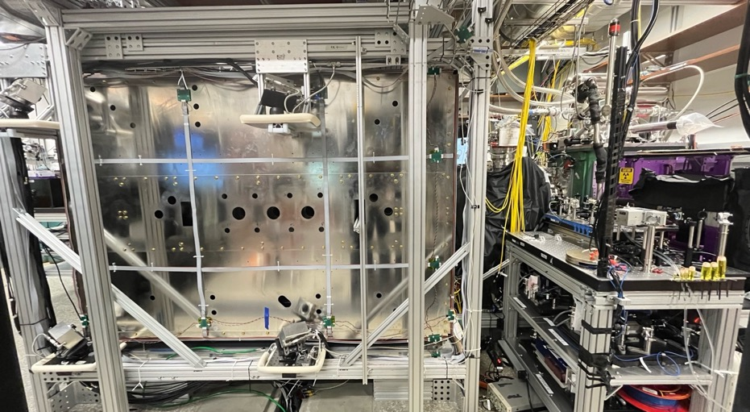

Spin-precession region
$$1m×4.2cm$$
Introduction
The search for
electron EDM
Magnetic fields
Summary

Slide 16




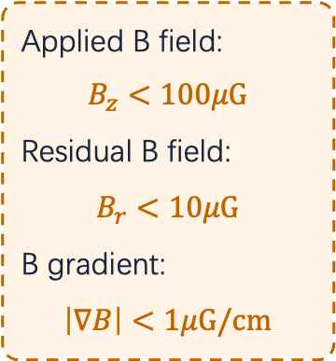
Excess noise from magnetic field
Applied B field:
$$B_{z}<100μG$$
Residual B field:
$$B_{r}<10μG$$
B gradient:
$$\left|∇B\right|<1μG/cm$$
$$φ_{B}∝B⋅\frac{L}{v_{ThO}}$$
$$v_{ThO}=200m/s±0.1\%$$
$$1μG=0.1nT$$
Spin-precession region
$$1m×4.2cm$$
Introduction
The search for
electron EDM
Magnetic fields
Summary

Slide 17




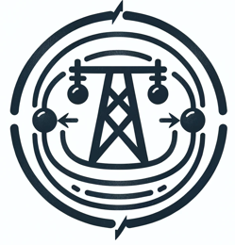
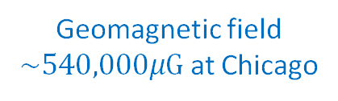
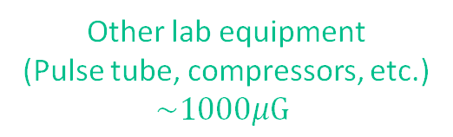
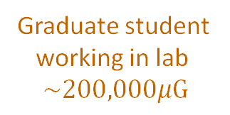
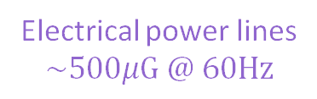
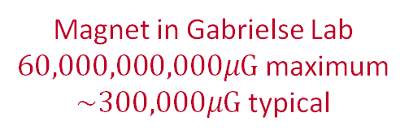
Magnetic shielding
Magnetic shielding is necessary for controlling fields at micro-gauss level:
Geomagnetic field
$\sim 540,000μG$ at Chicago
Magnet in Gabrielse Lab
$60,000,000,000μG$ maximum
$\sim 300,000μG$ typical
Graduate student
working in lab
$$\sim 200,000μG$$
Other lab equipment
(Pulse tube, compressors, etc.)
$\sim 1000μG$
Electrical power lines
$$\sim 500μG @ 60Hz$$
Icons used:
Siyuan Liu x (DALL·E x GPT-4)
Introduction
The search for
electron EDM
Magnetic fields
Summary

Slide 18

Magnetic shielding – How it works?
Introduction
The search for
electron EDM
Magnetic fields
Summary

Slide 19
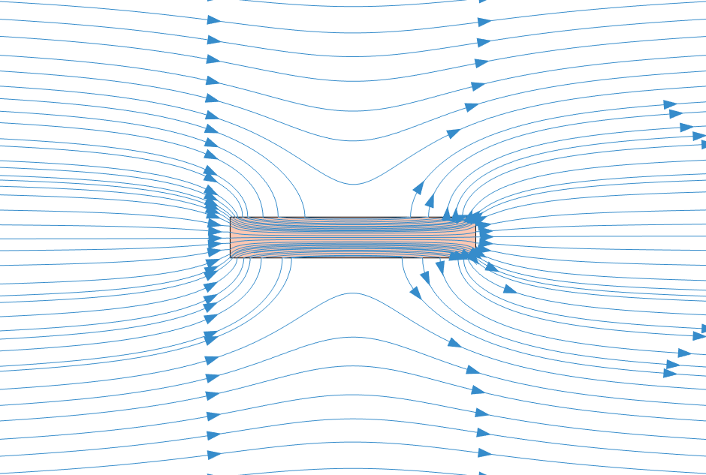
Magnetic shielding – How it works?
Introduction
The search for
electron EDM
Magnetic fields
Summary

Slide 20
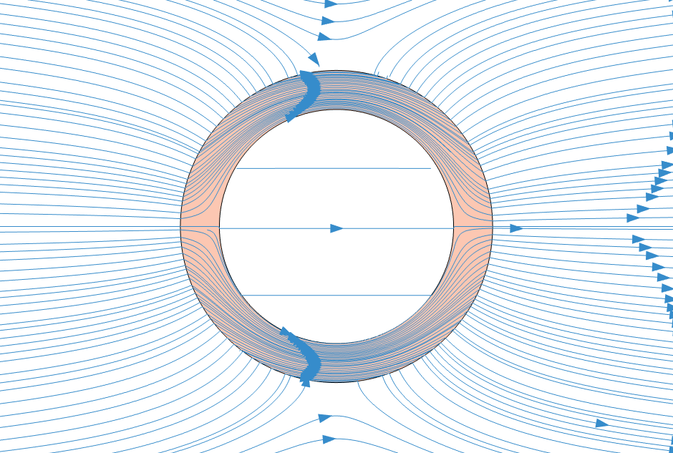
Magnetic shielding – How it works?
Introduction
The search for
electron EDM
Magnetic fields
Summary

Slide 21
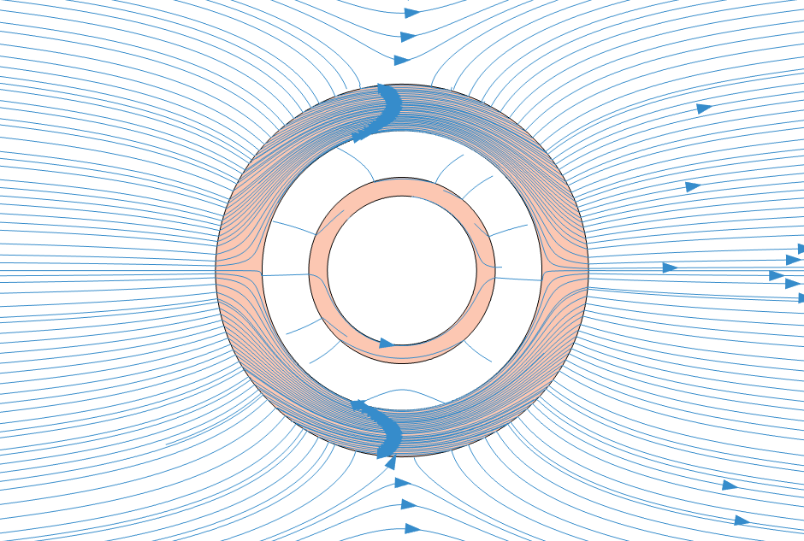
Magnetic shielding – How it works?
Introduction
The search for
electron EDM
Magnetic fields
Summary

Slide 22
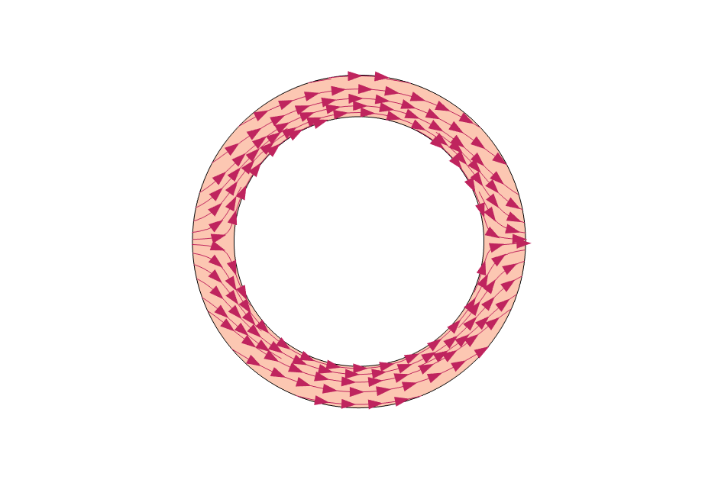
Remanent magnetization will be a problem
Introduction
The search for
electron EDM
Magnetic fields
Summary

Slide 23
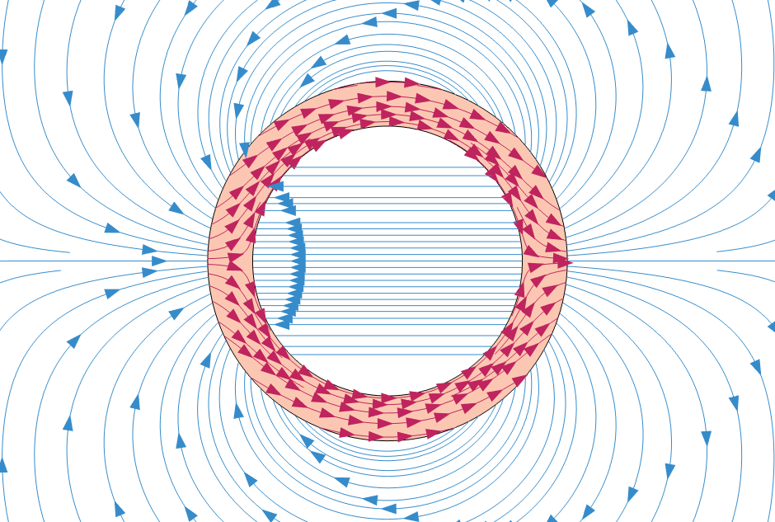
Remanent magnetization will be a problem
Introduction
The search for
electron EDM
Magnetic fields
Summary

Slide 24
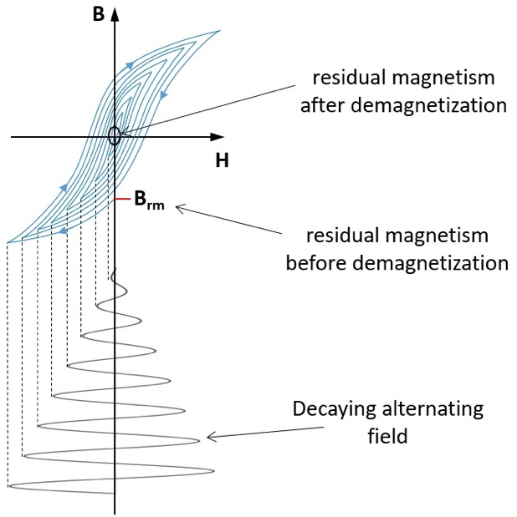
Degaussing – Remove the problem
Cestriom GmbH, Cestriom.com
Introduction
The search for
electron EDM
Magnetic fields
Summary

Slide 25
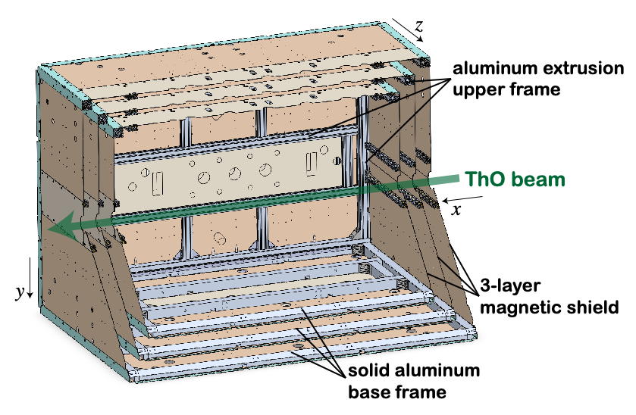

Our shield
Spin-precession region
$$1m×4.2cm$$
Introduction
The search for
electron EDM
Magnetic fields
Summary

Slide 26
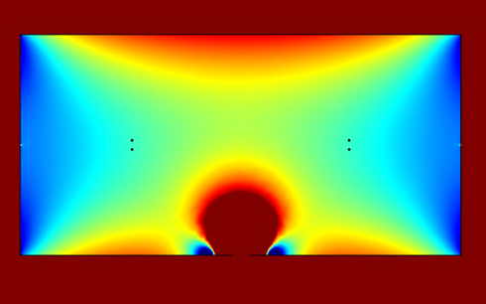
Effect of holes
simulation for single holes
cumulated hole leakage for final geometry (static ambient field)
field leakage effect vs. hole size
Introduction
The search for
electron EDM
Magnetic fields
Summary

Slide 27
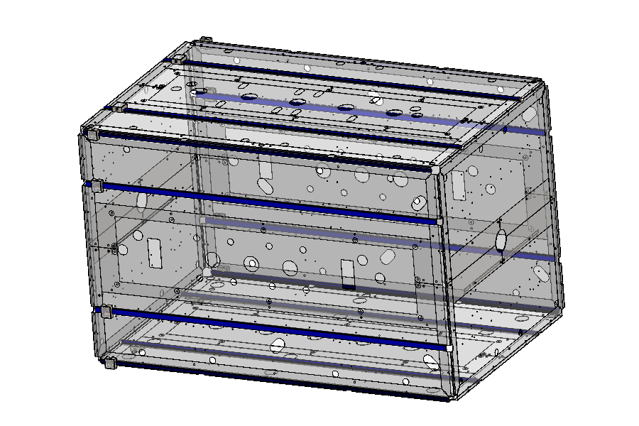
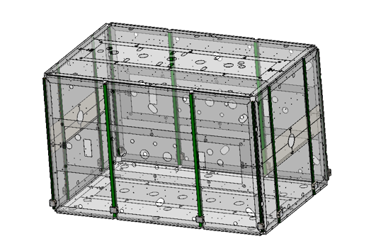
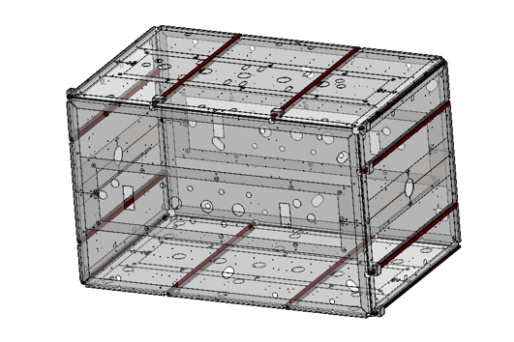






Degaussing system
We put 12 coils on edges and middle of surfaces to generate degaussing field in an “enclosed loop” of 4 surfaces
$$\overset{⃑}{B}$$
$$\overset{⃑}{B}$$
$$\overset{⃑}{B}$$
$x$ coil group
$y$ coil group
$z$ coil group
Inner layer
Middle layer
Outer layer
=108 individual coils
Introduction
The search for
electron EDM
Magnetic fields
Summary

Slide 28
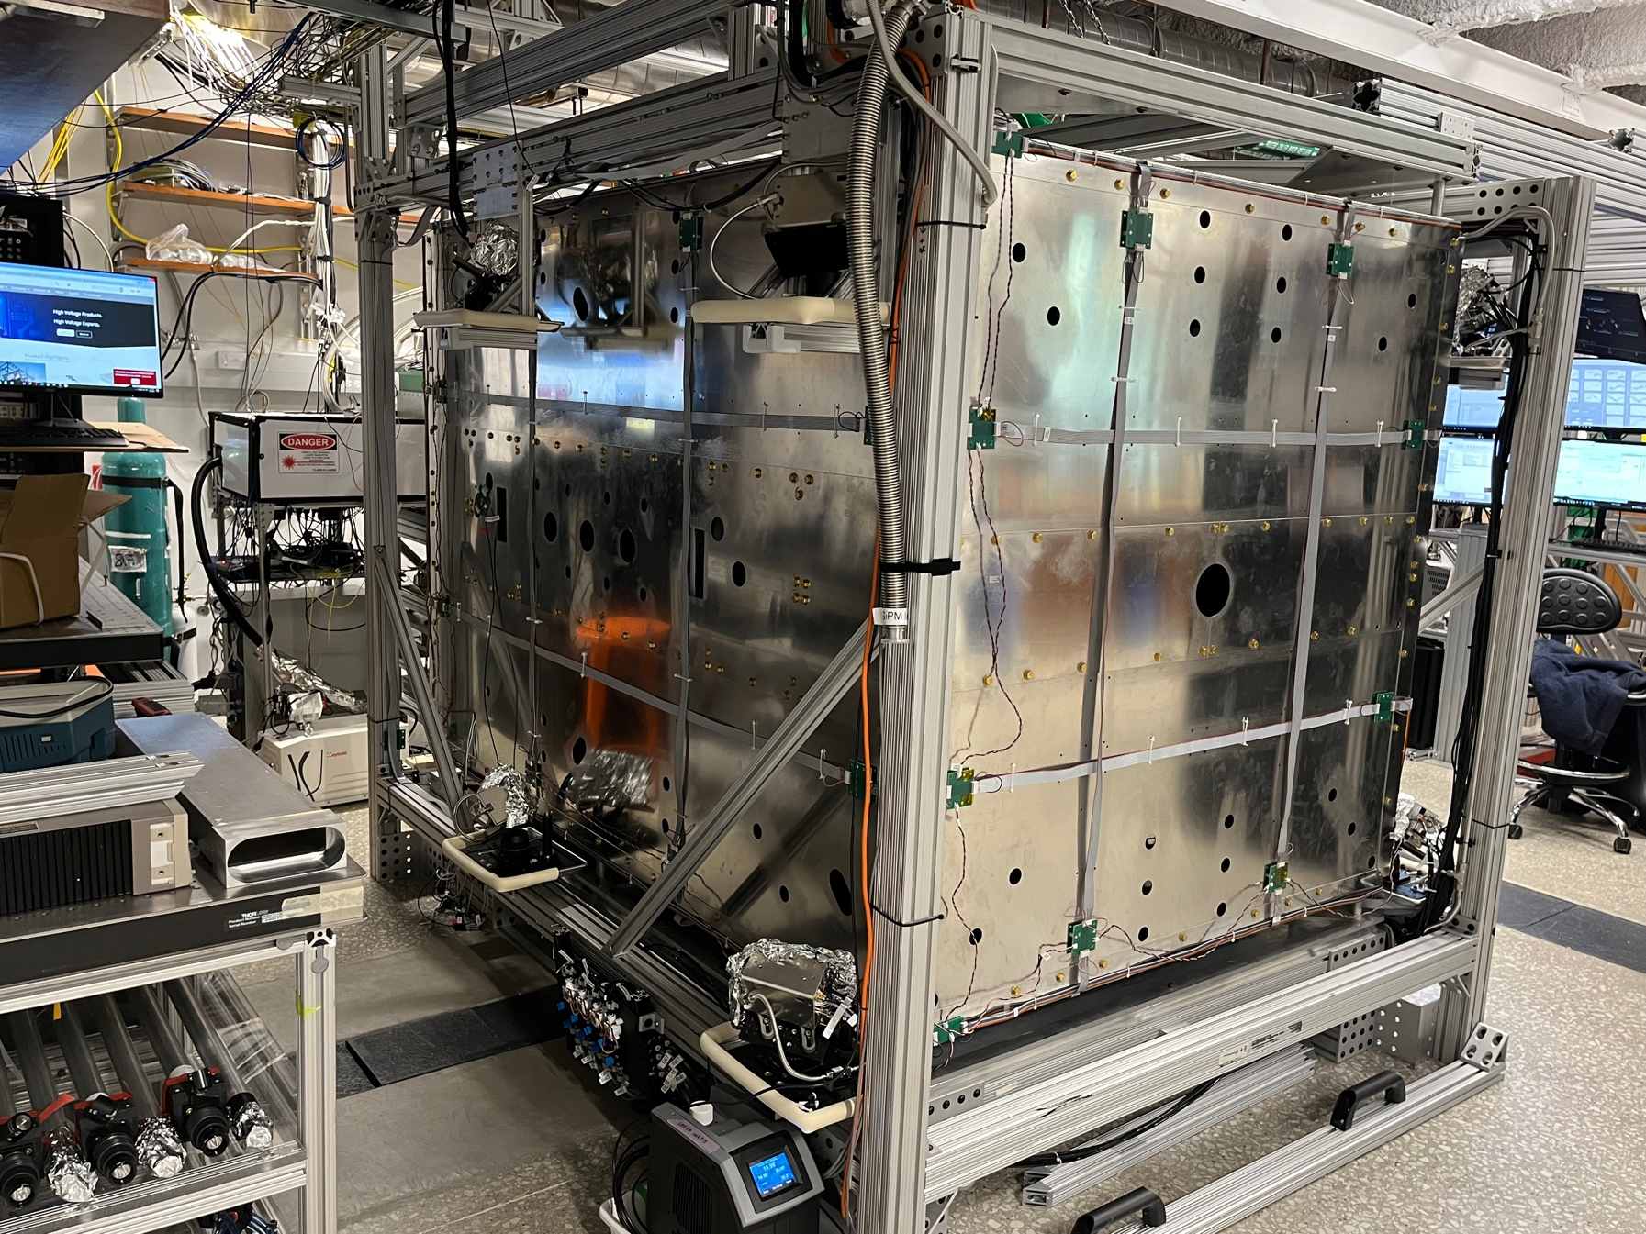
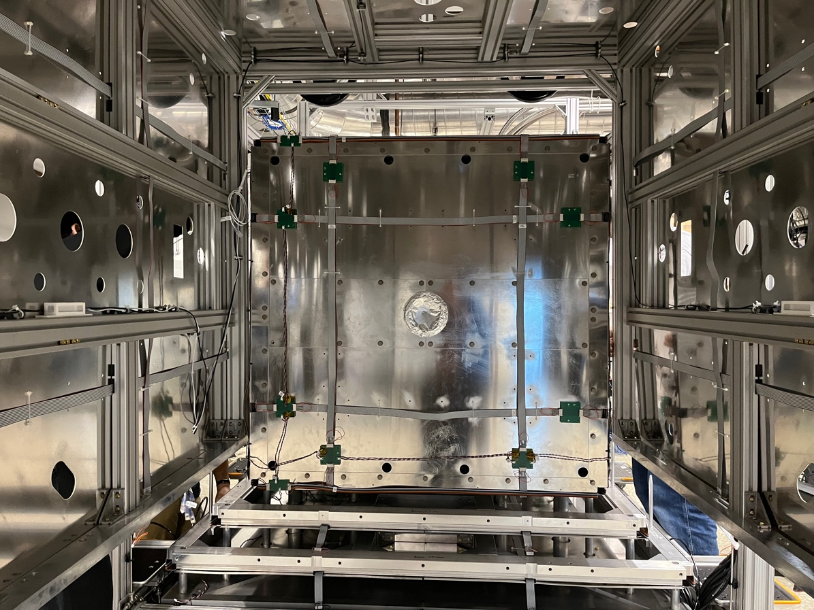
How does the real shield look like?
Side view of the shield
Internal look during final assembly
Introduction
The search for
electron EDM
Magnetic fields
Summary

Slide 29

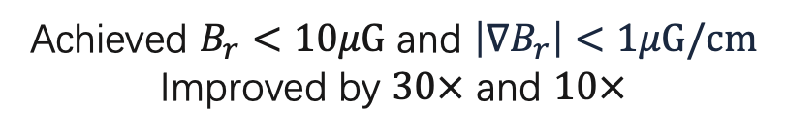
Shielding performance
On transverse axis
Achieved $B_{r}<10μG$ and $\left|∇B_{r}\right|<1μG/cm$
Improved by $30×$ and $10×$
for ac field
Introduction
The search for
electron EDM
Magnetic fields
Summary

Slide 30
Magnetic field foils
During the EDM measurement, a bias magnetic field is applied to drive the spin-precession
The magnetic field coil must be “self-shielding” to avoid magnetization of shields
Setup of boundary problem
Finite-element solution of
scalar potential
Introduction
The search for
electron EDM
Magnetic fields
Summary

Slide 31
Magnetic Field Coils – Design and Simulation
combined coil
Inner
coil
Outer
coil
simulated & measured
coil field in free space
Introduction
The search for
electron EDM
Magnetic fields
Summary

Slide 32



Magnetic field coils – Gradient control
$$∇⋅\vec{B}=0$$
$$∇×\vec{B}=0$$
Complete gradient control
Better uniformity & systematic studies
Introduction
The search for
electron EDM
Magnetic fields
Summary

Slide 33

Confirming Maxwell’s equations
$\frac{dB_{z}}{dx}$ coil
Introduction
The search for
electron EDM
Magnetic fields
Summary

Slide 34



The actual field coils
Combined coil side view
Combined coil
Inner coil during assembly stage
Introduction
The search for
electron EDM
Magnetic fields
Summary

Slide 35



Magnetic Field Coils
Measured $B_{z}$ field with
main coil inside shield
$|\vec{B}|$ change before/after applying $B_{z}$
(spin-precession region center)
Minimal magnetization of shield from $B_{z}$ coil
fringe field reduction by $20×$
Introduction
The search for
electron EDM
Magnetic fields
Summary

Slide 36



Magnetic Field Coils
Magnetized shield for $\sim 12mG$
Magnetized shield for $\sim 8mG$
No self-shielding on $B_{y}$ and $B_{x}$ coil
Introduction
The search for
electron EDM
Magnetic fields
Summary

Slide 37
Towards the next-generation EDM experiment
JILA
(HfF⁺)
ACME
(ThO)
ACME III
(projected)
Introduction
The search for
electron EDM
Magnetic fields
Summary

Slide 38








Our Collaboration
Northwestern University
Gerald Gabrielse (PI)
Xing Fan
Siyuan Liu
Collin Diver
Maya Watts
University of Chicago
David DeMille (PI)
Zhen Han
Peiran Hu
Xing Wu (now Prof. @ MSU)
Harvard University
John Doyle (PI)
Xing Wu (now Prof @ MSU)
Okayama University
Koji Yoshimura
Noboru Sasao
Satoshi Uetake
Takahiko Masuda
Ayami Hiramoto
UC Berkeley
Cris Panda
Caltech
Nick Hutzler
PAECRS
January 24, 2024
Siyuan Liu
siyuanliu2023@u.northwestern.edu

Slide 39

Teamwork made this possible
Northwestern University
Gerald Gabrielse (PI)
Xing Fan
Siyuan Liu
Collin Diver
Maya Watts
University of Chicago
David DeMille (PI)
Zhen Han
Peiran Hu
Xing Wu (now Prof. @ MSU)
Harvard University
John Doyle (PI)
Xing Wu (now Prof @ MSU)
Okayama University
Koji Yoshimura
Noboru Sasao
Satoshi Uetake
Takahiko Masuda
Ayami Hiramoto
UC Berkeley
Cris Panda
Caltech
Nick Hutzler
PAECRS
January 24, 2024
Siyuan Liu
siyuanliu2023@u.northwestern.edu

