Slide 1
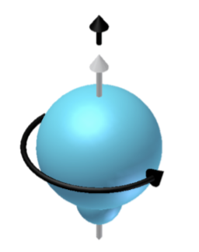
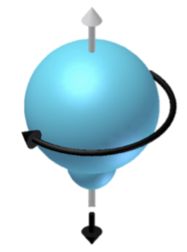
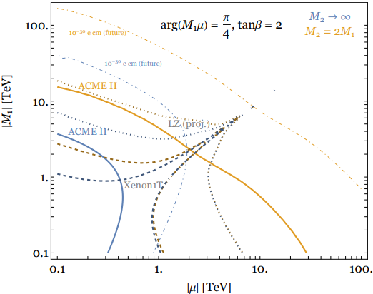
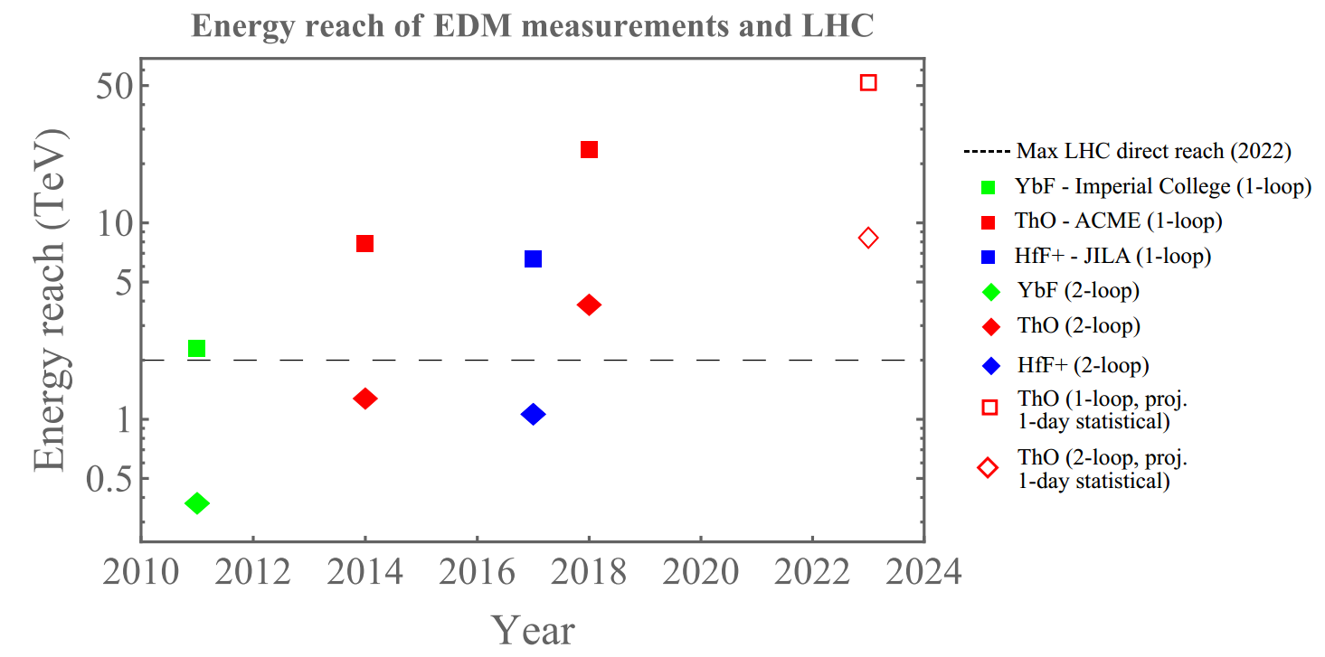
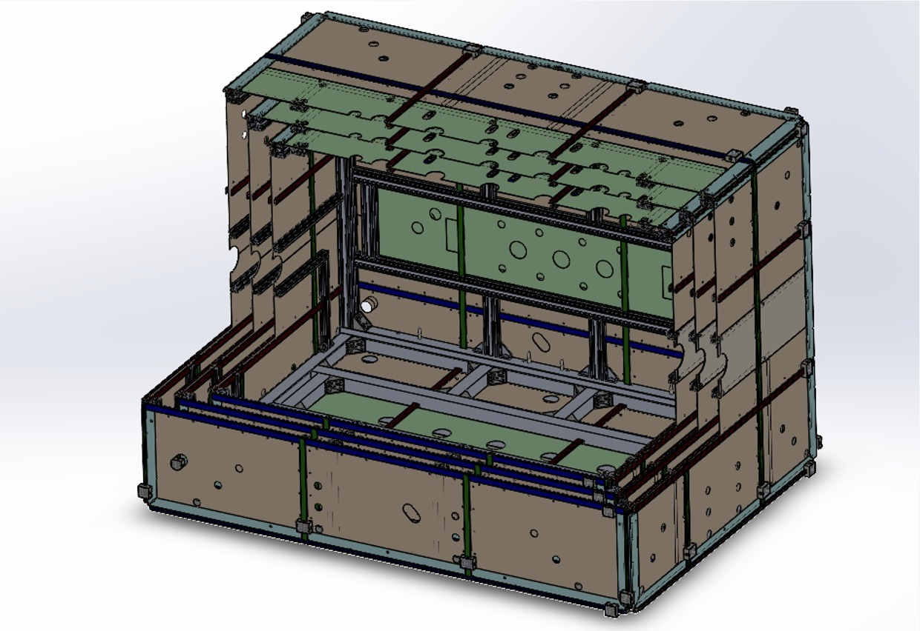
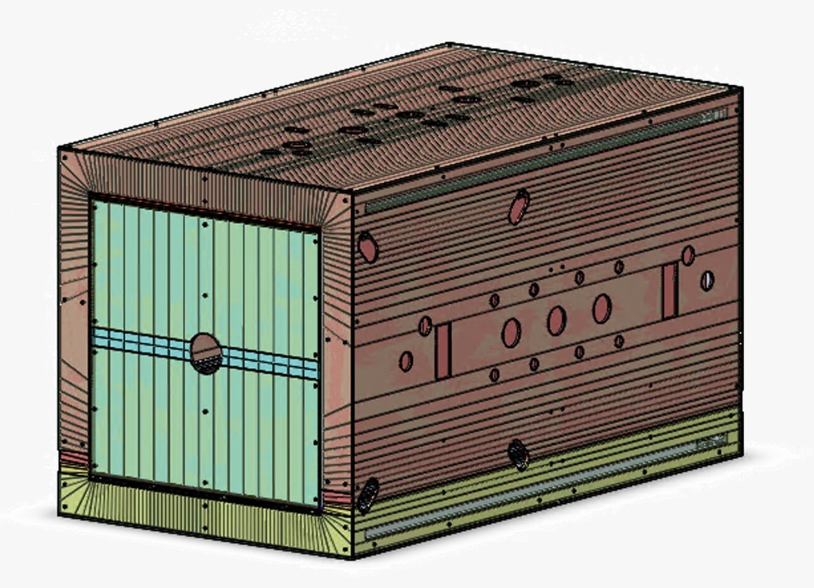
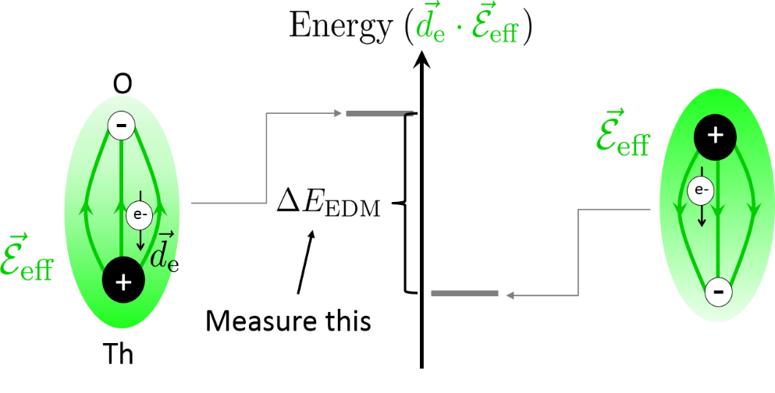
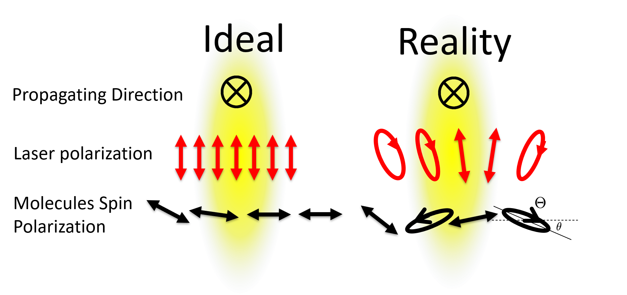
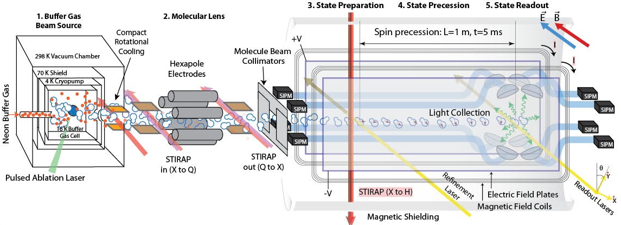
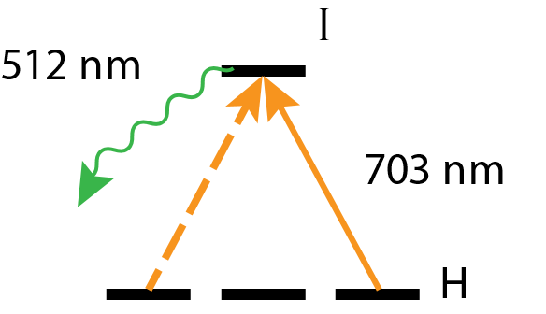
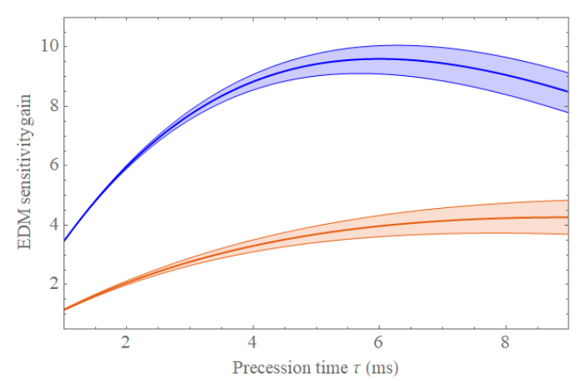
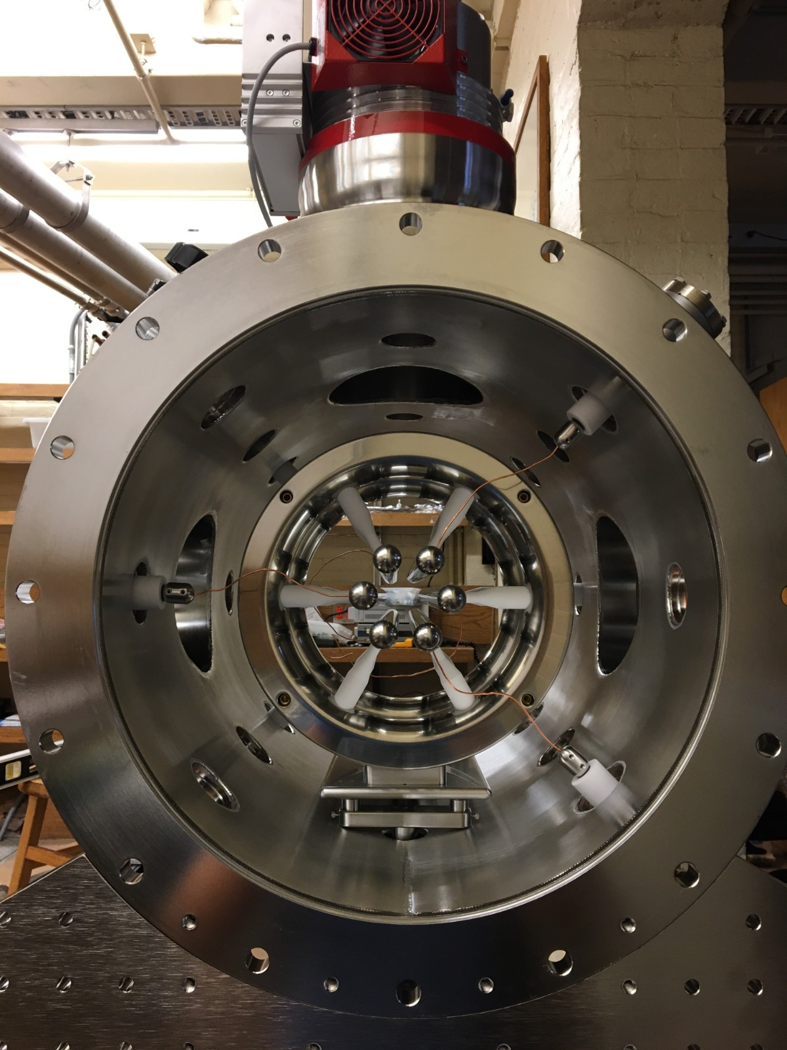
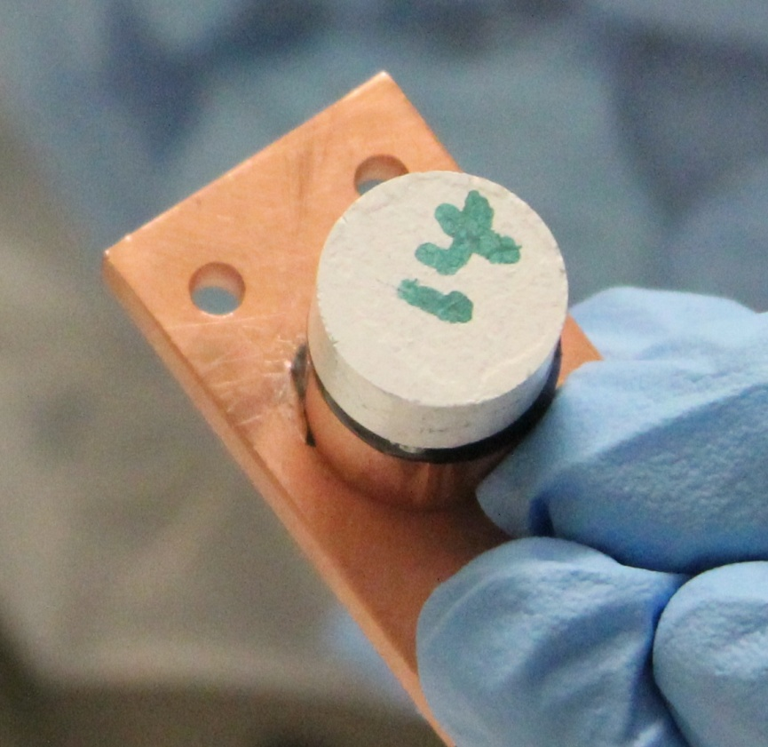
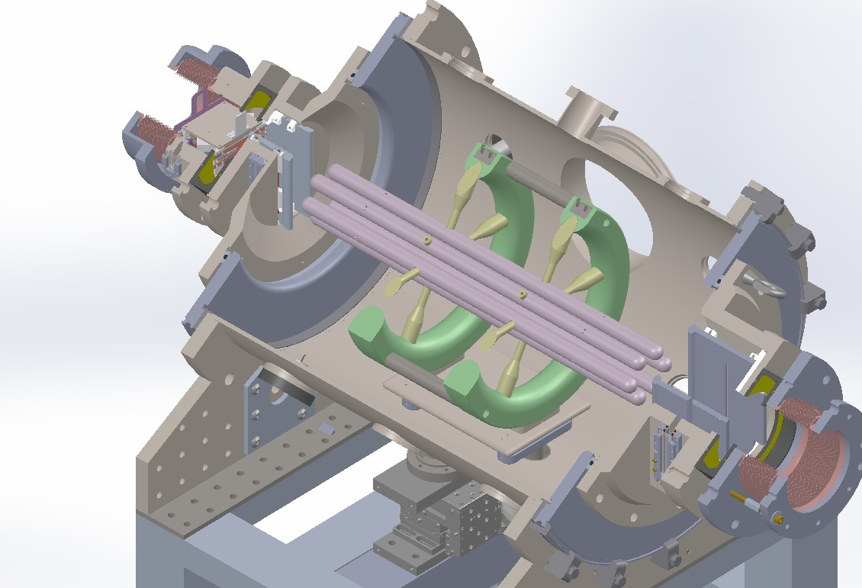
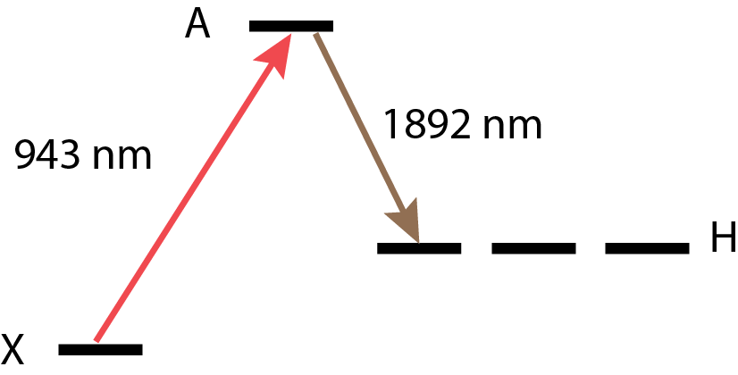
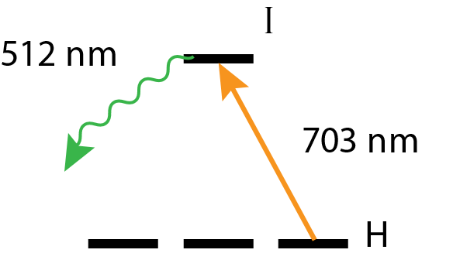
Motivation & Theory
Noise Reduction
$$S$$
$$d_{e}$$
Permanent EDMs violate T-symmetry.
Many theories beyond the Standard Model predict T violation and EDMs at current experimental precision.
ACME II had 1.7 times more noise than expected at the shot noise limit
Excess noise came from both a timing error in the data acquisition system and a timing offset between polarization bins
ACME III demonstrated improvement: We were able to suppress this noise by controlling both parameters
ACME II also saw excess noise when running with large (~10 mG) applied magnetic fields, caused by fluctuations in the molecular beam velocity
ACME III planned improvement: Reduce noise from velocity fluctuations by applying smaller magnetic fields
New 3-layer magnetic shields will need to reduce ambient fields to 1 µG and gradients to < 1 µG/cm
A self-shielded cosine theta coil will allow us to apply uniform fields in the interaction region, while keeping fringe fields at the shields below 5 µG
For more information see poster F01.00004
$$d_{e}$$
$$T$$
Progress Towards the ACME III Search for the Electron Electric Dipole Moment
$$S$$
ACME Collaboration: Cole Meisenhelder¹, Daniel G. Ang¹, David P. DeMille², John M. Doyle¹, Gerald Gabrielse³, Zhen Han², Bingjie Hao³, Ayami Hiramoto⁴, Peiran Hu², Nicholas Hutzler⁴, Daniel D. Lascar³, Zack Lasner¹, Takahiko Masuda⁴, Cristian D. Panda⁶, Noboru Sasao⁴, Satoshi Uetake⁴, Xing Wu^{1,2}, Koji Yoshimura⁴, Siyuan Liu³
Affiliation: ¹Harvard University, ²University of Chicago, ³Northwestern University, ⁴Okayama University, ⁵California Institute of Technology , ⁶University of California, Berkeley
SUSY particle bounds from this result.
Fig. from Matt Reece (unpublished)
ACME III projection ($\sim {10}^{−30}e⋅cm$) dashed.
Key EDM results since 2010. Two-loop sensitivity from Nakai & Reece (2017).
One-loop sensitivity from Feng (2013). LHC scale gives stop mass sensitivity.
Systematic Error Suppression
ThO: effective electric field $E_{eff} \sim 80 GV/cm$
ACME II parameters:
Precession time $τ \sim 1 ms$
Measurement contrast $C \sim 0.95$
Detected molecule flux $\dot{n}$ $\sim 1×{10}^{7} s^{−1}$
Result: $d_{e}=\left(−4.3±4.0\right)×{10}^{−30} e⋅cm$
$\left|d_{e}\right|<1.1×{10}^{−29} e⋅cm$
The largest source of systematic uncertainty in ACME II came from non-reversing electric fields
Non-reversing electric fields couple to the EDM value through imperfect polarization of the cleanup and readout lasers
ACME III planned improvement: Produce new transparent field plates with improved optical properties to reduce polarization imperfections, that have flat, parallel, and smooth surfaces.
Use SF57HTUltra glass to reduce the stress-optic coefficient by ~40x versus ACME II
Field plates must also be increased in size to match the increased 1m precession length, requiring composite field plates
For more information see poster N01.00100
$$δd_{e}=\frac{ℏ}{2Cτℇ_{\text{eff}}\sqrt{\dot{n}T}}$$
ACME III Apparatus
Designs for the 3-layer mu metal magnetic shields (left), and the self shielding cosine theta and gradient coils (right).
4. State Precession
5. State Readout
The molecules in the prepared state acquire phase as they fly through the electric and magnetic fields of the interaction region.
Recent measurements determined that the lifetime of the H-state is 4.6 ms
For more information see talk K03.00001
ACME III planned improvement: Develop new apparatus to increase precession time by a factor of 5 compared to ACME II
Electrostatic lens helps compensate for solid angle losses
After precession, the final state is projected to a pair of orthogonal basis vectors using a 703 nm probe laser (on the H-I transition) with linear polarization rapidly switched (200 kHz) between x and y.
We collect the 512 nm fluorescence as the molecules decay back to the ground state.
ACME III planned improvement: upgrade PMTs to silicon photomultipliers (SiPMs) and optimize collection optics
SiPM characterization tests have been performed
For more information see poster N01.00095
Projected EDM sensitivity gain vs precession time without the electrostatic lens (Red), and when combined with the lens (Blue).
 | Requirement | Measured Value
Photon Detection Efficiency | ~ 50% | 2.5 x PMT
Dark Count Rate | < 10 Mcps | < 10 Mcps @ -10 °C
Cross Talk and After Pulse | < 25% | ~ 15%
1. Buffer Gas Beam Source
2. Molecular Lens
3. State Preparation
Overall projected sensitivity
References
Produce ThO molecules through pulsed ablation of a ceramic ThO₂ target at 50 Hz
Neon buffer gas thermalizes the molecules at 16K, beam expansion cools to 4K
~10¹¹ molecules/sr in the vibronic ground state
ACME III demonstrated improvement: a new compact rotational cooling scheme has been demonstrated, reaching up to a factor of 3.6 signal gain
ACME III planned improvement: improve molecular beam flux by focusing with a hexapole electrostatic lens
The highly polarizable Q state of ThO allows the electric lens to enhance the EDM signal by about 20 times when turned on, based on trajectory simulation
First signal at Lens exit shows a factor of 2.5 signal gain, consistent with prediction from trajectory simulations
Demonstrated efficient STIRAP transfer into and out of the Q state, with about 80% total efficiency
For more information see: K03.00002
STIRAP coherently transfers population to experimental H-state with ~75% efficiency (ACME II)
ACME III planned improvement: perform STIRAP through the X-A-H states (1892 nm, 943 nm), which will allow better suppression of systematics through improved STIRAP saturation
703 nm cleanup laser reprojects the state onto a coherent superposition of $M=+1, M=−1$ states
Improvement | Signal Gain | EDM Sensitivity Gain
Increased precession time |  | 5
Electrostatic lens | 9.6 | 3.1
SiPM detector upgrade | 2.3 | 1.5
Improved Collection Optics | 1.5 | 1.2
Increased decay time | 0.45 | 0.67
Timing jitter noise reduction | 1 | 1.7
Total | 14.9 | 31.8
ACME II daily statistical sensitivity |  | $$\sim 1×{10}^{−29}e⋅cm$$
Projected ACME III daily sensitivity |  | $$\sim 3×{10}^{−31}e⋅cm$$
ACME II result: V Andreev et al., Nature 562, 355-360 (2018)
ACME I result: J Baron et al., Science 343, 269-272 (2014)
ACME I detailed report: J Baron et al., New J. Phys.19 (2017)
E_{eff} Calculations: L. V. Skripnikov et al., J. Chem. Phys. 142 024301 (2015), T. Fleig et al., J. Mol. Spec. 300:16-21 (2014)
EDM & SUSY: J. Feng, Annu. Rev. Nucl. Part. Sci., 63:35, 1-82 (2013), Y. Nakai, et al., J. High Energy Phys. 2017:31 (2017)
Interpreting the Electron EDM Constraint: C. Cesarotti et al., J. High Energ. Phys. 2019:59 (2019)
9 cm
Beamline
4 K
1.5 cm
STIRAP Level Structure
Cleanup Level Structure
Neon
flow
line
16 K
Ablation
window

