Slide 1



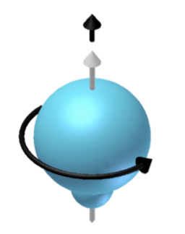
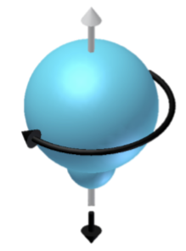
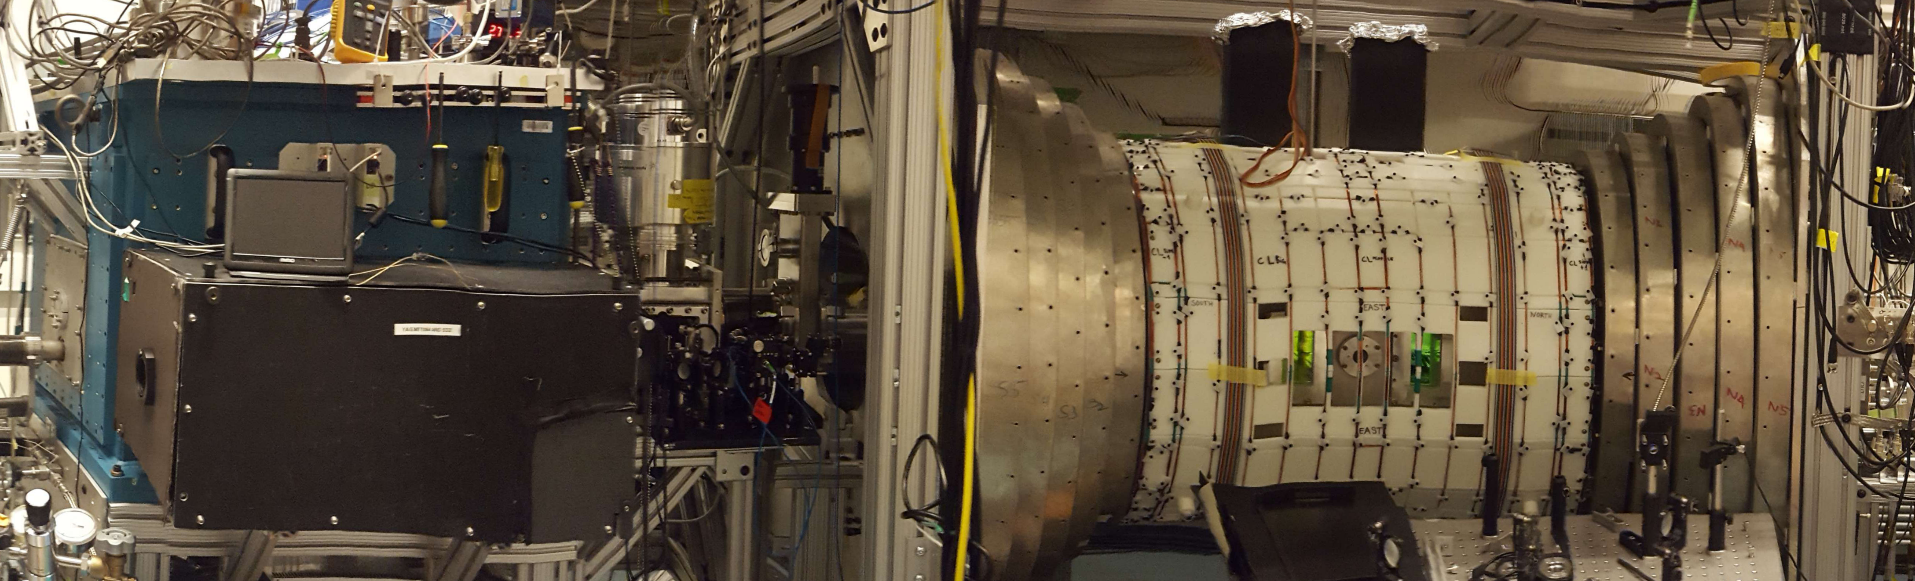
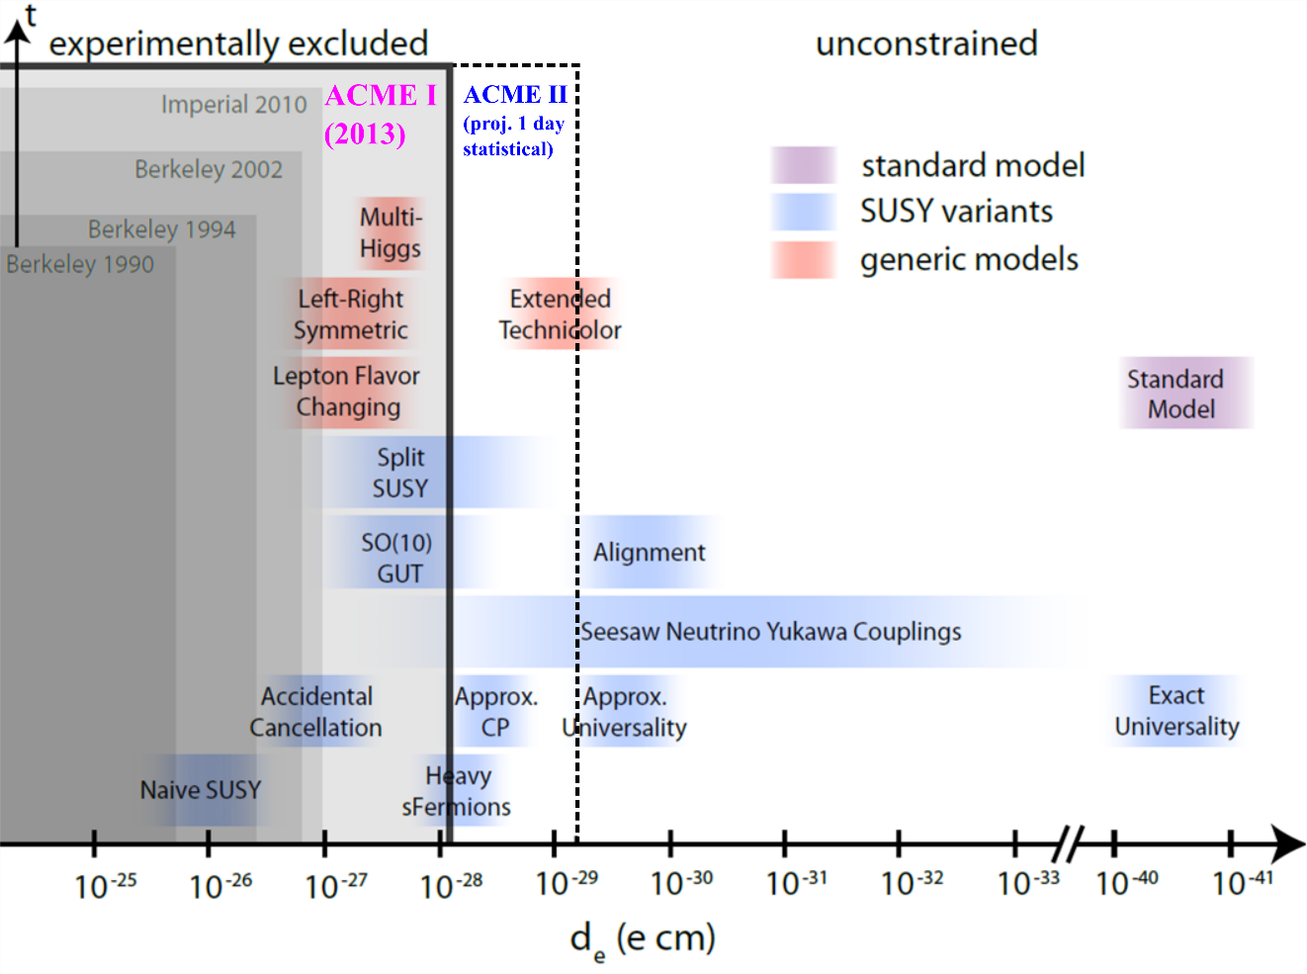
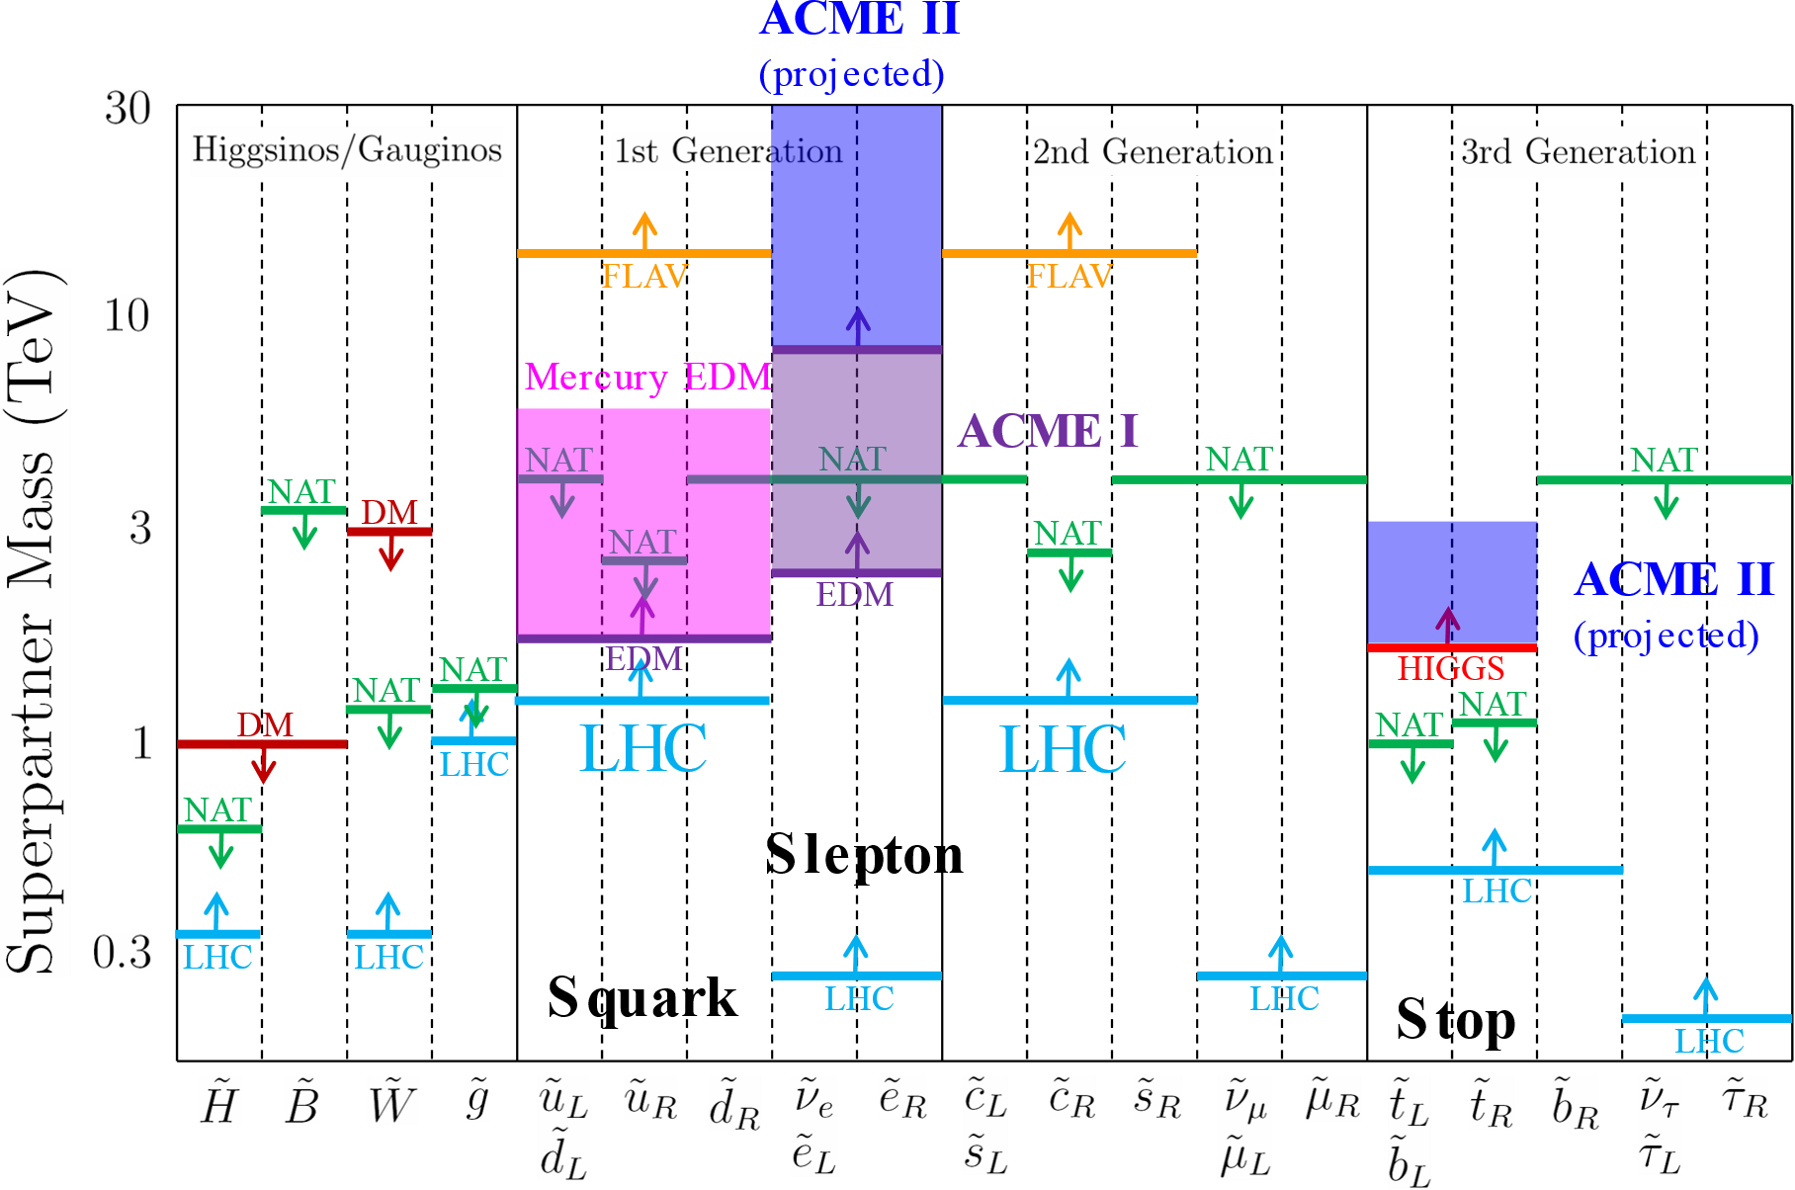
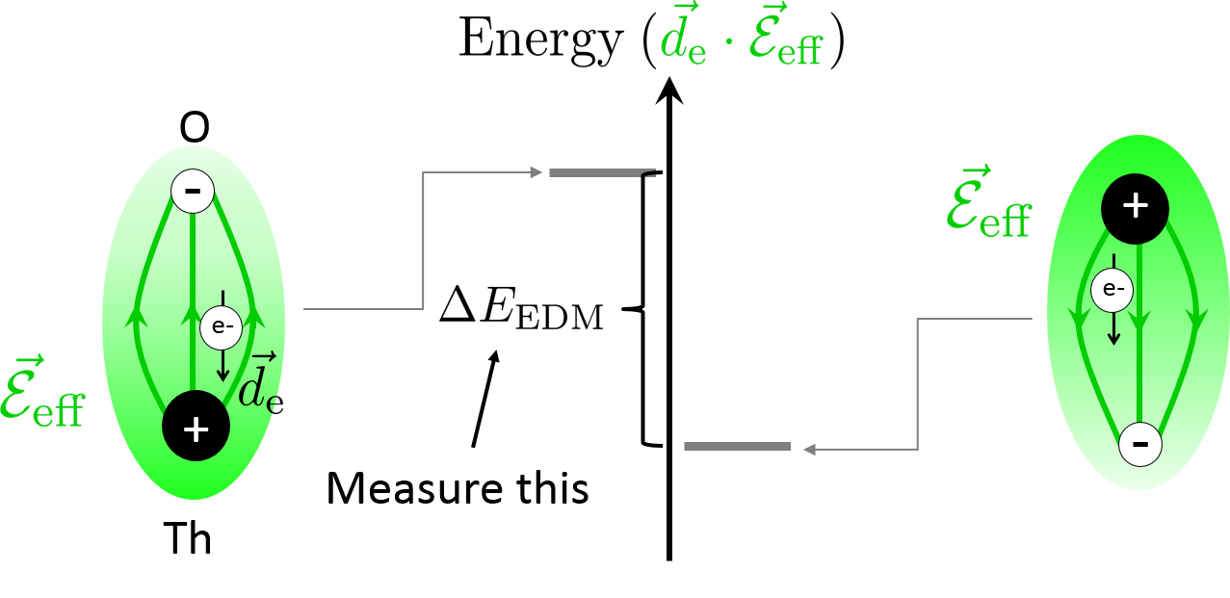
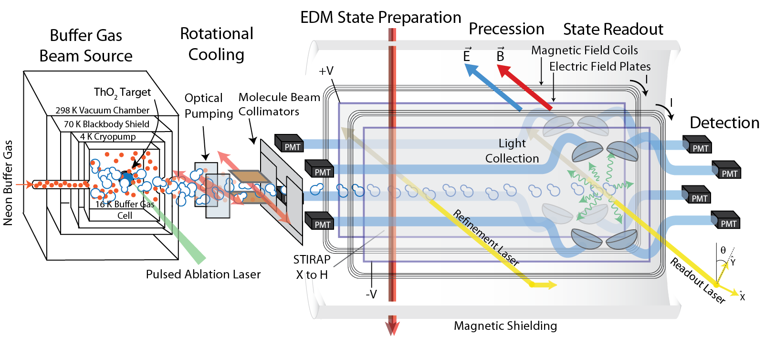
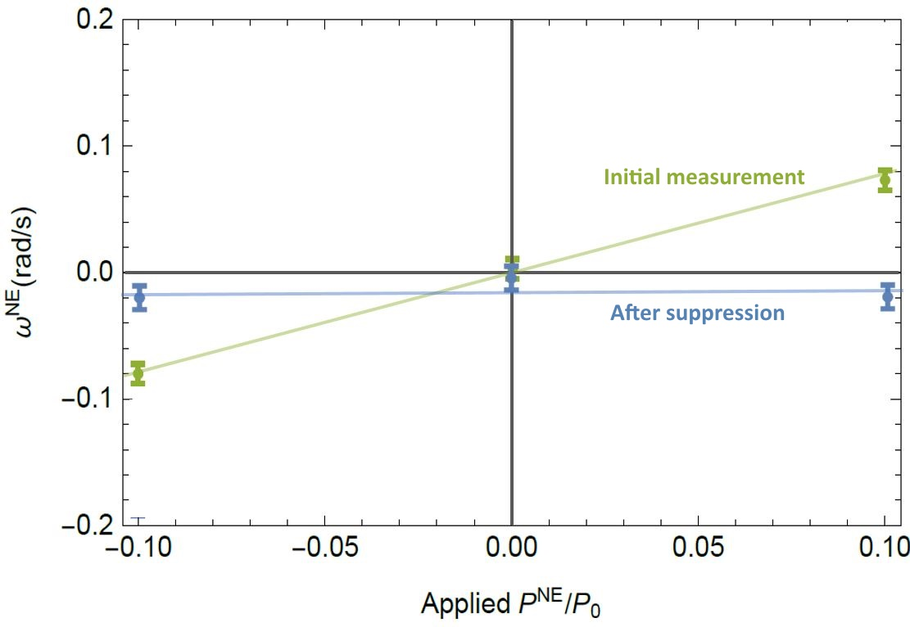
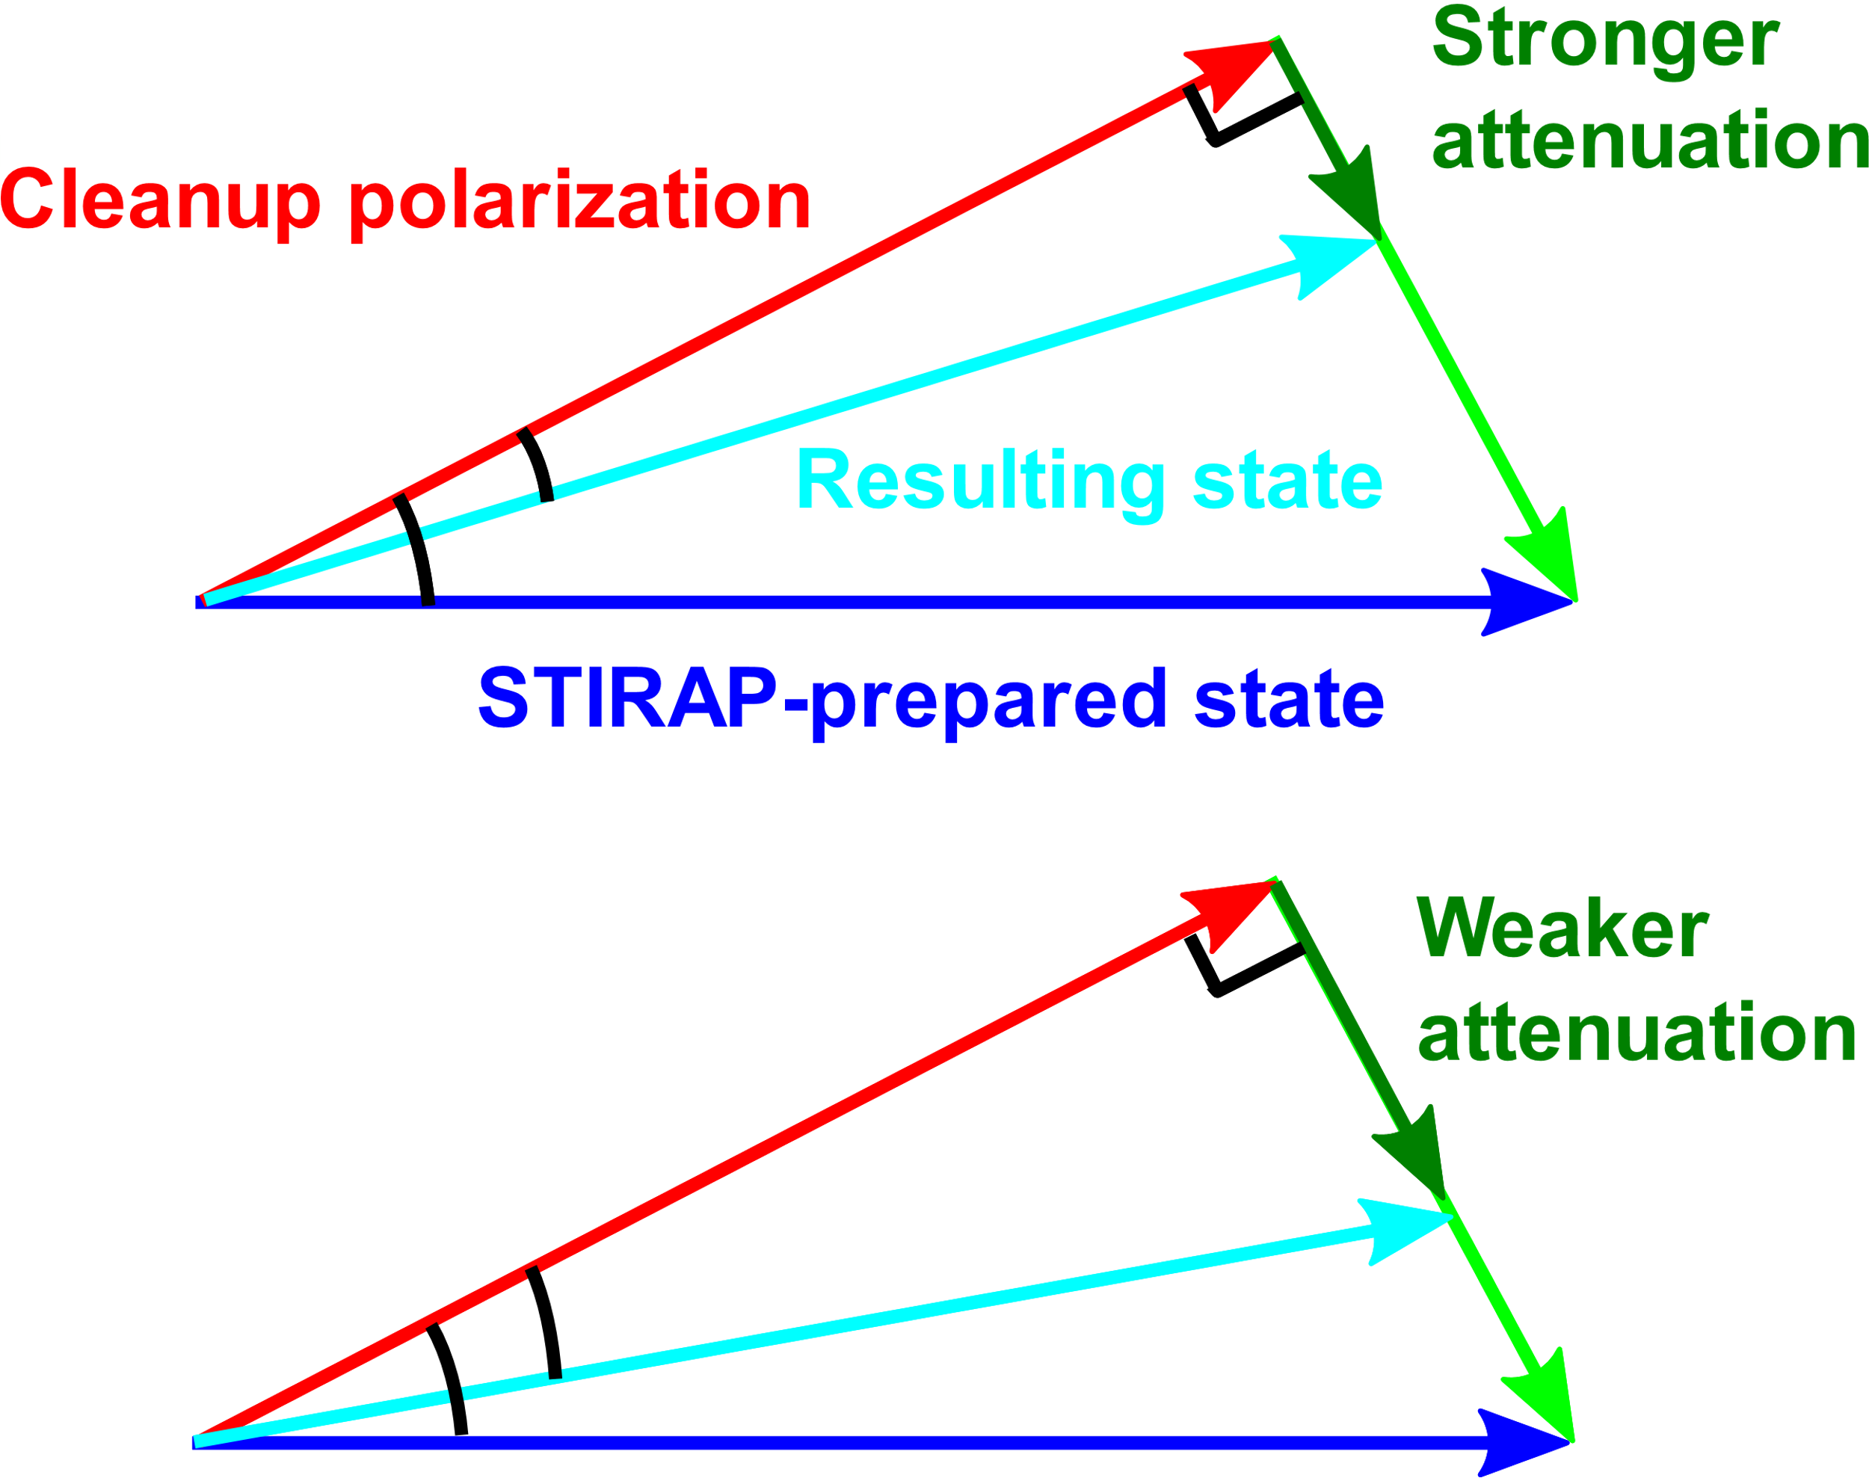

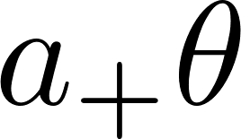
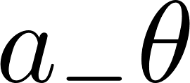
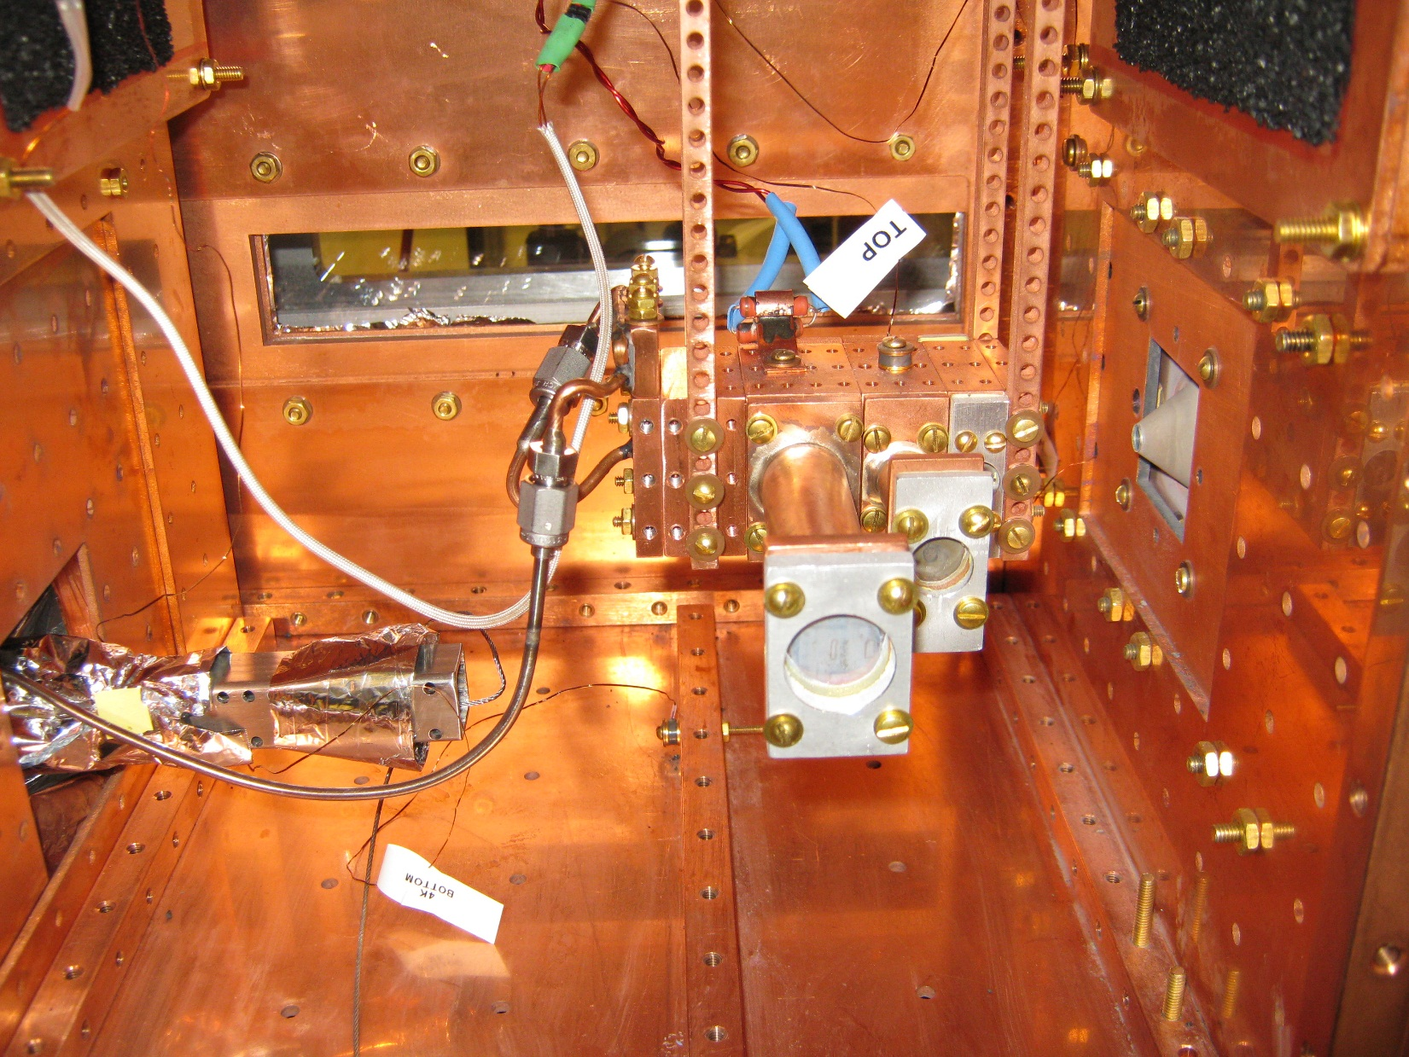
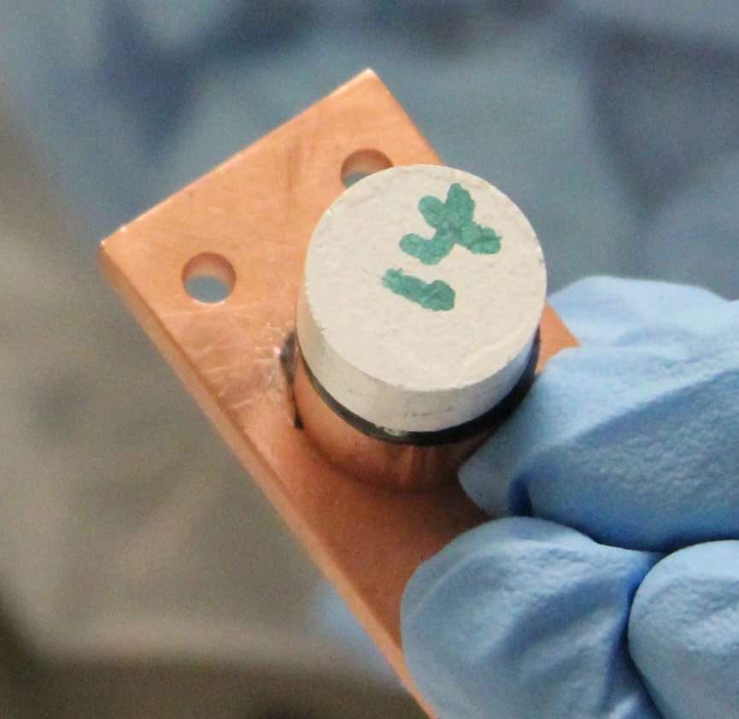
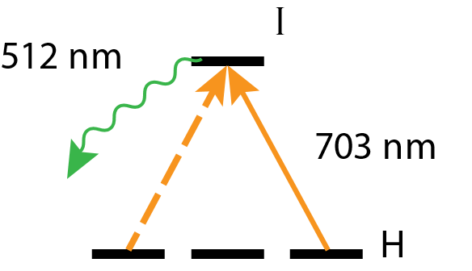
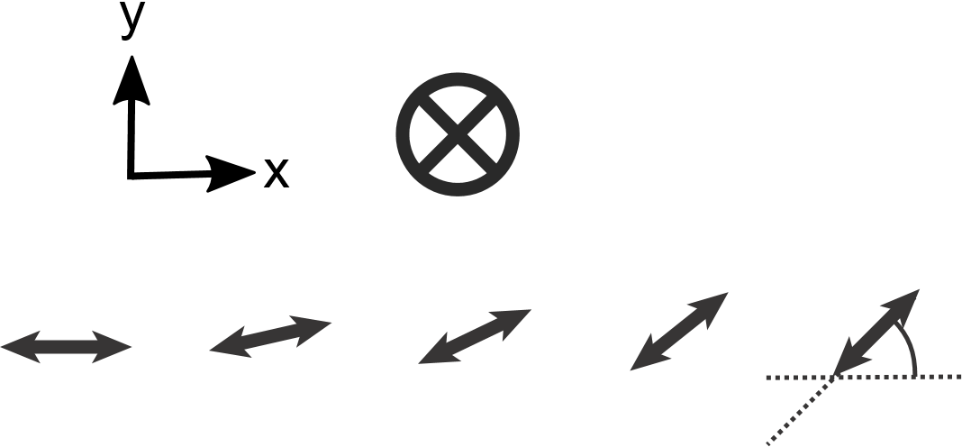
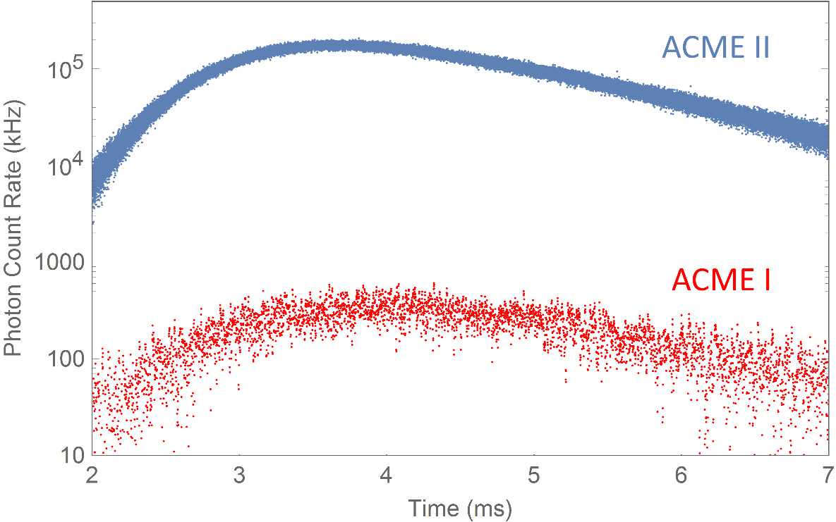
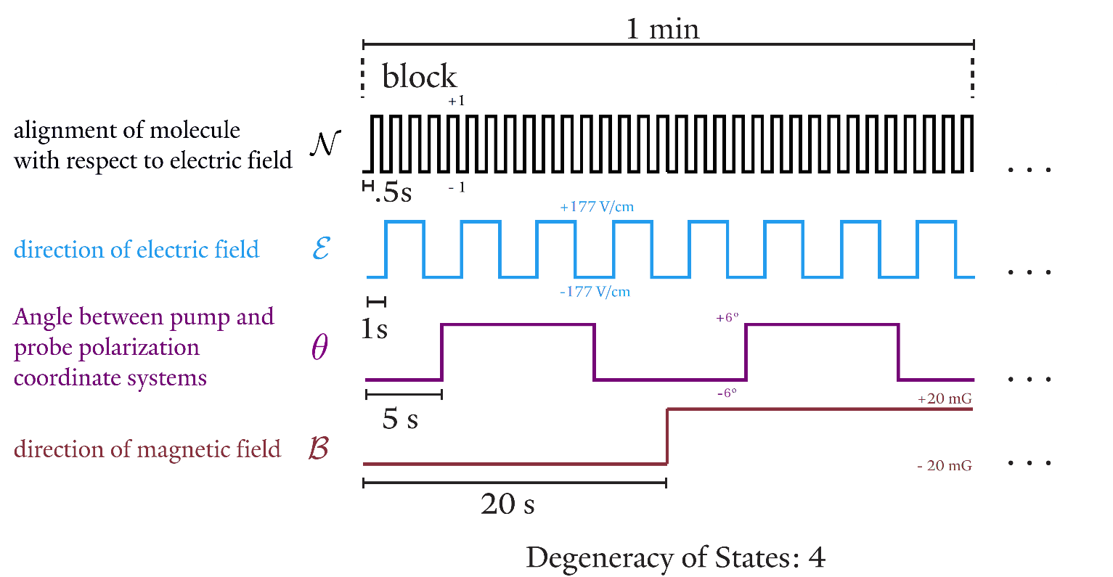
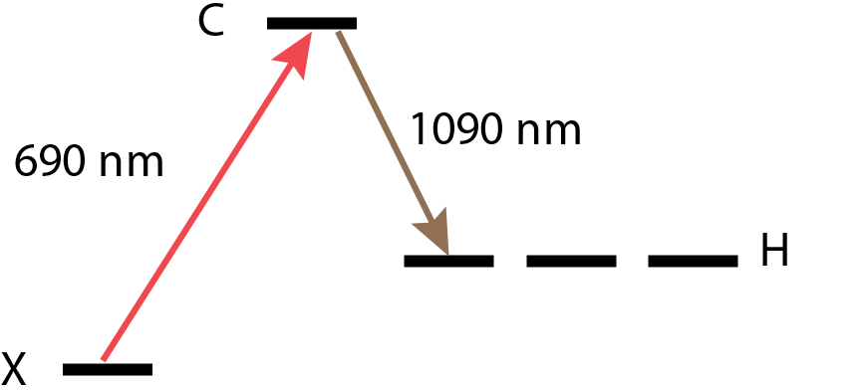
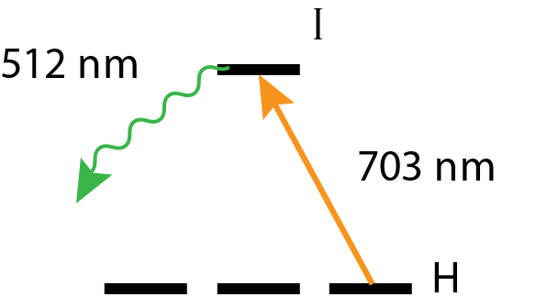
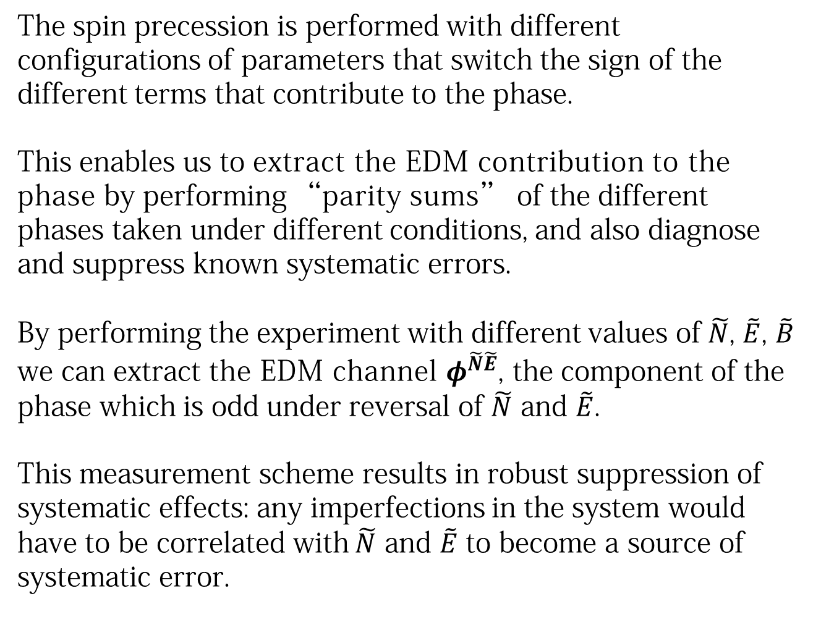
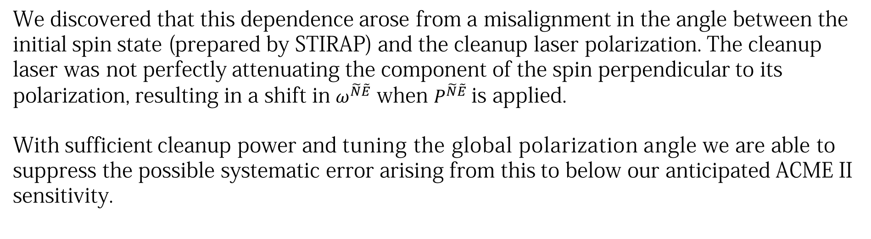
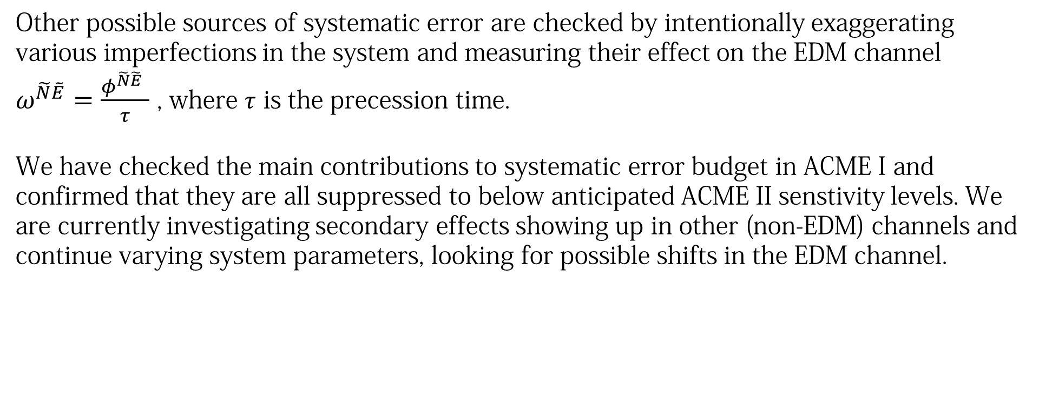
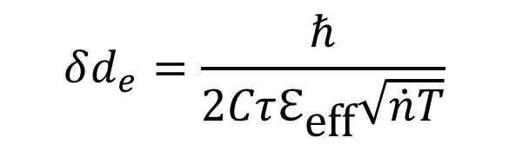




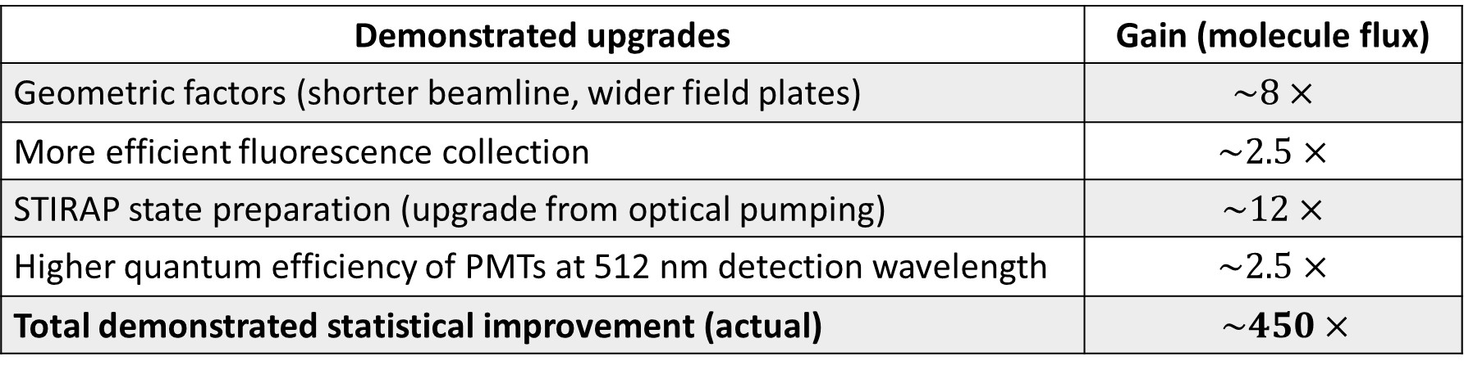
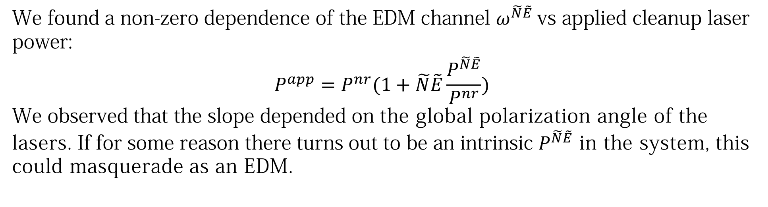
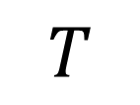
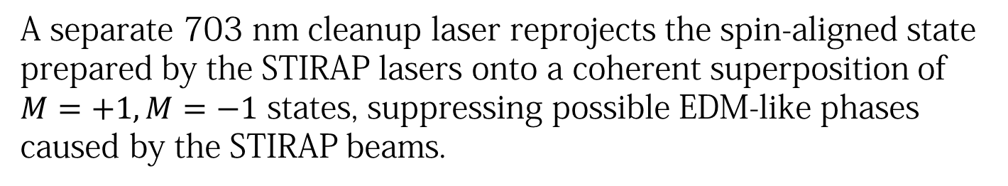



Progress Towards an Order of Magnitude Improvement on
the Measurement of the Electron Electric Dipole Moment
ACME Collaboration: Daniel Ang,¹ David DeMille² (PI), John M. Doyle¹ (PI), Gerald Gabrielse¹ (PI), Jonathan Haefner,¹ Zack Lasner,² Cole Meisenhelder,¹ Cristian Panda,¹ Adam West,² Elizabeth P. West,¹ Xing Wu²
Affiliation: ¹Harvard University, ²Yale University
Motivation & Theory
ACME II Apparatus
Systematic Search & Characterization
$$S$$
$$d_{e}$$
Permanent EDMs violate T-symmetry.
Many theories beyond the Standard Model predict T violation and EDMs at current experimental precision.
Other possible sources of systematic error are checked by intentionally exaggerating various imperfections in the system and measuring their effect on the EDM channel $ω^{\tilde{N}\tilde{E}}=\frac{φ^{\tilde{N}\tilde{E}} }{τ}$ , where $τ$ is the precession time.
We have checked the main contributions to systematic error budget in ACME I and confirmed that they are all suppressed to below anticipated ACME II senstivity levels. We are currently investigating secondary effects showing up in other (non-EDM) channels and continue varying system parameters, looking for possible shifts in the EDM channel.
$$H_{d}=−{\vec{d}}_{e}⋅\vec{ℇ}$$
$$d_{e}$$
$$T$$
3.
$$S$$
4.
5.
Example: Correlation between prepared phase and power
1.
2.
We found a non-zero dependence of the EDM channel $ω^{\tilde{N}\tilde{E}}$vs applied cleanup laser power:
$$P^{app}=P^{nr}(1+\tilde{N}\tilde{E}\frac{P^{\tilde{N}\tilde{E}}}{P^{nr}})$$
We observed that the slope depended on the global polarization angle of the lasers. If for some reason there turns out to be an intrinsic $P^{\tilde{N}\tilde{E}}$ in the system, this could masquerade as an EDM.
Figure taken from Feng (2013)
3.
4.
5.
Effective electric field $ℇ_{eff}$: ~80 GV/cm
Precession time $τ$: ~1 ms
Measurement contrast $C$: ~0.95
Integration time $T$: set at ~340 hours
(Detected) molecule flux $\dot{n}$:
ACME I: ~ $3×{10}^{4} s^{−1}$
ACME II: ~ $1×{10}^{7} s^{−1}$
ACME I result: $d_{e}={(−2.2 ±4.8 )×10}^{−29} e∙cm$
$$⇒\left|d_{e}\right|<9.3{ ×10}^{−29} e∙cm$$
Projected ACME II sensitivity: $δd_{e}\sim {10}^{−29} e∙cm$
1.
2.
$$δd_{e}=\frac{ℏ}{2Cτℇ_{\text{eff}}\sqrt{\dot{n}T}}$$
1. Buffer gas beam source
We discovered that this dependence arose from a misalignment in the angle between the initial spin state (prepared by STIRAP) and the cleanup laser polarization. The cleanup laser was not perfectly attenuating the component of the spin perpendicular to its polarization, resulting in a shift in $ω^{\tilde{N}\tilde{E}}$ when $P^{\tilde{N}\tilde{E}}$is applied.
With sufficient cleanup power and tuning the global polarization angle we are able to suppress the possible systematic error arising from this to below our anticipated ACME II sensitivity.
ThO in the gas phase is produced through pulsed ablation of a ceramic ThO₂ target with an Nd:YAG laser. Ablation is performed at 50 Hz in a cryogenic buffer gas cell. The ThO molecules thermalize with and are entrained in the flow of the neon buffer gas. The molecular beam is cooled to 4 K. Each pulse produces a flux of ~10¹¹ molecules per steradian in the electro-vibrational ground state.
9 cm
Beamline
4 K
1.5 cm
Statistical Gains Versus ACME I
Neon
flow
line
16 K
Ceramic ThO₂ ablation target
Demonstrated upgrades | Gain (molecule flux)
Geometric factors (shorter beamline, wider field plates) | $$\sim 8×$$
More efficient fluorescence collection | $$\sim 2.5×$$
STIRAP state preparation (upgrade from optical pumping) | $$\sim 12×$$
Higher quantum efficiency of PMTs at 512 nm detection wavelength | $$\sim 2.5×$$
Total demonstrated statistical improvement (actual) | $\sim 450×$
Ablation
window
4. State Precession
5. State Readout
The molecules in the prepared state precess and acquire phase as they fly through the electric and magnetic fields of the interaction region.
At the end of the interaction region, the final state is projected to a pair of orthogonal basis vectors by subjecting the molecules to a 703 nm probe laser (on the H-I transition) with linear polarization rapidly switched (200 kHz) between x and y.
We collect the 512 nm fluorescence using PMTs as the molecules in the short-lived I-state decay back to the ground state.
2. Rotational Cooling
The molecules in the X state are primarily distributed in the lowest four rotational states after leaving the cell. Optical pumping on the $X−C$ transition transfers population from the $J=0, 1, 2$ levels to the $J=0$ level, increasing usable molecule flux by a factor of ~2.7.
Comparison of ACME I and ACME II spin precession fluorescence data
Step 1
Step 2
Data Acquisition Structure
3. State Preparation
The spin precession is performed with different configurations of parameters that switch the sign of the different terms that contribute to the phase.
This enables us to extract the EDM contribution to the phase by performing “parity sums” of the different phases taken under different conditions, and also diagnose and suppress known systematic errors.
By performing the experiment with different values of$\tilde{N}$, $\tilde{E}$, $\tilde{B}$ we can extract the EDM channel $φ^{\tilde{N}\tilde{E}}$, the component of the phase which is odd under reversal of $\tilde{N}$ and $\tilde{E}$.
This measurement scheme results in robust suppression of systematic effects: any imperfections in the system would have to be correlated with $\tilde{N}$ and $\tilde{E}$ to become a source of systematic error.
Parameter switch
Outlook
The EDM measurement is performed in the metastable H state. STIRAP coherently transfers population through an intermediate short-lived state to the spin-aligned state that represents the beginning of the EDM measurement. This transfer occurs with an efficiency of ~75%.
STIRAP Level Structure
Cleanup Level Structure
The ACME II measurement of the electron EDM is currently ongoing, measuring ThO spin precession with a daily statistical uncertainty of 10⁻²⁹ e·cm.
We are currently checking for and investigating systematic effects, with the aim of a measurement near or better than 10⁻²⁹ e·cm.
References
ACME I result: J Baron et al., Science 343, p. 269-272 (2014)
ACME I detailed report: J Baron et al., arXiv:1612.09318
STIRAP state preparation: C.D. Panda et al., Phys. Rev. A 93, 052110 (2016)
Previous eEDM Limit: J. J. Hudson et al., Nature 473, 7348 (2011)
E_{eff} Calculations: L. V. Skripnikov et al., J. Chem. Phys. 142 024301 (2015), T. Fleig et al., J. Mol. Spec. 300 p. 16-21 (2014)
EDM & SUSY: J. Feng, Annu. Rev. Nucl. Part. Sci., 63:351-82 (2013)
A separate 703 nm cleanup laser reprojects the spin-aligned state prepared by the STIRAP lasers onto a coherent superposition of $M=+1, M=−1$ states, suppressing possible EDM-like phases caused by the STIRAP beams.
EDM phase
More information: www.electronedm.info

