Slide 1
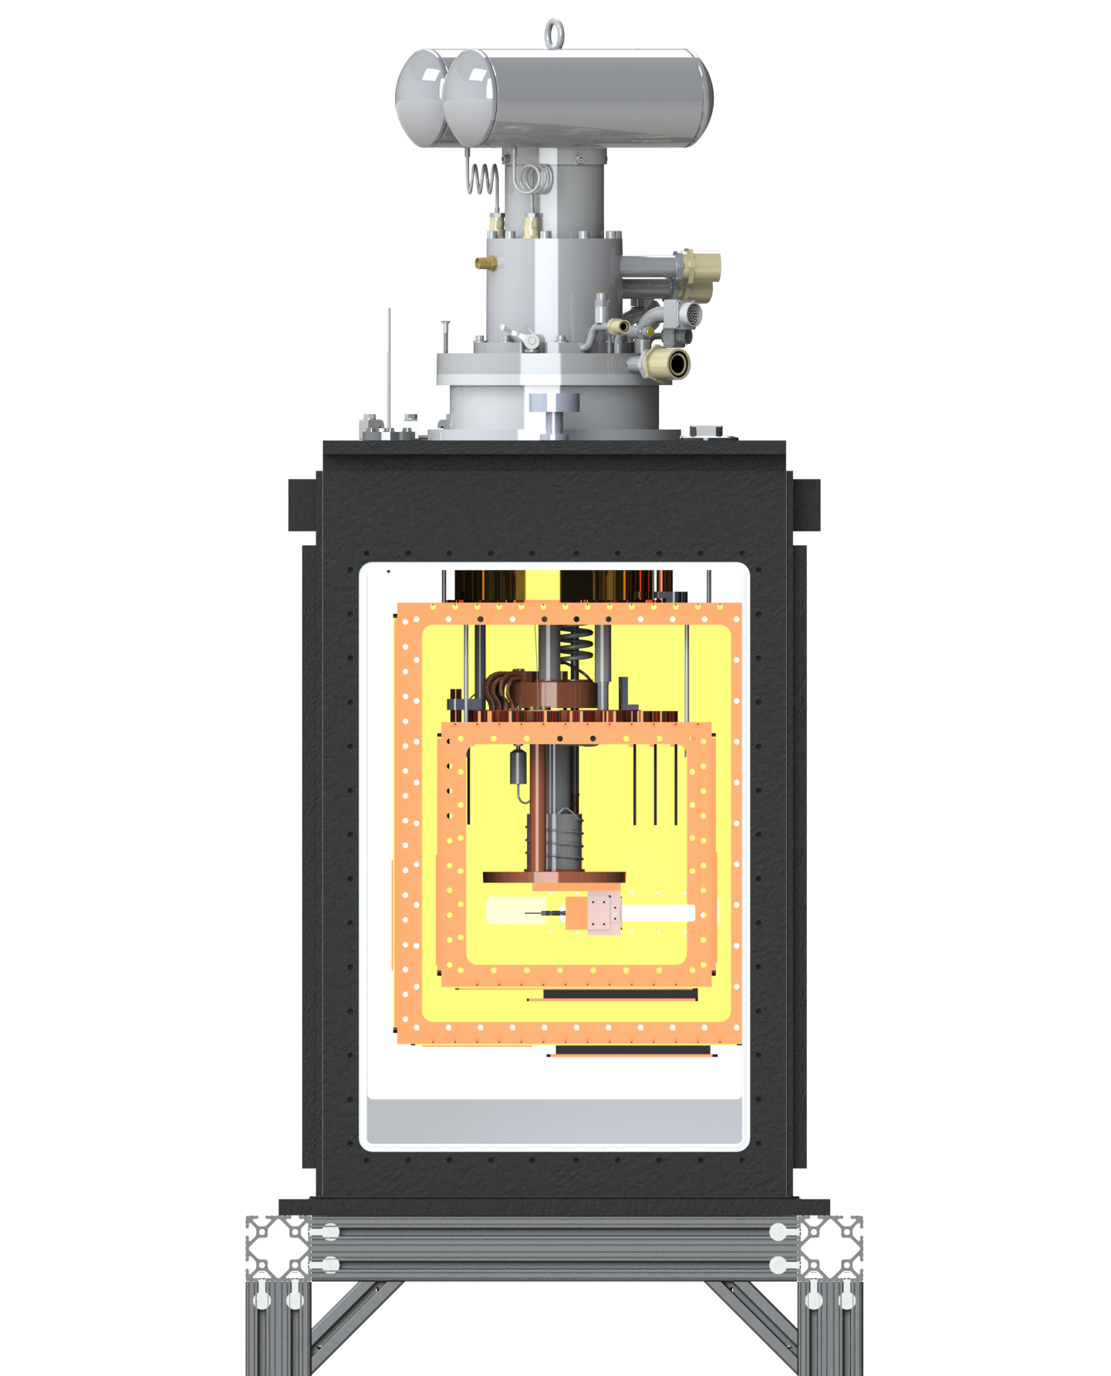
What’s New in CaF Gen2 Beam Box?
Yicheng Bao
2021/1/13

Slide 2
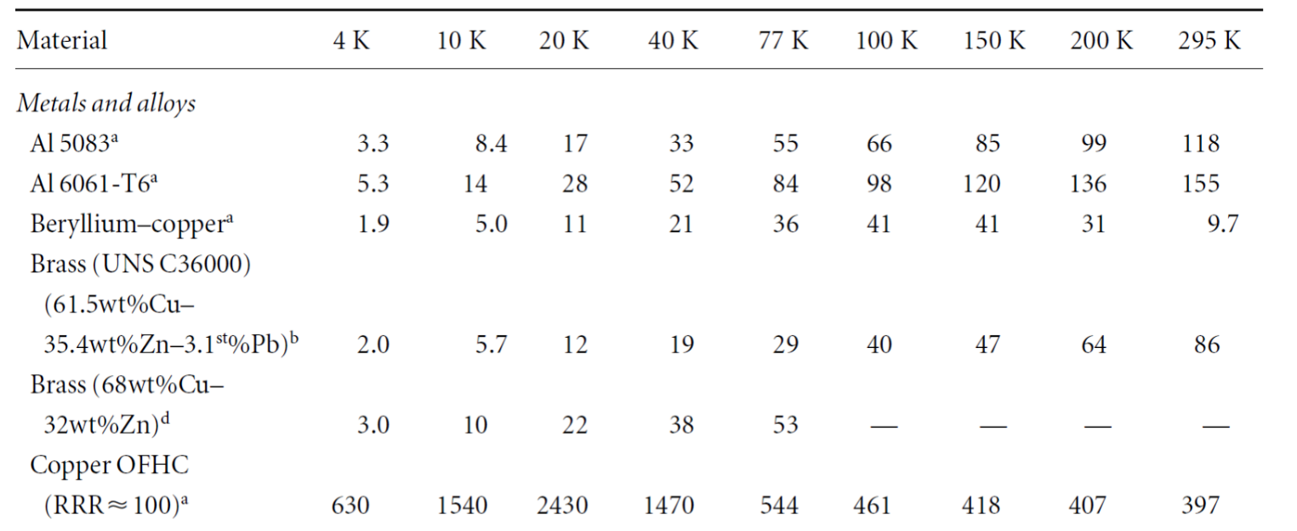
Fast Cool Down
Reduce thermal mass
Use copper for 40K shield construction.
Cu-101 has much higher thermal conductivity compared to 6061 aluminum(15x), so much less material can be used in shield construction.
Copper enthalpy is half of aluminum(equal mass), but density is 3.3 times higher.
Taken all these into account, copper shield still wins.
Notes:
If total cooling power and material volume is the same, copper will take 40% longer time to cool down compare to aluminum.

Slide 3
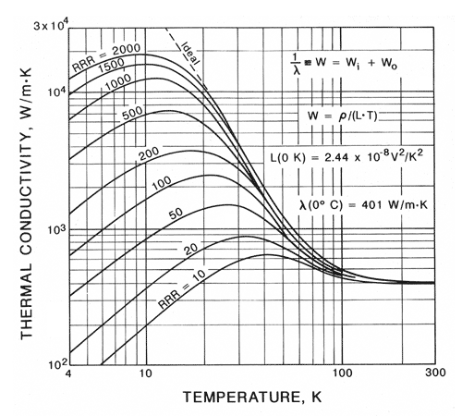
Copper vs Aluminum Enthalpy and Conductivity
Copper: 8.96 g/cm^3
Al: 2.7g/cm^3
Copper: 79 J/g
Al: 170 J/g
Copper is 1.5X the Enthalpy per volume
Conductivity at 40k:
1500 vs 100
Copper Is 10x Better Per Thermal Mass Than Aluminum at 40K
(~50% better at room temp)
(~2.6x better at 100K)
Notes:
Hard to get ‘pure’ aluminum

Slide 4
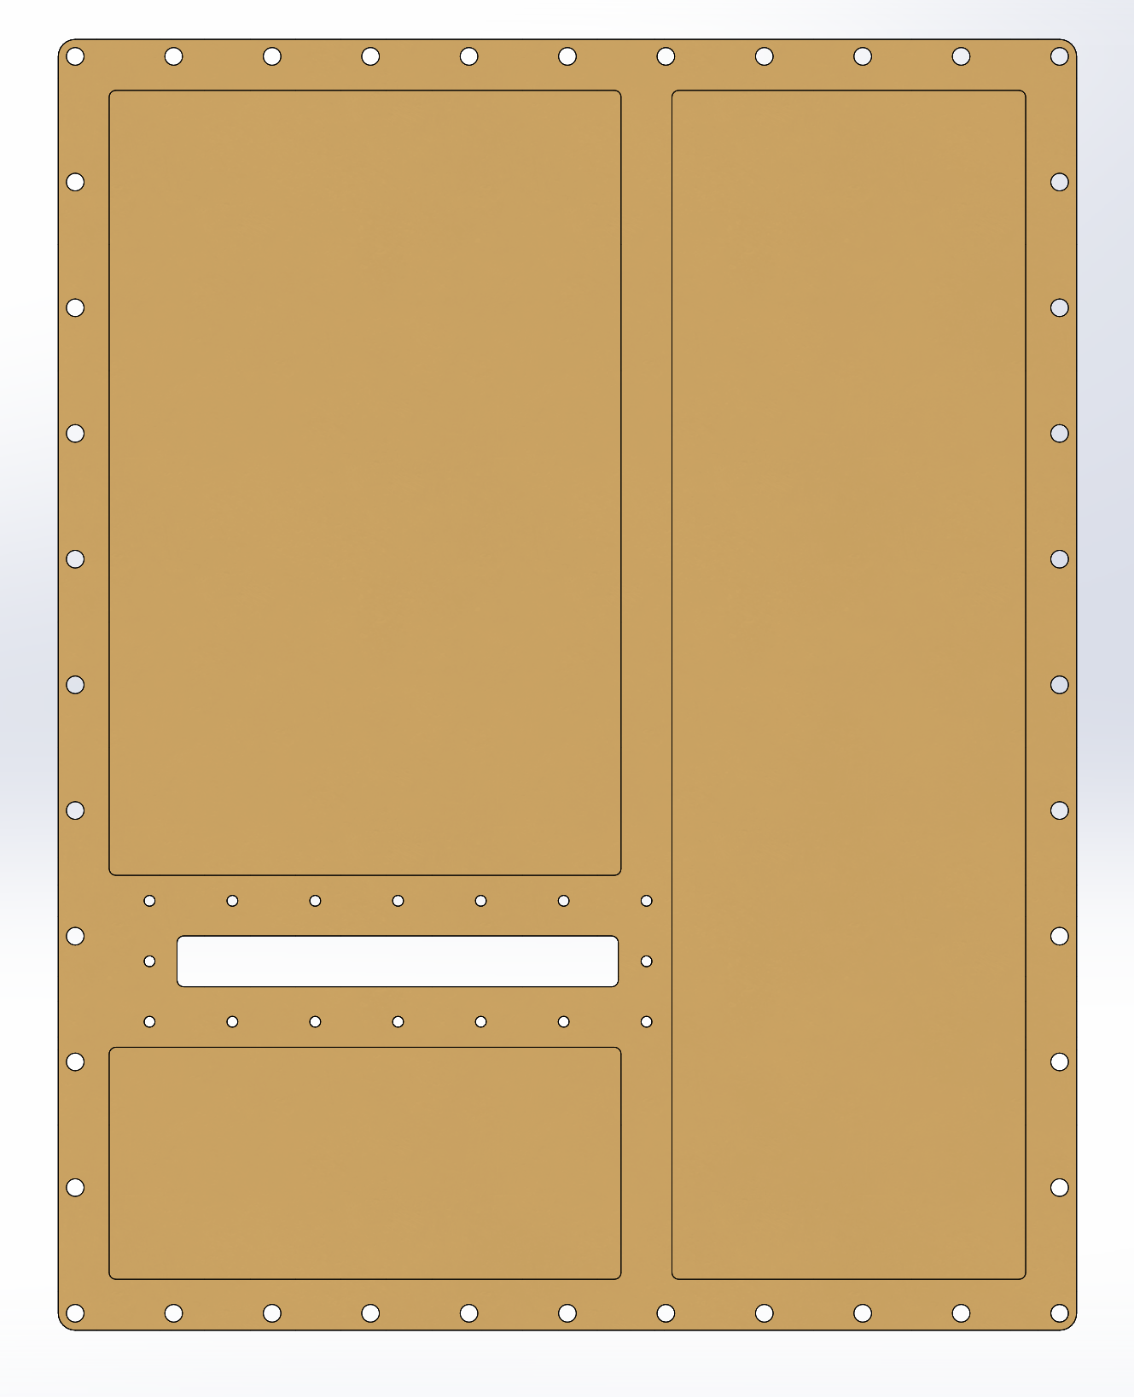
40K shield detail
Ideally copper shield can be very thin, but we need mechanical strength.
Start from 1/8-inch-thick copper
Milled down to 1/16 inch in some areas to reduce thermal mass
Keep window area 1/8 inch thick to provide mechanical strength and avoid deformation. (Also ensure enough threads for tapped holes)
Max top/bottom temperature difference after cool down is below 1K.

Slide 5
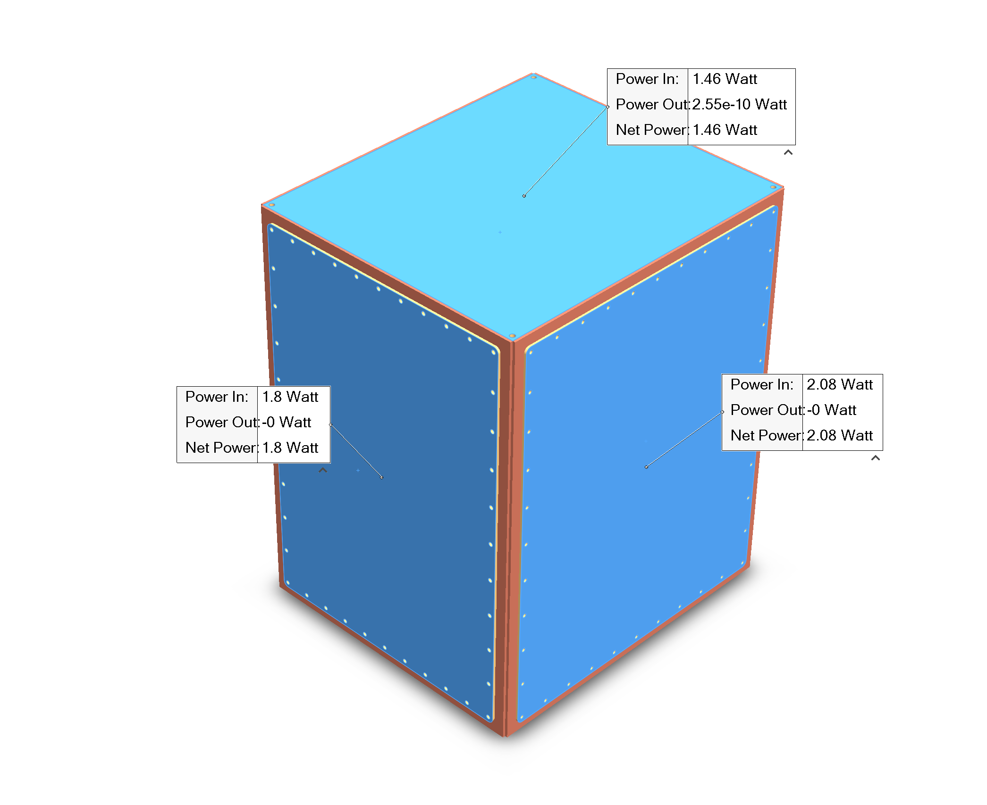
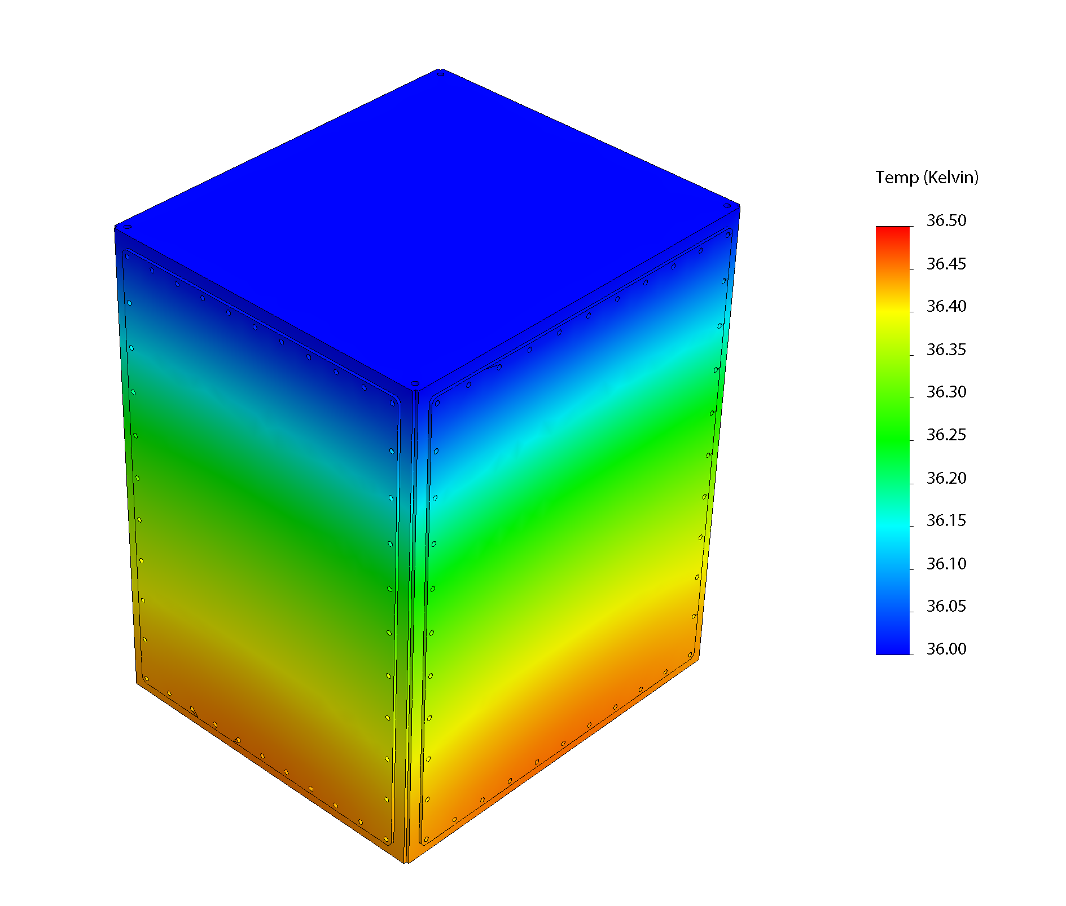
Better Vacuum?
Super insulation (aluminized Mylar) is not a great choice for vacuum.
Cryopumping does not help you, last layer of superinsulation is near room temperature after cool down.
Use gold plated copper to replace superinsulation.
Polished copper emissivity: 0.02 (if tarnished, 0.6)
Polished gold emissivity: 0.02 (will not tarnish)

Slide 6
Better metal-metal thermal contact
Bare copper vs Gold plated copper
Notes:
No grease, grease will migrate

Slide 7
Gold plating details
Choice of gold coating: soft gold (24K) vs hard gold (18K)
We choose soft gold, soft gold is not shiny after plating and needs final post-polishing. Post-polishing might not be needed if hard gold is chosen.
Copper panels are machined, sanded, polished, then sent for plating.
Panels are polished again carefully(gold layer is thin) after plating.
Notes:
Actually electroplate nickel first then gold
CIL electroplating
0.000005 to 0.00002”

Slide 8
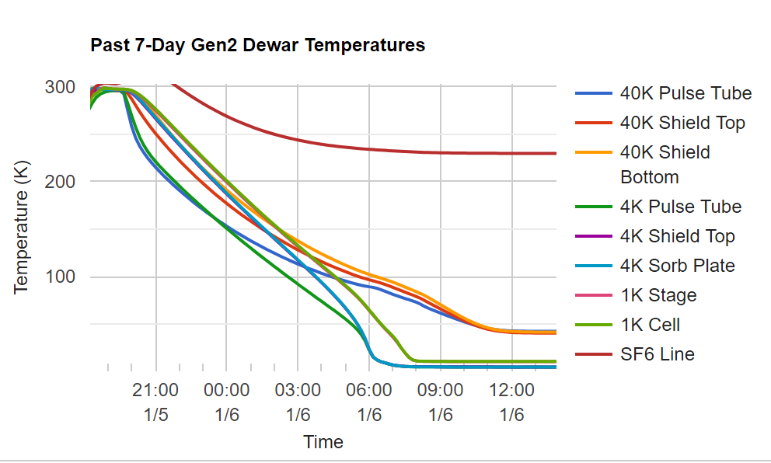
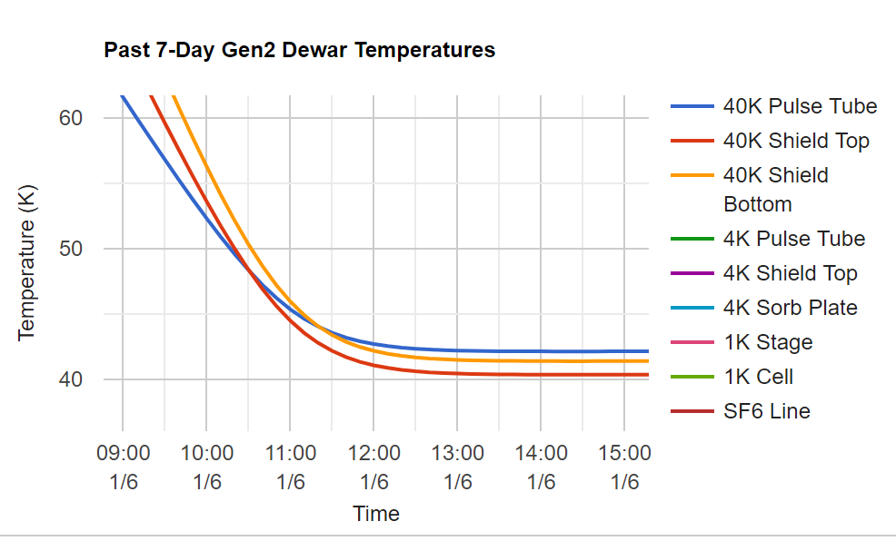
Cool Down Performance
4K reached in 11 hours (experiment can start)
40K reached in 16 hours
Gold coating works well
40K shield top temperature is lower than 40K pulse tube!
4K shield can ‘radiative cool’ 40K shield?
Notes:
Diode sensors are all calibrated at 77K and 4K, differential error is within 0.1K for these sensors.

Slide 9
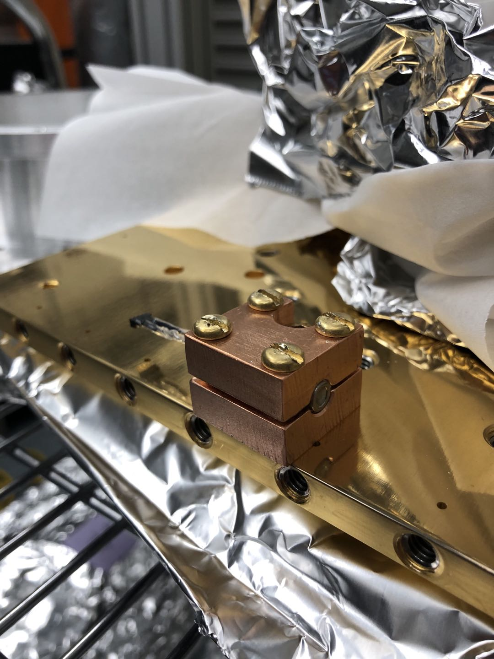
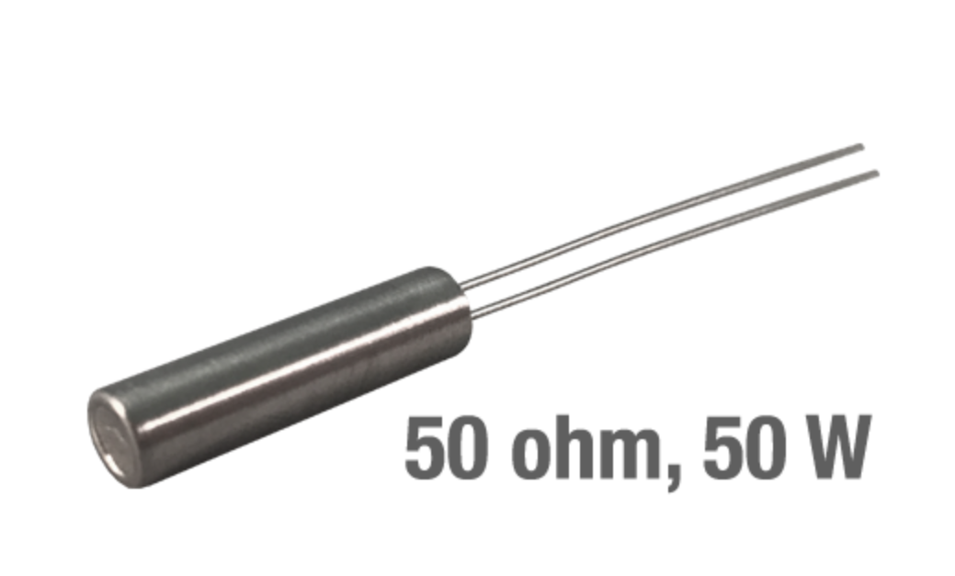
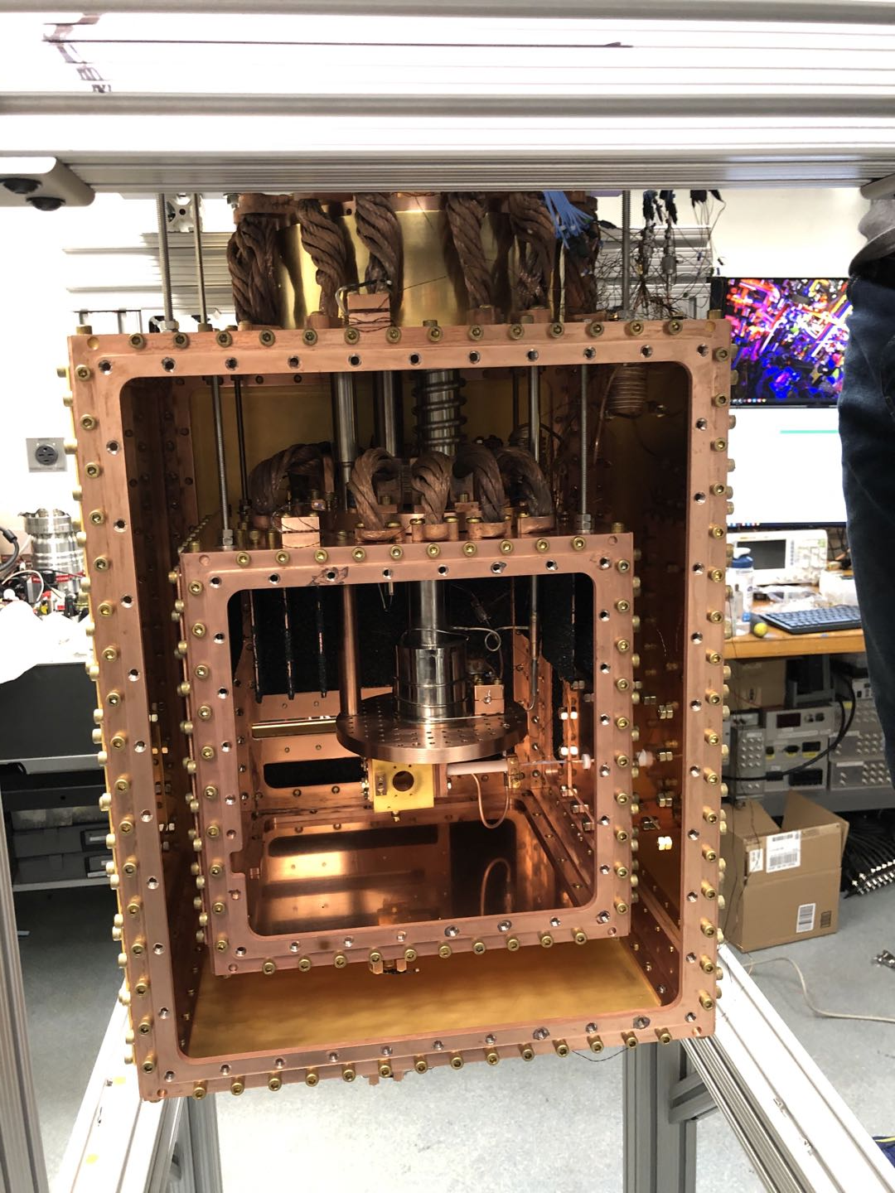
Fast Warm Up
Add resistive heaters
Lake Shore 50ohm 50V heater cartridge
Sandwiched between copper block with indium foil, then clamped to shields
Heaters are placed far from windows to avoid big thermal gradient on glass

Slide 10
Wire choice for heaters
Be careful of fuse current rating given by Lake Shore!
30AWG Manganin wire is rated for 4.3A fuse current in vacuum.
Resistance of Manganin is too high. And insulation coating(Formvar, 105C max) fails above 500mA in vacuum.
For our 1A 50V heaters, we use 30AWG Kapton(250C max) coated copper wire from Accu-glass.
Heat load from one pair of 1m long 30AWG copper wire is less than 20mW. We have 5 pairs between 4K and 300K, that is 100mW. This is reasonable heat load for a 1.5W PT415 PTR.

Slide 11
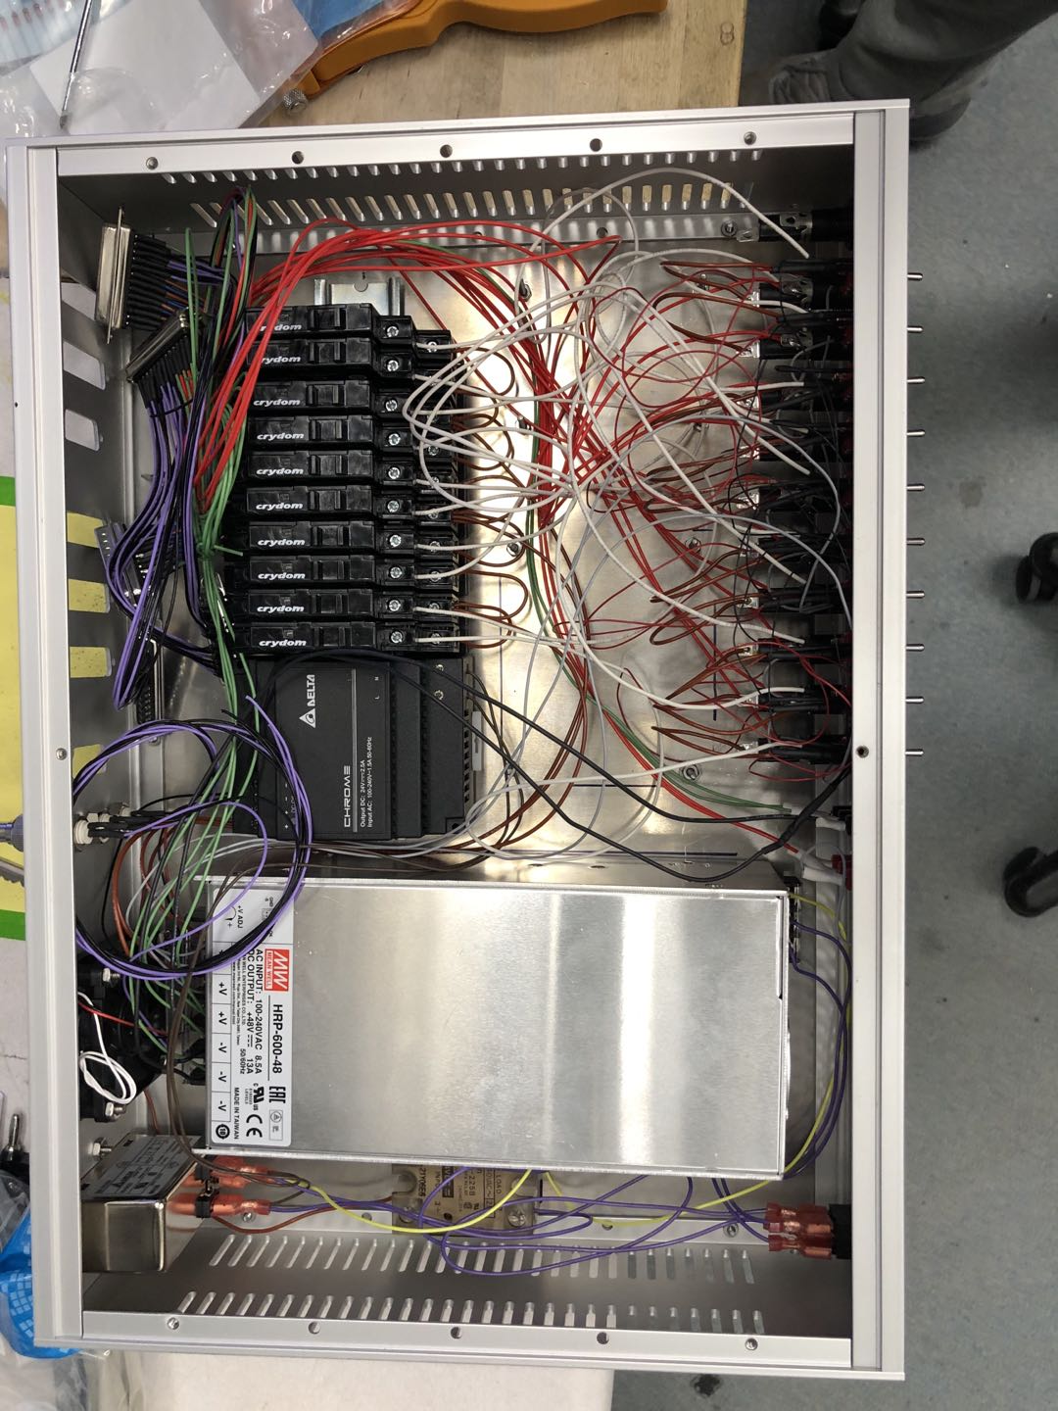
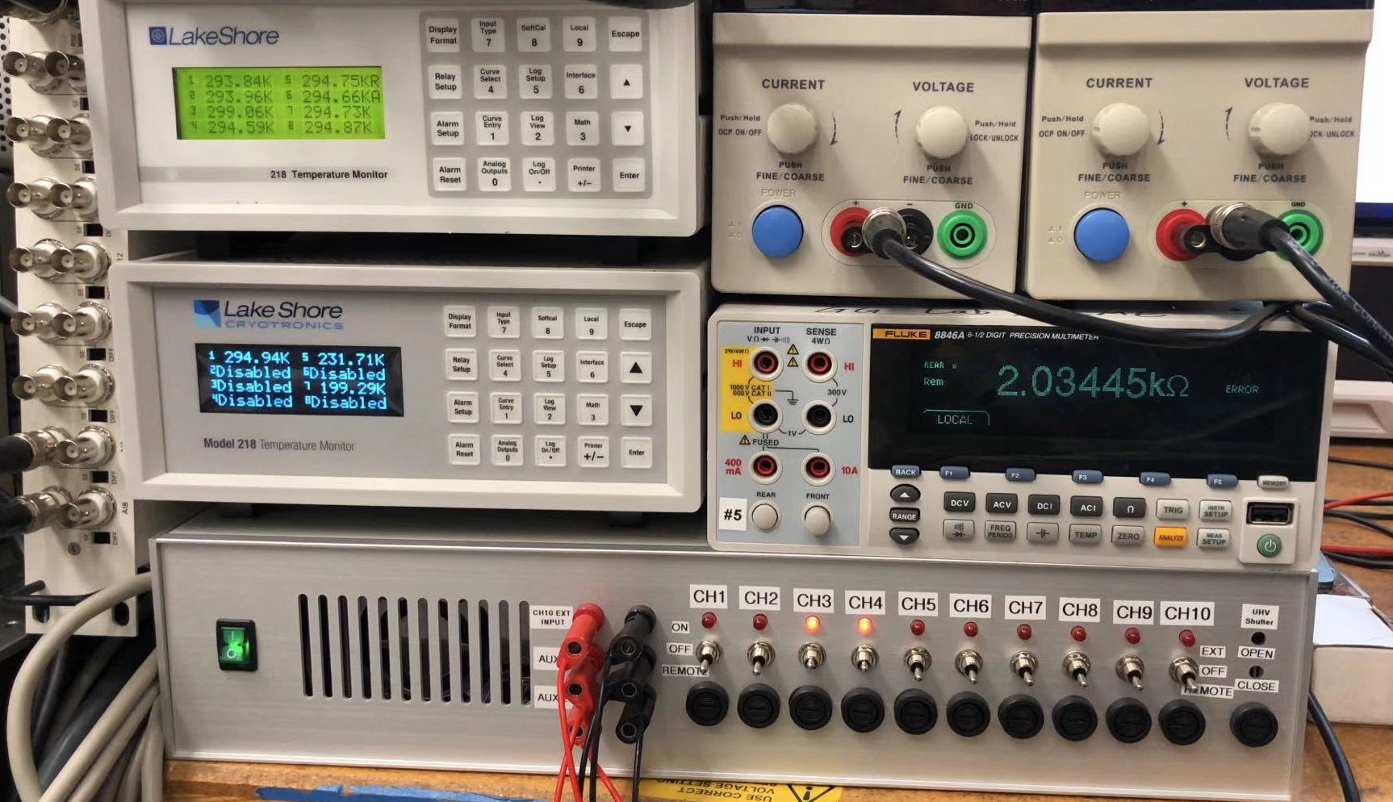
Heater controller
Heaters are PWM controlled by LabVIEW to bring whole beam box to room temperature at the same time.
Hardware protection required!!!
>350K on any part of the pulse tube cold stages might cause damage and will void the warranty!
In addition to LabVIEW control, there is a Lake Shore temperature monitor interlock that directly shut off heater control box main input.

Slide 12
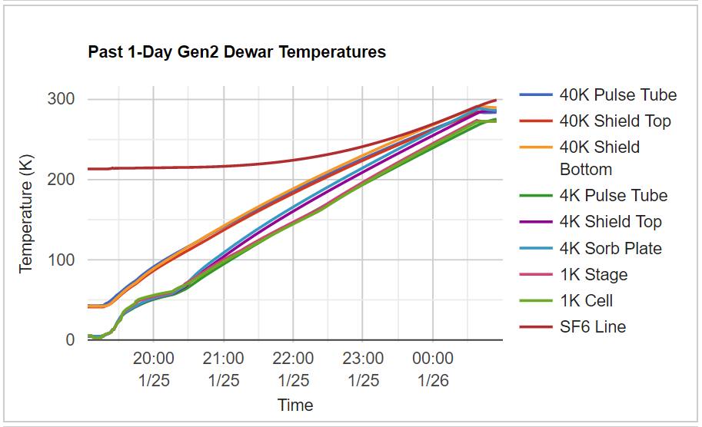
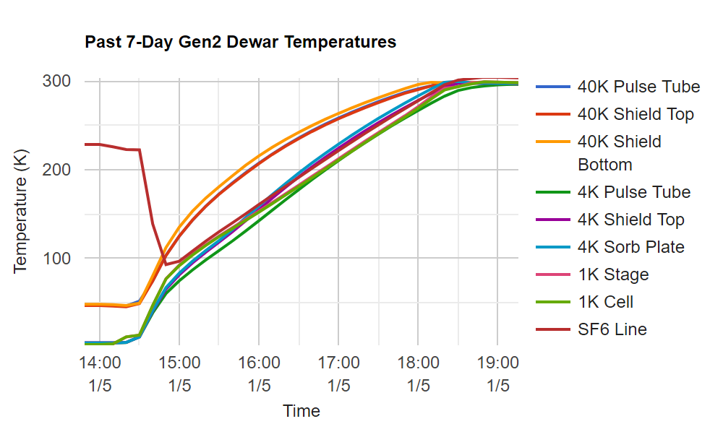
Performance
Left: Beam box under high vacuum (~5 hours)
Right: Beam box filled with 1 torr of helium (~4 hours)
Total heating power is around 350W

Slide 13
Make-life-better Improvements
Also, more elegant

Slide 14
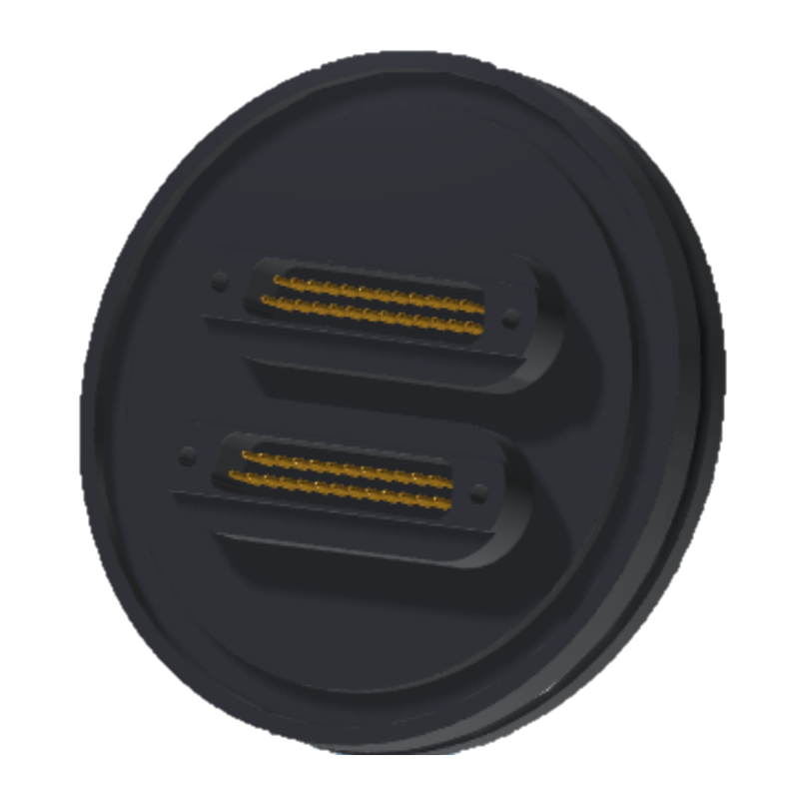
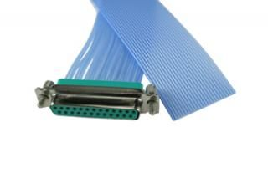
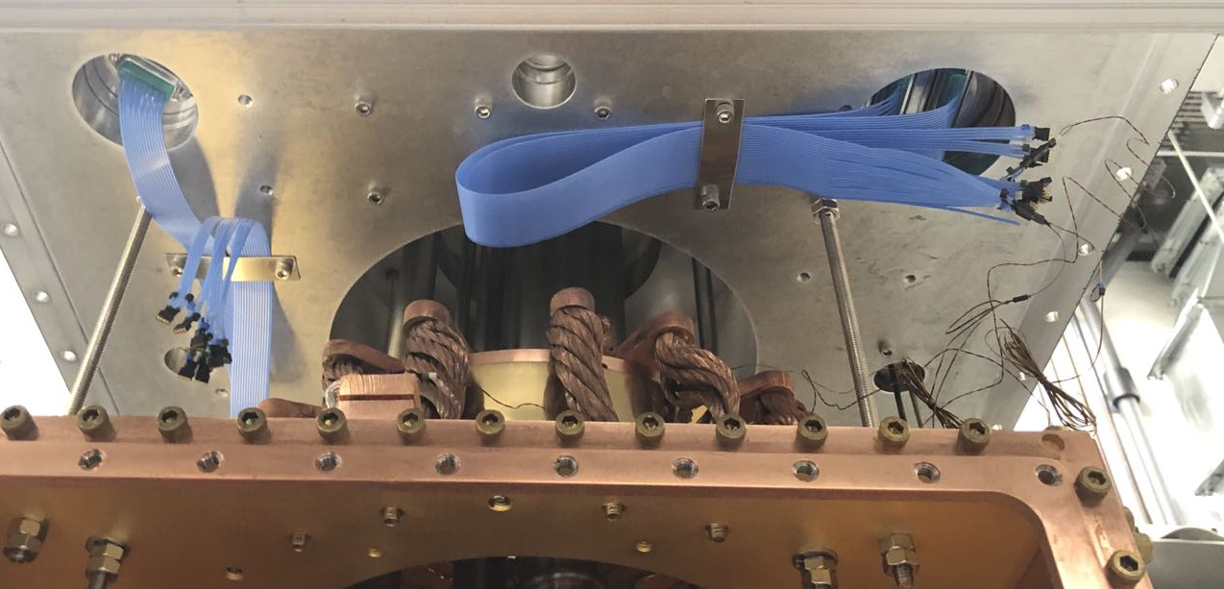
Feedthroughs
DB-25 feedthroughs from Kurt Lesker
High vacuum compatible(FEP) DB-25 breakout cable from Accu-glass
Color coded ceramic beads from LewVac for labeling.
Less messy outside beam box: Only three cables
Less messy inside the beam box
Very compact feedthrough so flanges can be saved.

Slide 15
Helium Charcoal Sorbs
Nothing special here
All four 4K shield panels are coated with sorbs on inside surface.
About 12 pieces 3.5in*3.5in double-side protection sorb.
Protection sorbs hanging from 4K shield top plate.
No sorbs are installed on the bottom, leaving a lot of space for future use.

Slide 16
Other Miscellaneous Improvements
Avoid mixed type of fasteners. All shield screws are standard ¼-20 SHCS brass screws.
No slotted screws!
Use ¼-20 threaded SS rods for rigid shield hanging.
Use BBAR coated, cut-to-size, properly beveled glasses for windows.(Customized by ESCO, not that expensive!)

Slide 17
Questions?

Slide 18
Superinsulation is bad for vacuum

