Slide 1
Microwave Spectroscopy
Adam West

Slide 2
Outline:
Introduction:
Motivation
Current knowledge
Experimental setup:
Measurement procedure
Microwaves setup
Initial measurements
Results:
Measured lines
Estimate of E-field distribution
Estimate of non-reversing E-field
Mysteries and Future Work
Microwave Spectroscopy
Adam West, 07/10/13

Slide 3
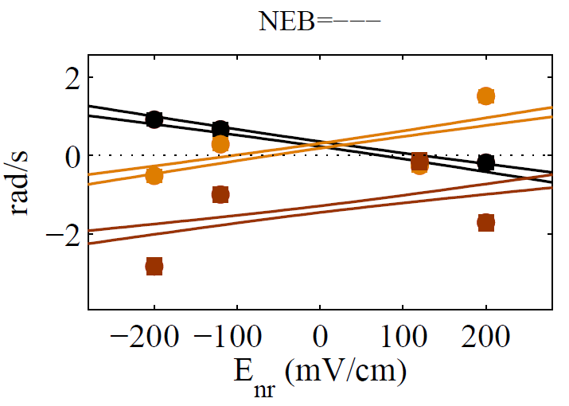
Motivation:
Why measure our electric field?
It’s good to accurately know the field we apply to our molecules.
We believe that things like patch potentials could possibly explain data in the EDM experiment we currently don’t understand.
Paranoia: ‘You only have to be right once to make it all worthwhile’
Microwave Spectroscopy
Adam West, 07/10/13

Slide 4
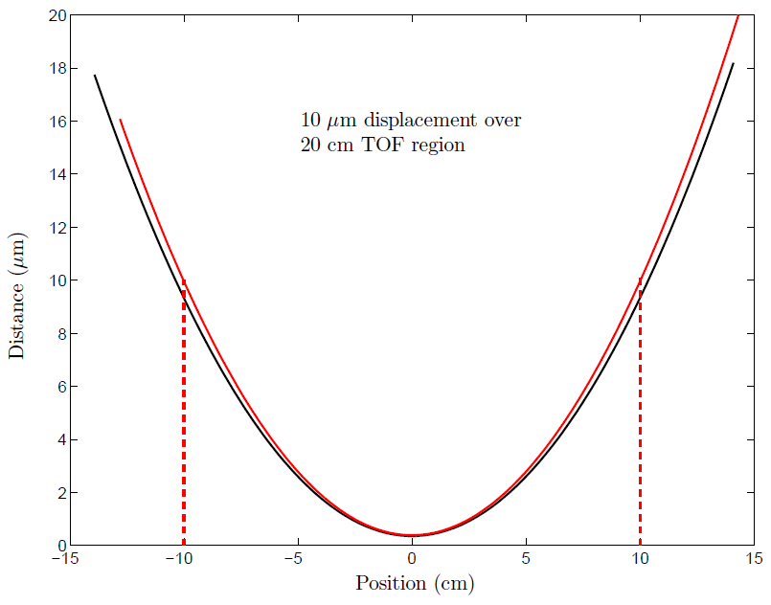
Current Knowledge:
Interferometry:
An interferometer was used when the plates were installed to measure the spacing between the plates.
Applied voltage = ±177 V
This gives a field of 140 V/cm.
A 10 micron change in displacement corresponds to an E-field change of 56 mV/cm.
This corresponds to a change in Stark shift of ± 58 kHz.
Microwave Spectroscopy
Adam West, 07/10/13

Slide 5
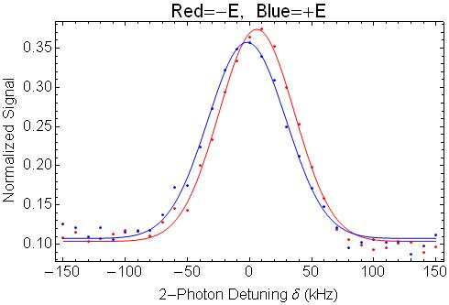
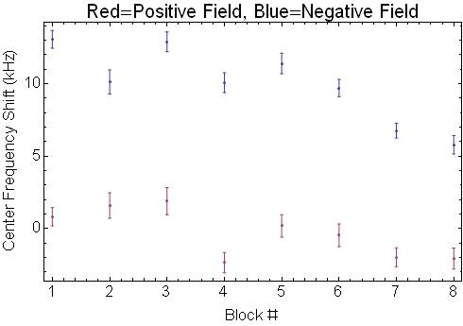
Current Knowledge:
Raman spectroscopy:
Limited to pump and probe regions.
Very sensitive (10 ppm) measurement of Stark shift.
$$Δν_{E}$$
Microwave Spectroscopy
Adam West, 07/10/13

Slide 6
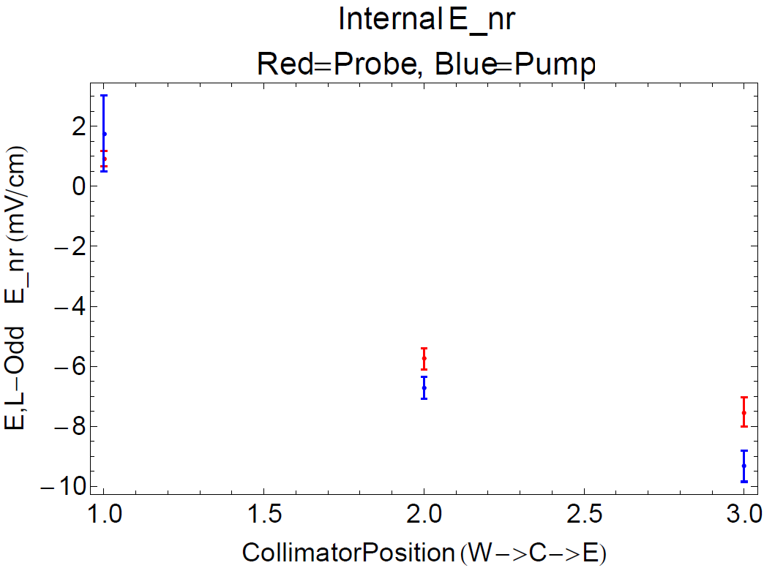
Current Knowledge:
Conclusions:
Transition linewidth of around 65 kHz.
Non-reversing E-field of around 5 mV.
Dependence of the non-reversing E-field on adjustable collimator position.
Microwave Spectroscopy
Adam West, 07/10/13

Slide 7
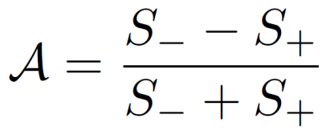
Measurement Procedure:
Pump:
Phase precession:
Probe:
Asymmetry:
Microwave Spectroscopy
Adam West, 07/10/13

Slide 8
Measurement Procedure:
CW: Longer interaction time, less microwave power needed.
Pulsed: Higher asymmetry, spatial resolution.
Microwave Spectroscopy
Adam West, 07/10/13

Slide 9
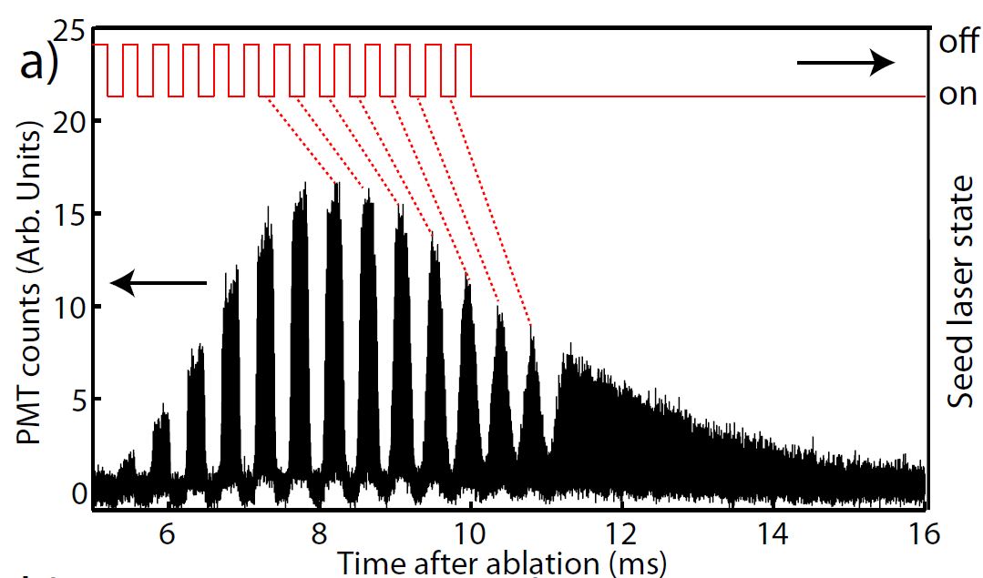
Measurement Procedure:
We also wish to pulse our optical pumping laser.
This could provide even better spatial resolution.
Demonstrated by Emil previously.
arXiv:1305.2179
Require short pulse so contained molecules approximated by single velocity class.
Require separated pulse so no overlap during time of flight.
Typical pulse duration (separation) = 100 us (200 us).
Will allow for mapping of the velocity distribution/dispersion.
Microwave Spectroscopy
Adam West, 07/10/13

Slide 10
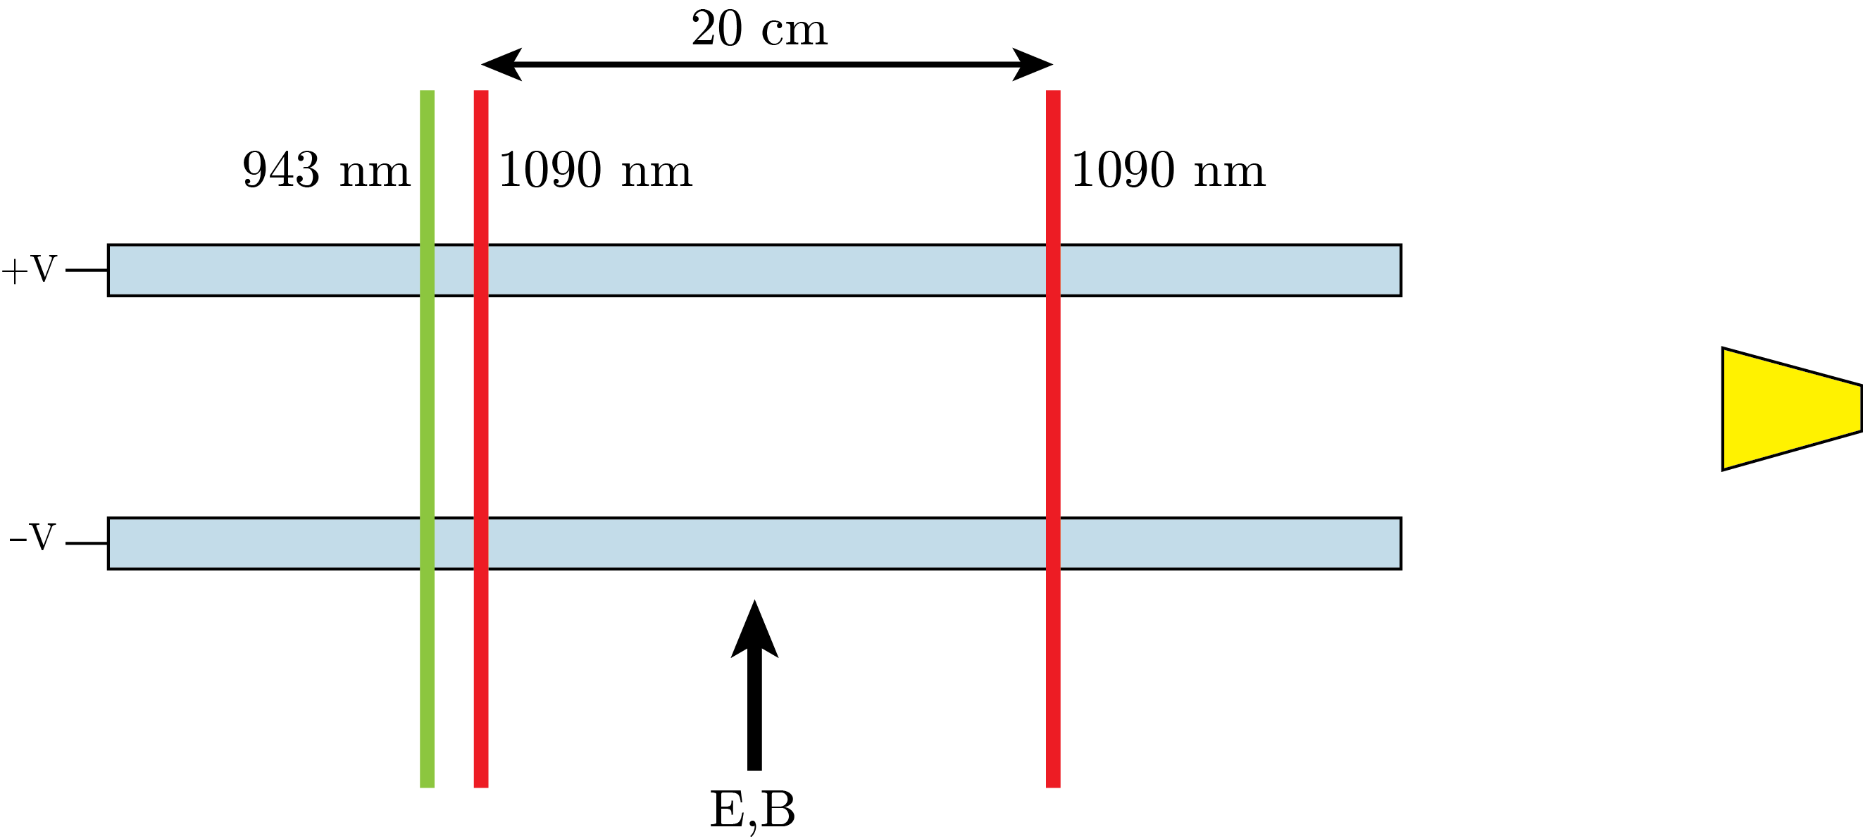
Measurement Procedure:
Prepare molecule pulse
Optically pump into H
Apply microwave pulse
2b. Apply multiple optical pumping pulses
Microwave Spectroscopy
Adam West, 07/10/13

Slide 11
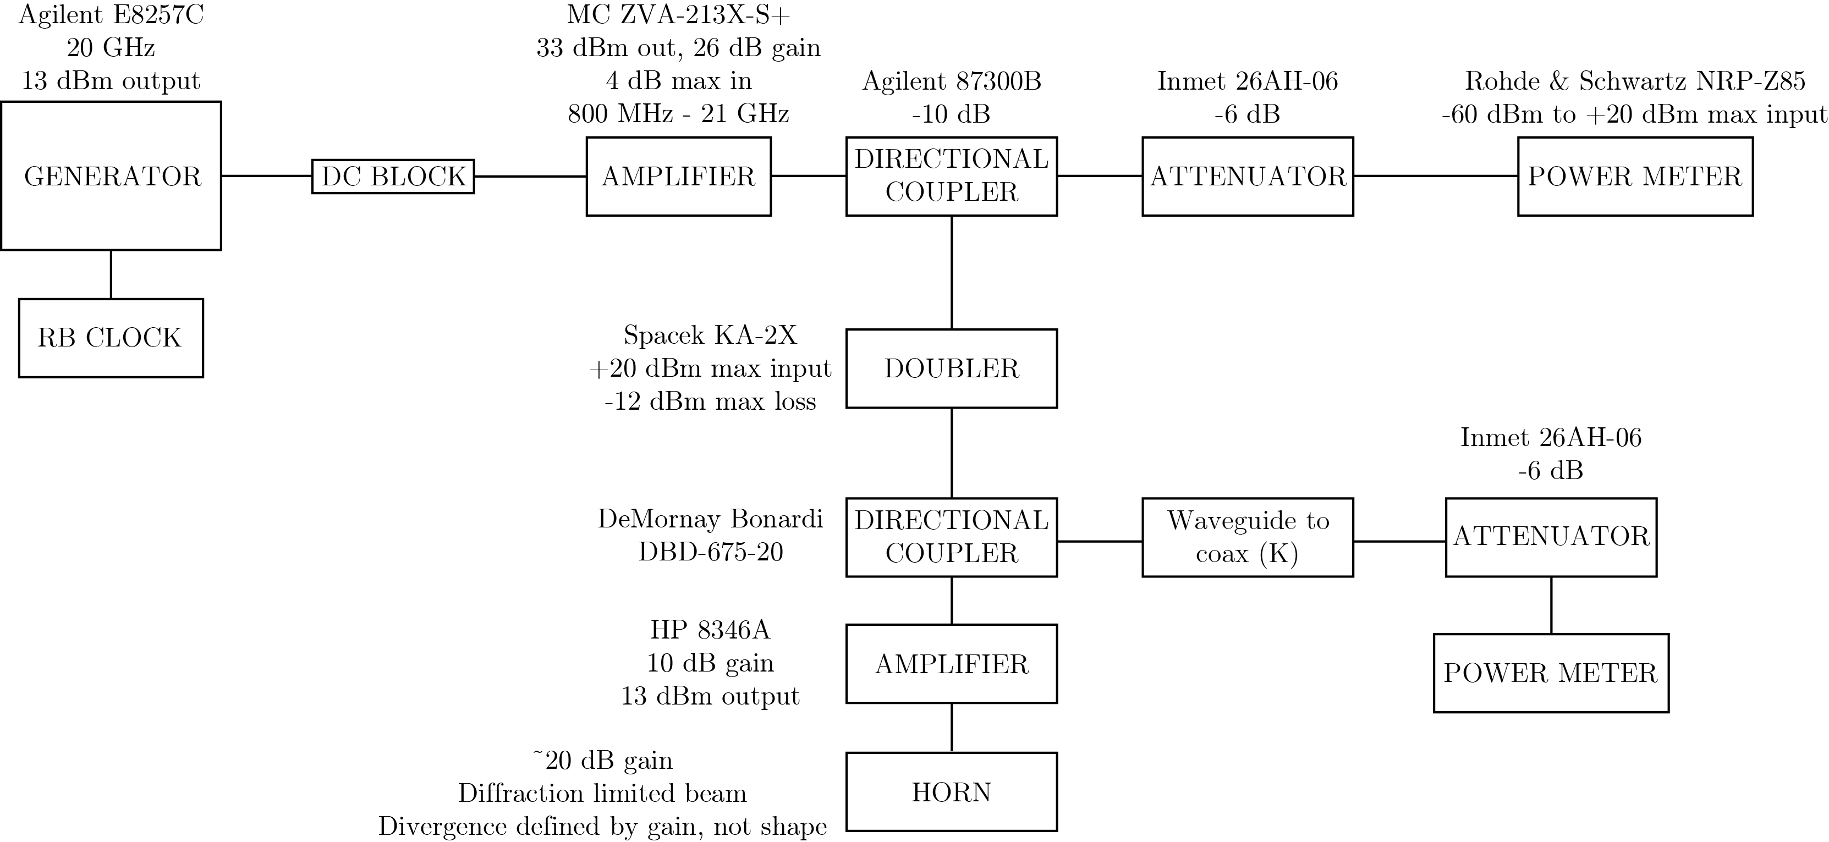
Microwaves Setup:
Power measured through system.
Power from horn measured via collection in second horn.
Vacuum chamber and guard ring simulated in test rig.
Microwave Spectroscopy
Adam West, 07/10/13

Slide 12
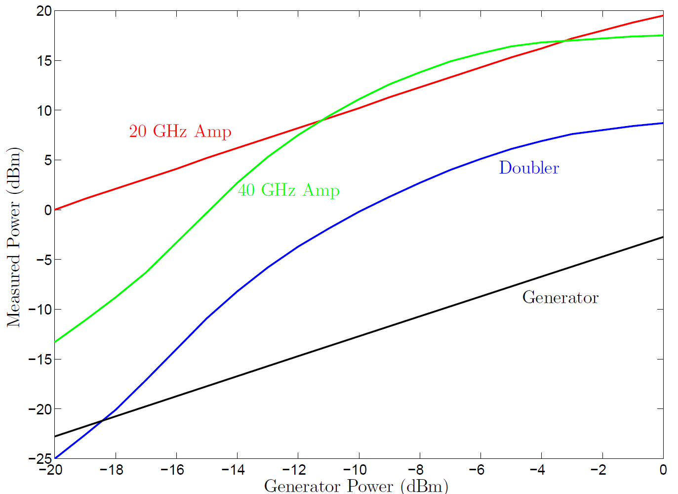
Microwaves Setup:
Microwave power measured throughout setup.
Observe 1 to 3 dB loss per 6 inch of SMA cable.
20 GHz amplifier provides around 20 dB of gain and is very linear.
Doubler shows (expected) non-linear behaviour with around 8 dB of loss.
40 GHz amp shows linear behaviour with around 10 dB of gain.
Microwave Spectroscopy
Adam West, 07/10/13

Slide 13
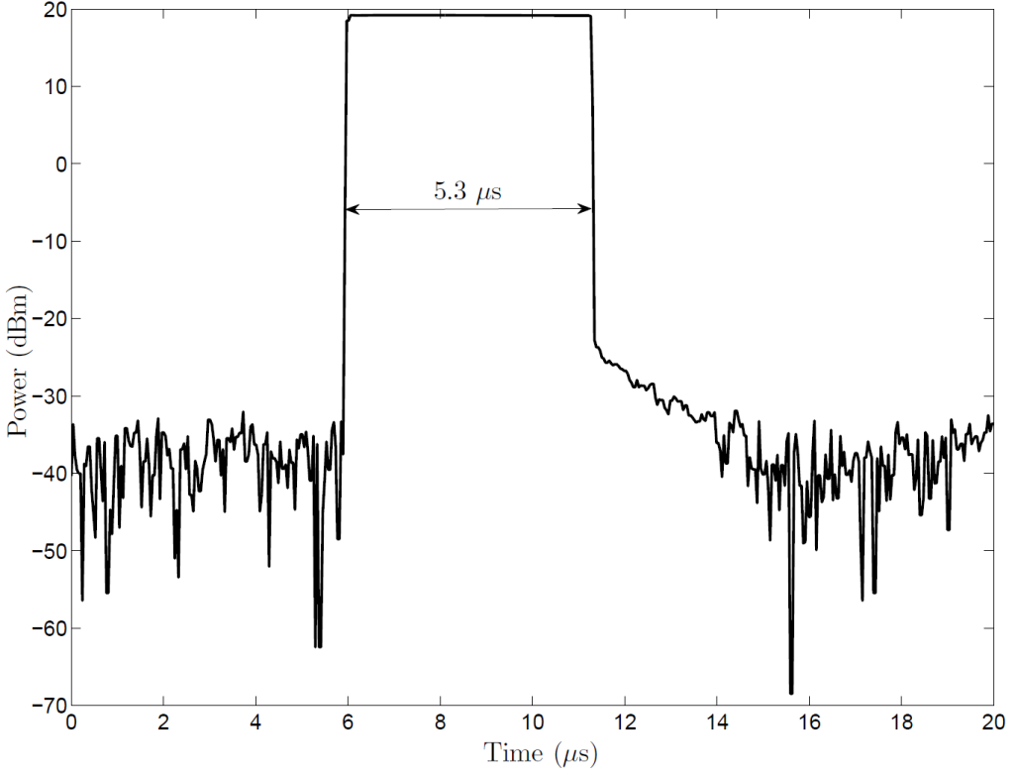
Microwaves Setup:
Microwave pulse measured using power meter.
Observe over 40 dB (10,000) suppression of power over pulse length.
In practice, tune pulse length and microwave power to achieve a pi pulse.
Microwave Spectroscopy
Adam West, 07/10/13

Slide 14
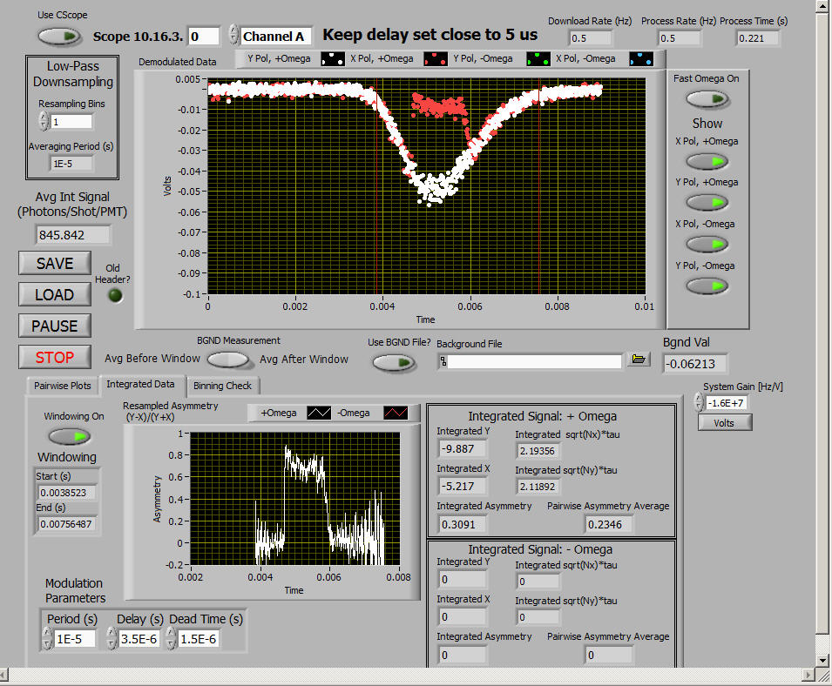
Initial Measurements:
Red/white traces show orthogonal probe polarisations.
Clear region where molecule population is depleted.
Depletion is polarisation dependent – clearly produces an asymmetry.
Microwave Spectroscopy
Adam West, 07/10/13

Slide 15
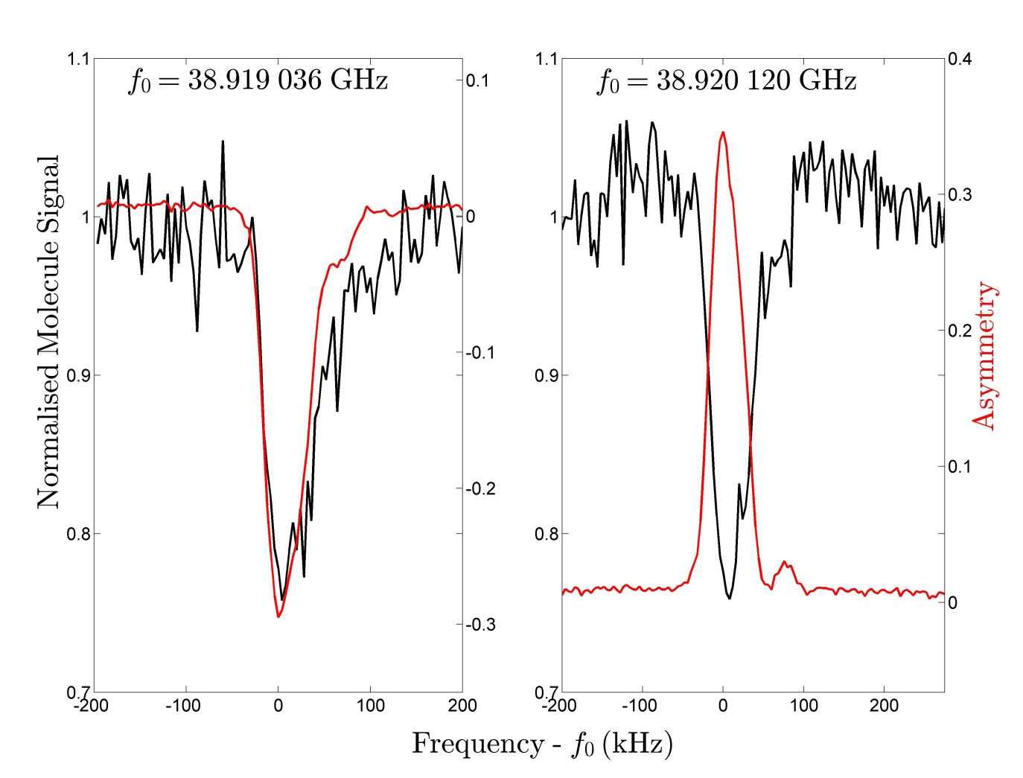
Initial Measurements:
Observe significant variation in molecule signal.
Using asymmetry cancels this variation giving greater signal-to-noise.
Evidence for reflected signal.
Resonant frequency found to within a few kHz.
Microwave Spectroscopy
Adam West, 07/10/13

Slide 16
Measured Lines:
Microwave Spectroscopy
Adam West, 07/10/13

Slide 17
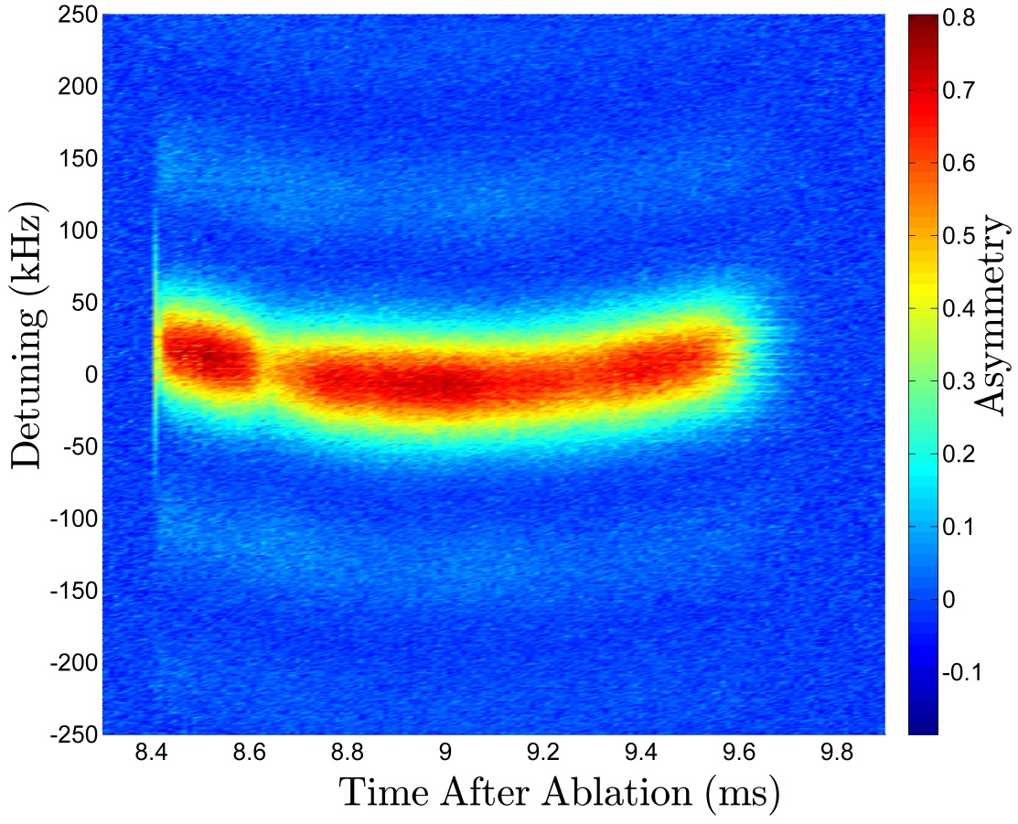
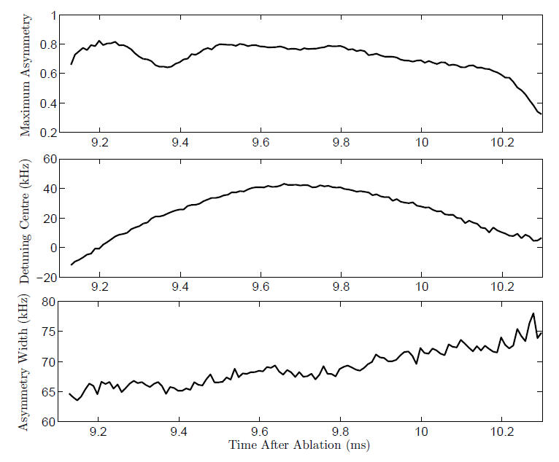
E-field Distribution:
Spatial resolution limited by:
Molecule movement during microwave pulse – 0.7 mm
Time for two probe polarisations – 1 mm
Velocity dispersion – 1 cm
Gaussian fits central feature well.
Sinc fits wings well.
Microwave Spectroscopy
Adam West, 07/10/13

Slide 18
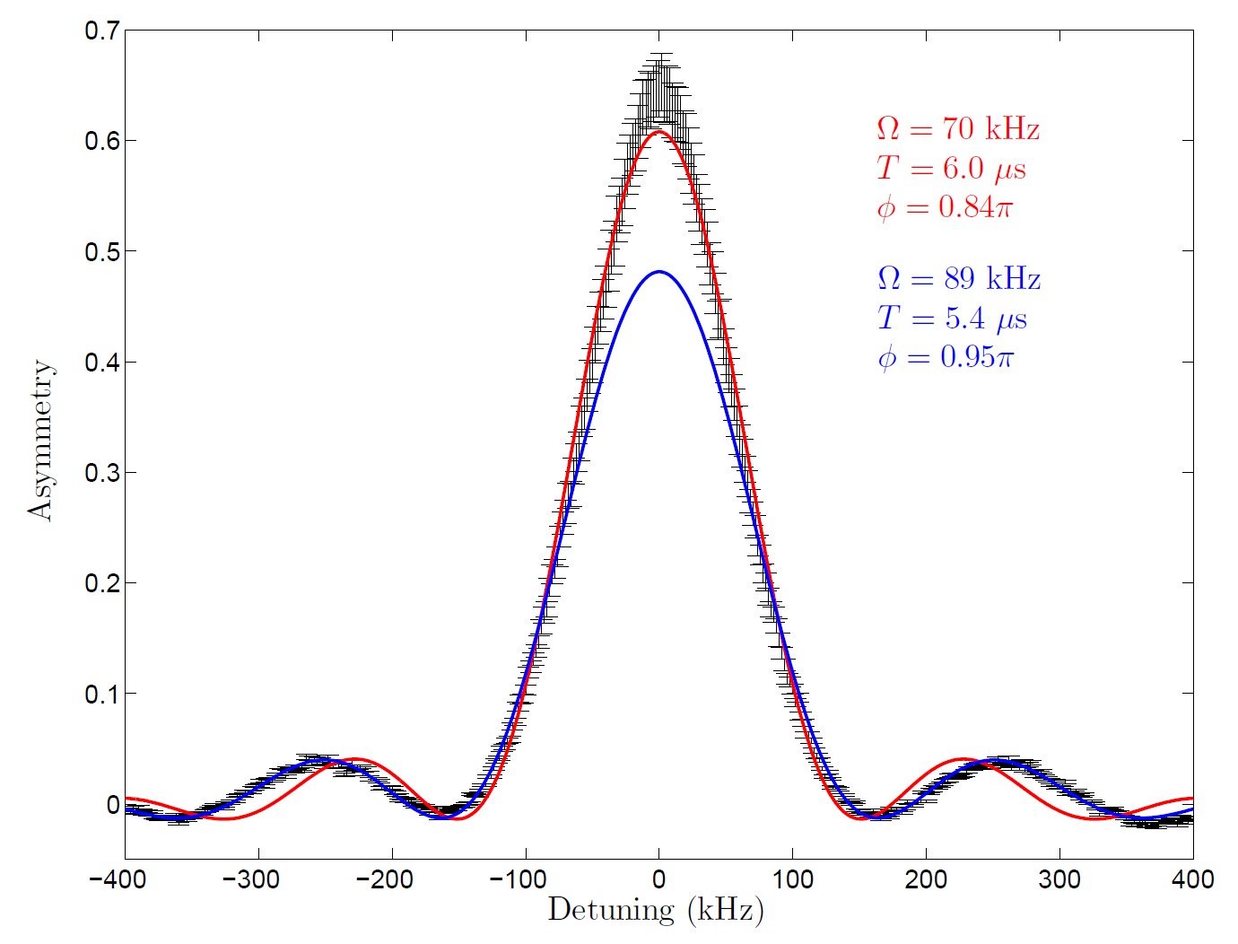
E-field Distribution:
Molecules are subject to effective transit-time broadening.
Uncertainty relation dictates a non-zero linewidth:
Using this treatment can derive population during Rabi flopping:
Weighted fit more accurate in wings.
Also provides more accurate value of pulse duration.
Spectra of Atoms and Molecules, Bernath
Atomic Physics, Budker et al.
Microwave Spectroscopy
Adam West, 07/10/13

Slide 19
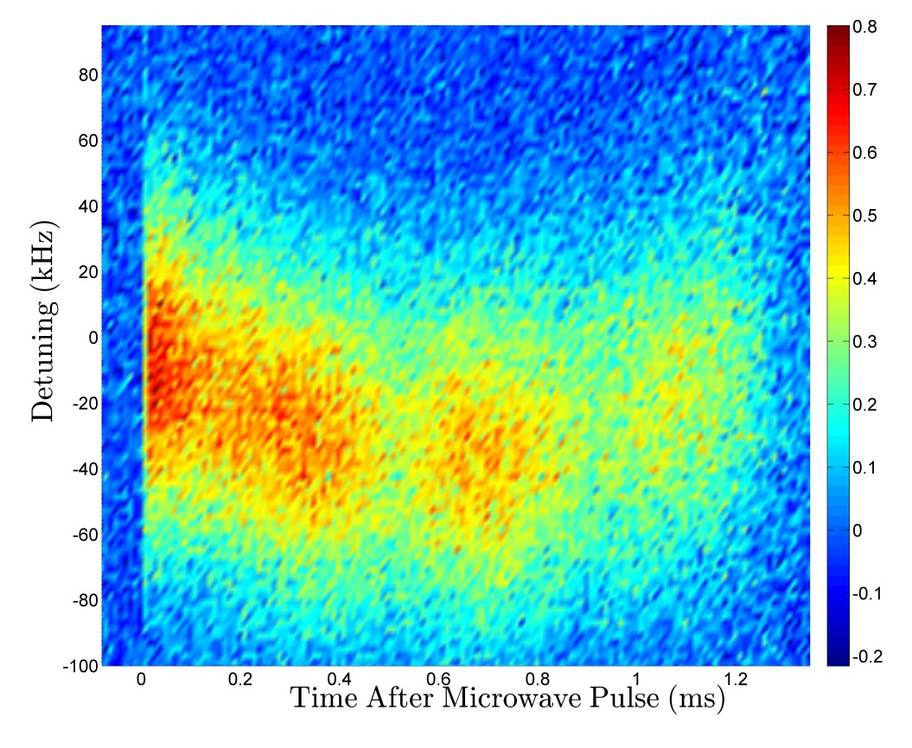
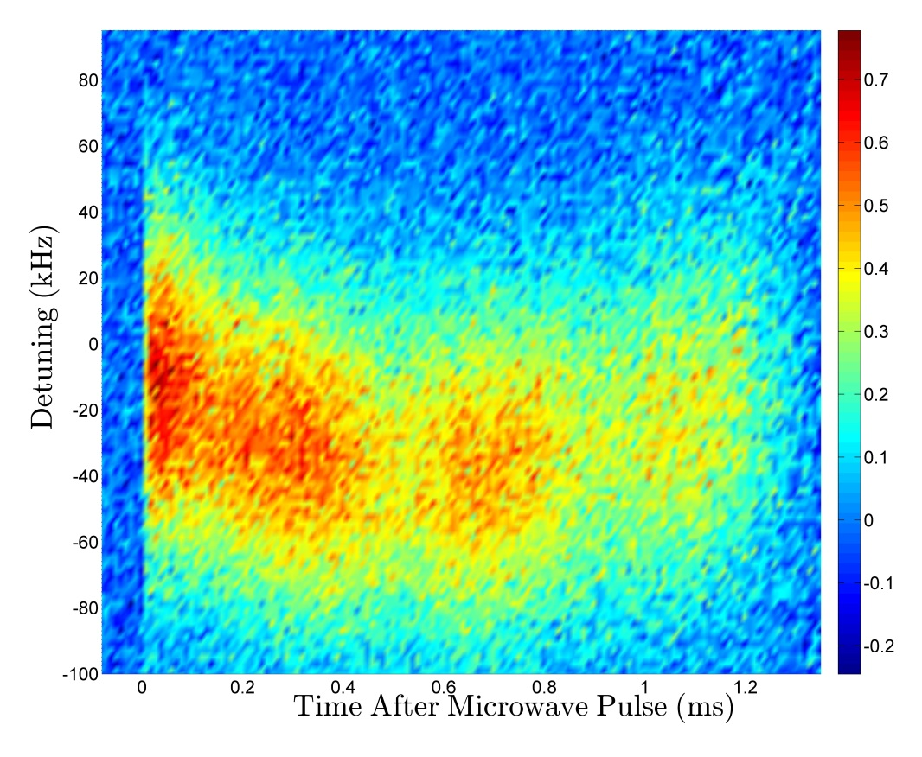
Non-reversing E-field:
Perform same procedure for E orientated along +z and along –z.
Switch E-field using leads; reversing the voltage also introduces a non-reversing voltage.
Microwave Spectroscopy
Adam West, 07/10/13

Slide 20
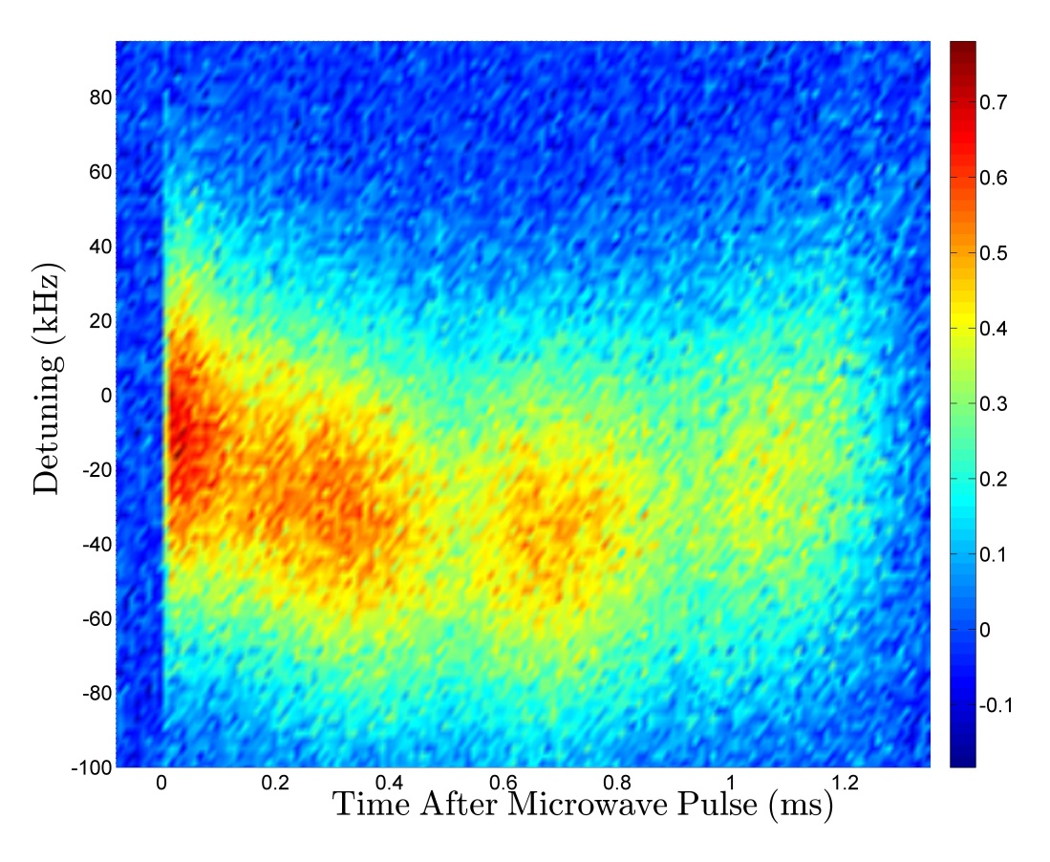
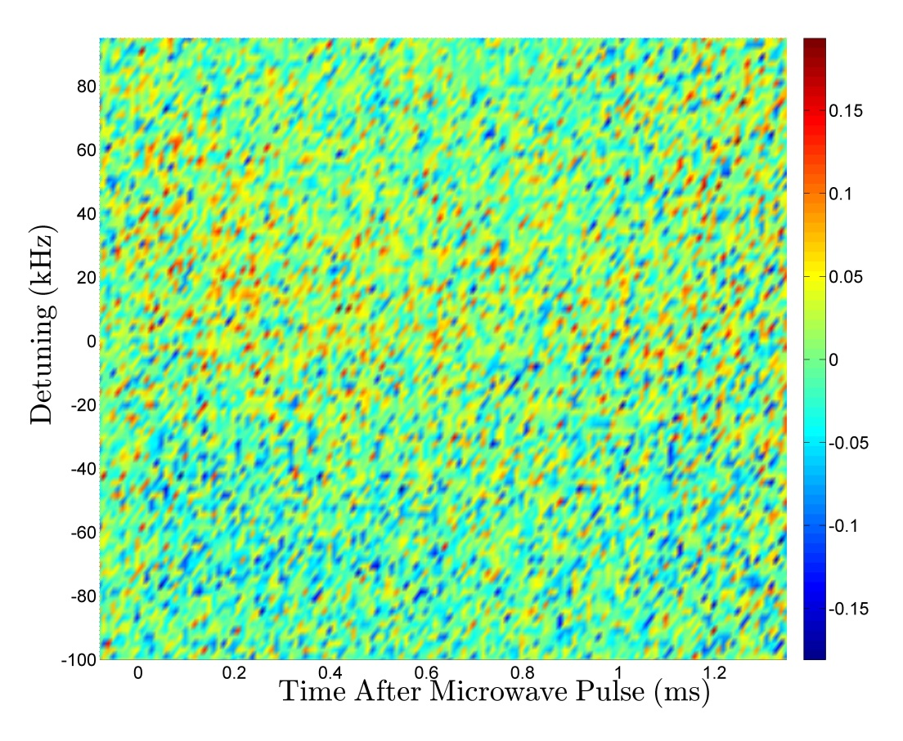
Non-reversing E-field:
Perform parity sum of the asymmetry over the E-field state.
+ parity sum shows the reversing component – very familiar!
– parity sum shows the non-reversing component – a general trend can be discerned.
Microwave Spectroscopy
Adam West, 07/10/13

Slide 21
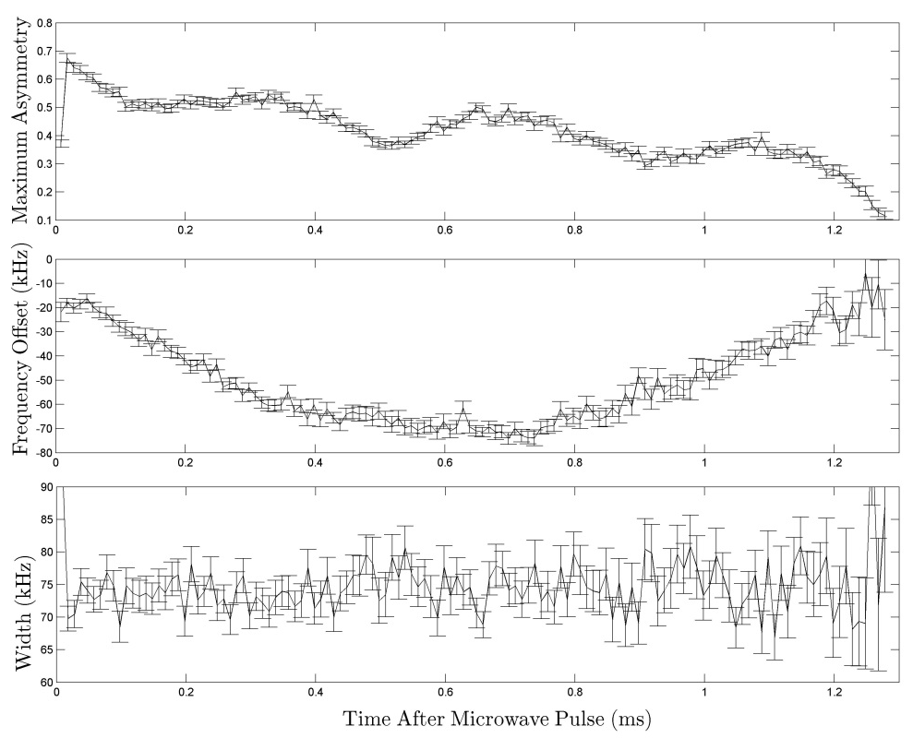
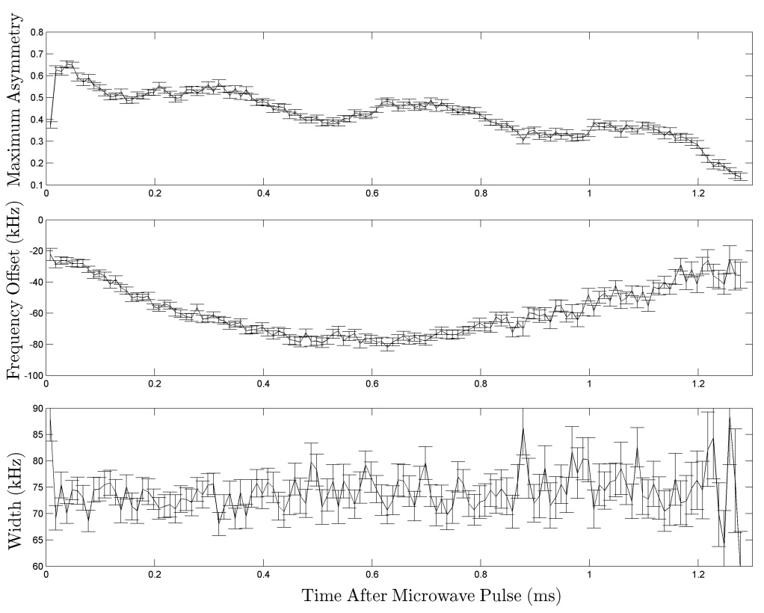
Non-reversing E-field:
It is more instructive to perform parity sums over the fitting parameters for the frequency spectrum.
In particular we want to see how the ‘frequency offset’ changes.
Recall the microwave transition resonance is Stark shifted by electric fields.
Microwave Spectroscopy
Adam West, 07/10/13

Slide 22
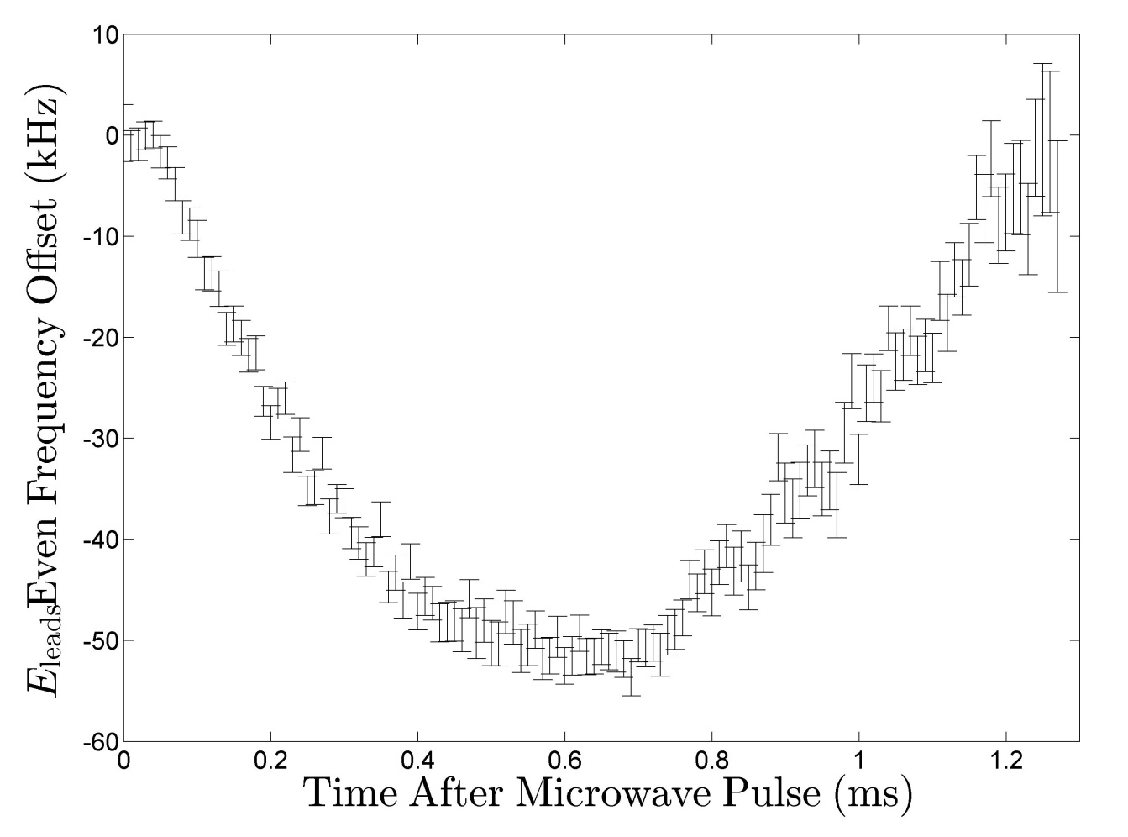
Non-reversing E-field:
The even parity sum reveals the reversing E-field.
This shows the overall spatial variation of our E-field.
Recall the spatial resolution is limited to about 5% in places.
We see a roughly 50 kHz shift.
This compares to 58 kHz from interferometery and corresponds to around 50 mV variation.
Other measurements have also measured the variation in the y direction.
Microwave Spectroscopy
Adam West, 07/10/13

Slide 23
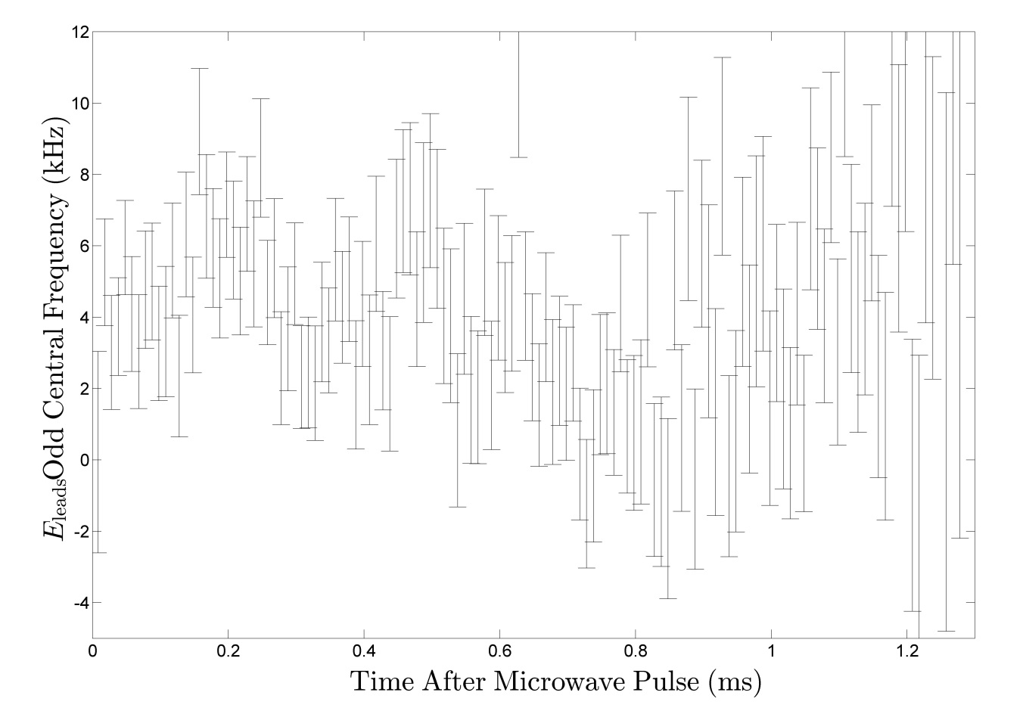
Non-reversing E-field:
The odd parity sum reveals the non-reversing E-field.
We observe a non-reversing field of around 4 mV – agrees well with Raman spectroscopy.
There is significant and reproducible spatial structure.
The variation is smeared out over around 1cm, but plate separation is 2.5 cm.
By using a longer microwave pulse we can achieve greater frequency resolution and thus better resolution of the spatial variation.
Microwave Spectroscopy
Adam West, 07/10/13

Slide 24
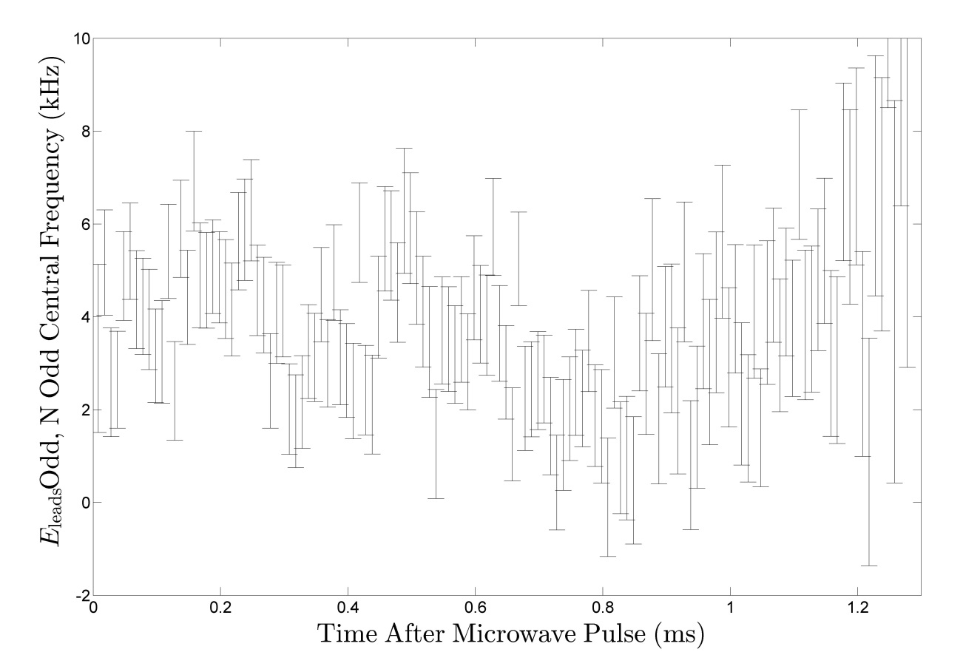
Non-reversing E-field:
We have also formed parity sums over the two omega doublets.
The odd sum displays almost an almost identical result (right).
The even sum is consistent with zero.
Microwave Spectroscopy
Adam West, 07/10/13

Slide 25
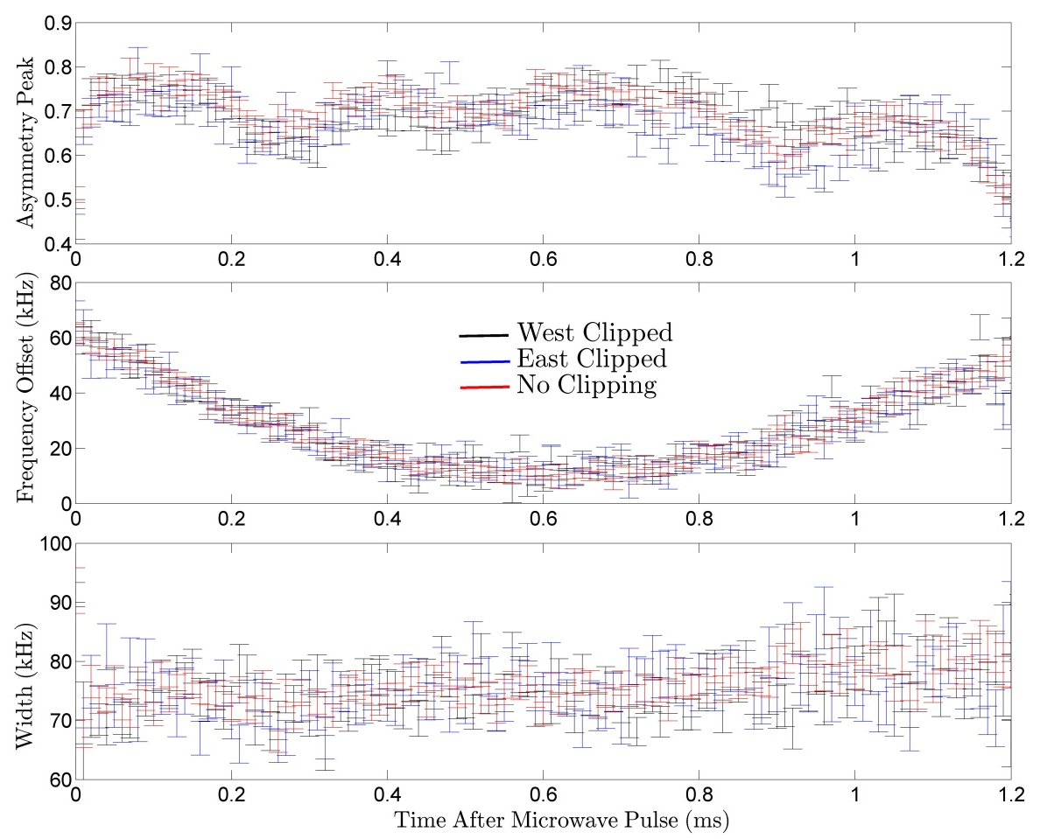
Non-reversing E-field:
Dependence of the non-reversing field on collimator position was also investigated.
These collimators move transverse to the molecular beam.
The collimators are outside the interaction region.
Just analysing the asymmetry map does not yield any obvious trends.
Again we must use parity sums to gain insight.
Microwave Spectroscopy
Adam West, 07/10/13

Slide 26
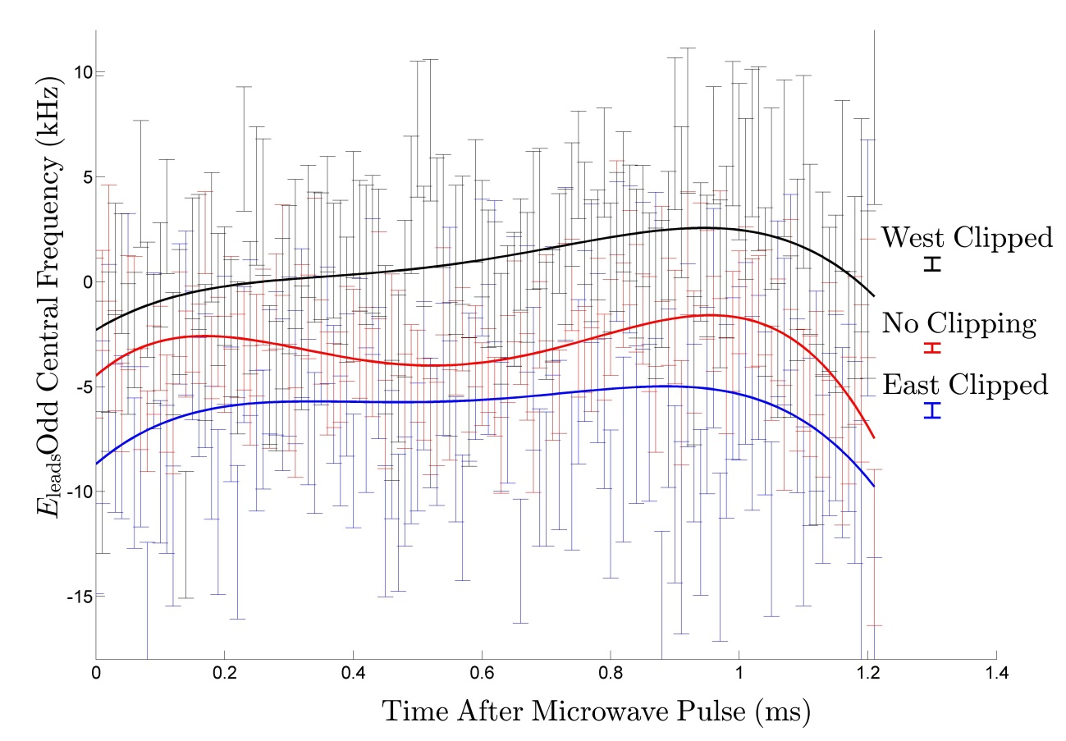
Non-reversing E-field:
We see reproducible structure in the non-reversing E-field.
We also see variation in the non-reversing field as the collimators are moved.
What is causing this?
E-field from collimator
Deflected ions
To investigate the latter, try varying the ion sweeper voltage.
Microwave Spectroscopy
Adam West, 07/10/13

Slide 27
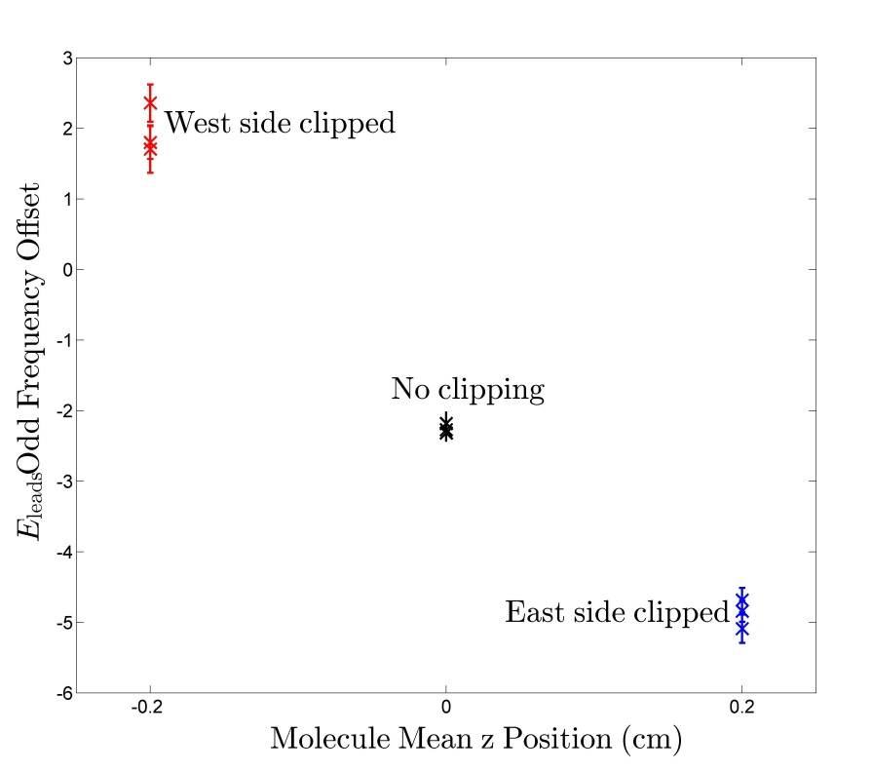
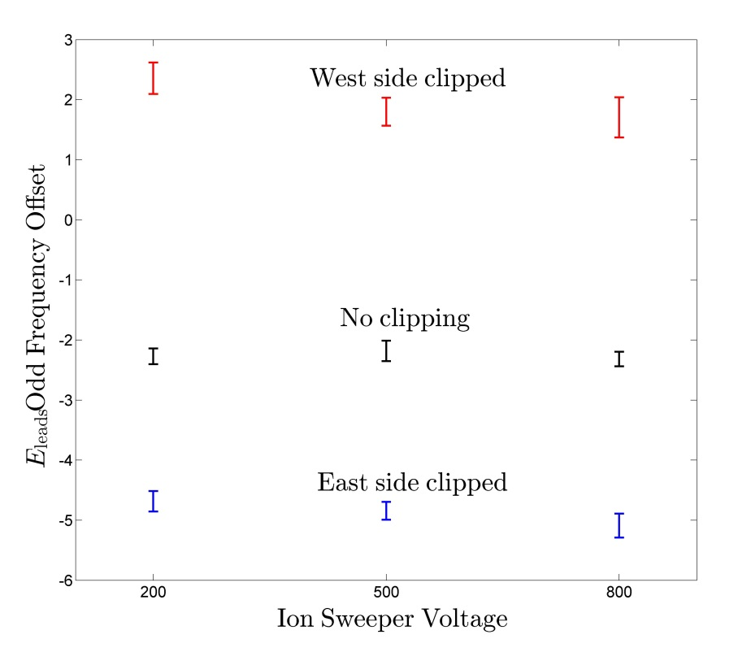
Non-reversing E-field:
Here we take mean values of the non-reversing E-field.
Again we see variation in the non-reversing field with collimator position.
It is dubious as to whether we see significant variation with ion sweeper voltage.
Microwave Spectroscopy
Adam West, 07/10/13

Slide 28
Non-reversing E-field:
Microwave spectroscopy
Raman spectroscopy
Observe very similar general trend.
Also get quantitative agreement.
Microwave Spectroscopy
Adam West, 07/10/13

Slide 29
Mysteries/Future Work:
Changes in spatial variation of asymmetry.
Variation of non-reversing E-field with collimator position.
Ground collimators
Use collimators as sweeper
Install electron multiplier
Quantitative comparison with Raman spectroscopy
Perform measurements with pulsed optical pumping
Achieve better spatial resolution
Turn more knobs
Microwave Spectroscopy
Adam West, 07/10/13

