Slide 1




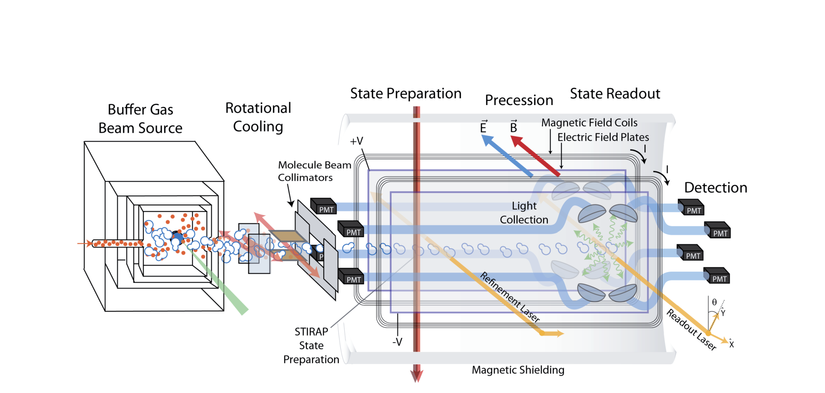
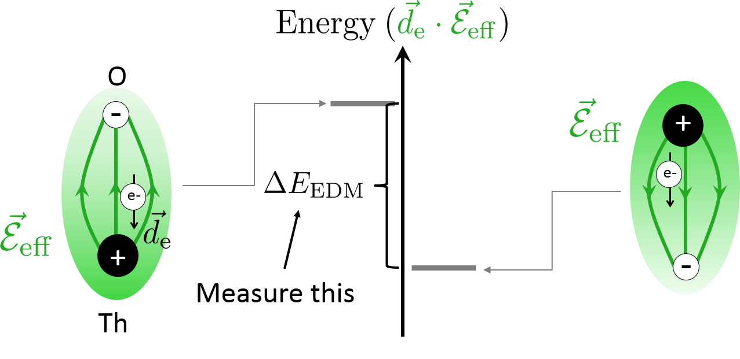
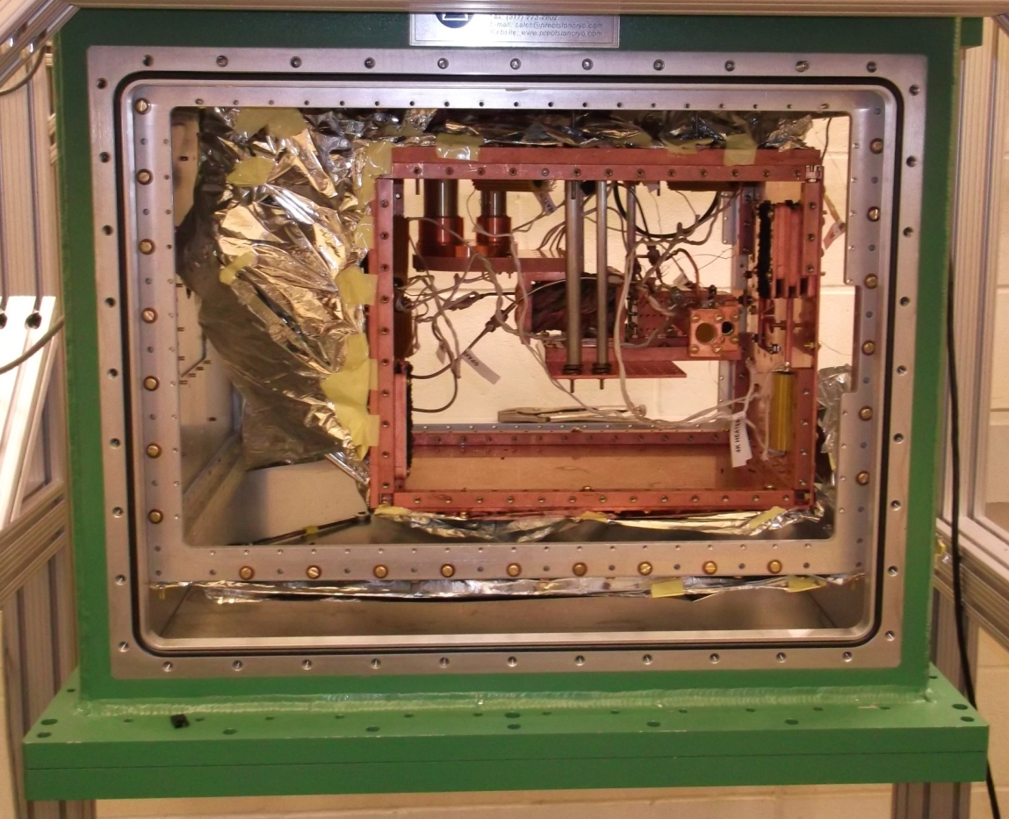
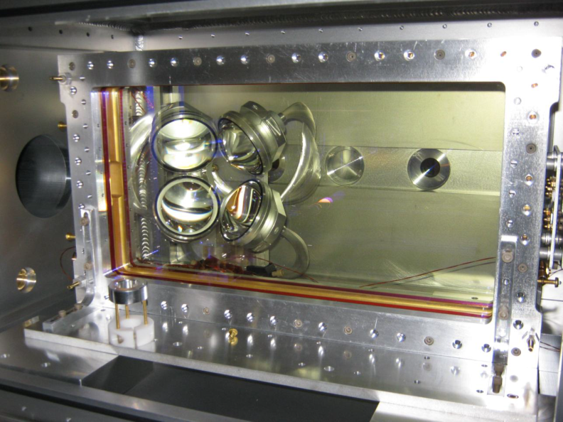
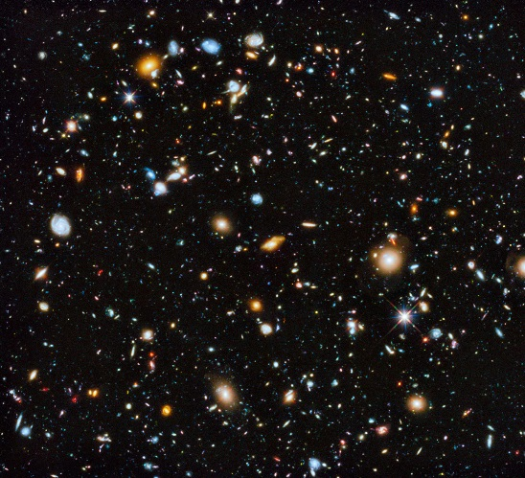
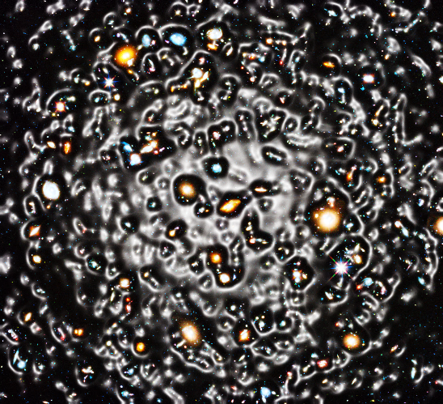
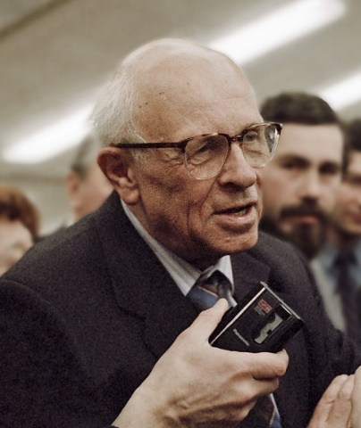

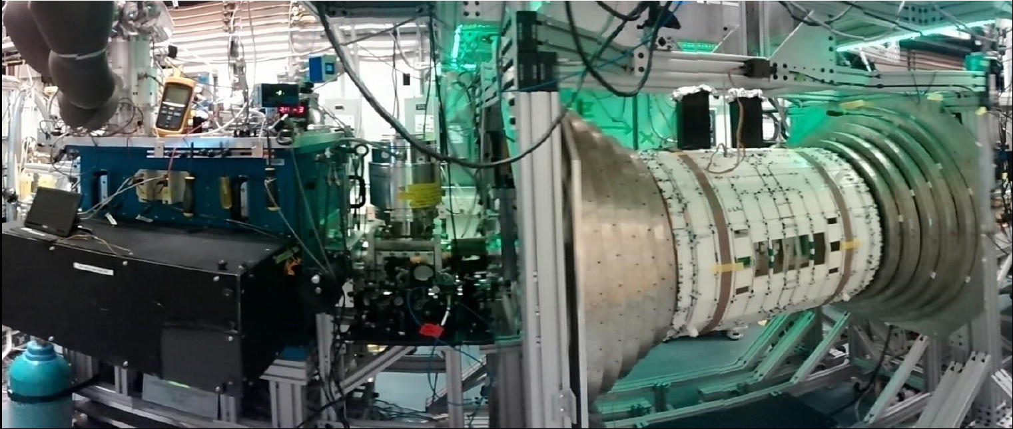
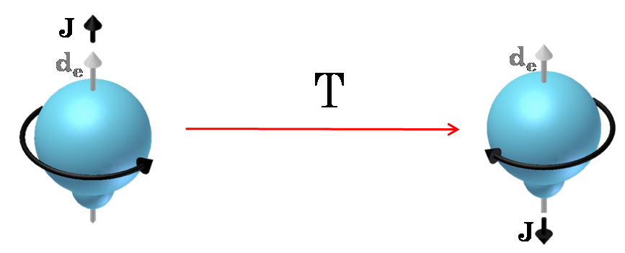
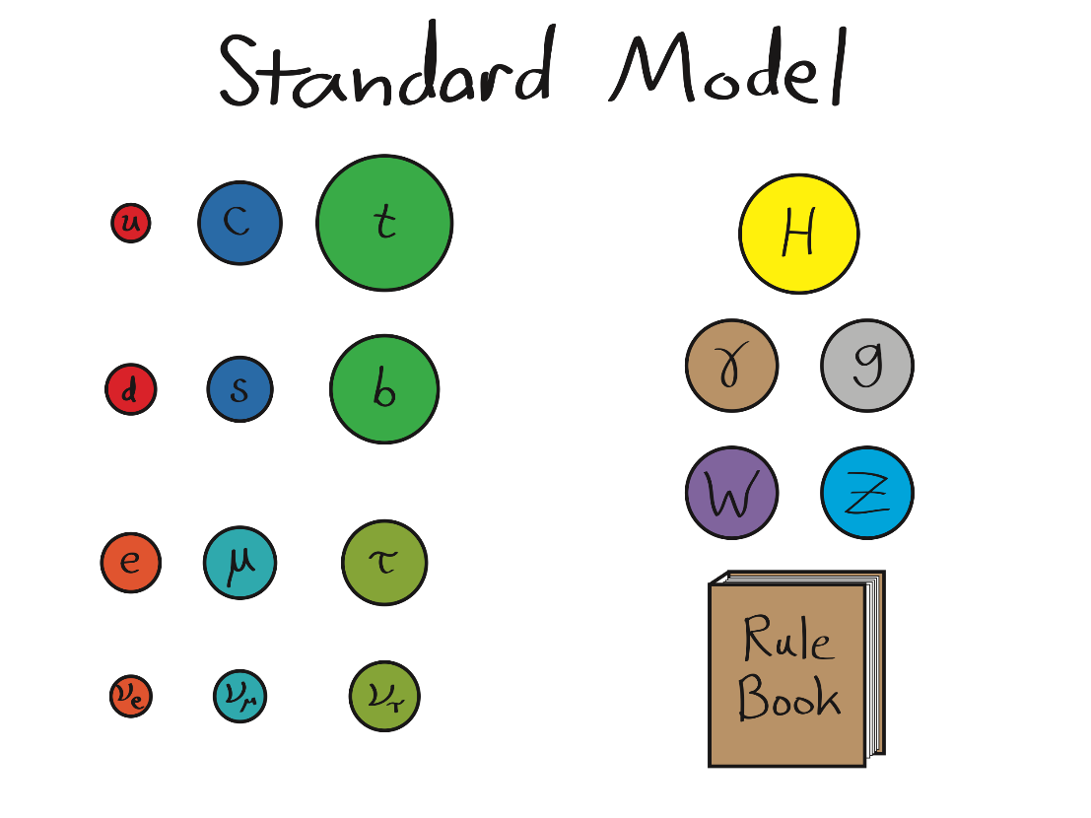
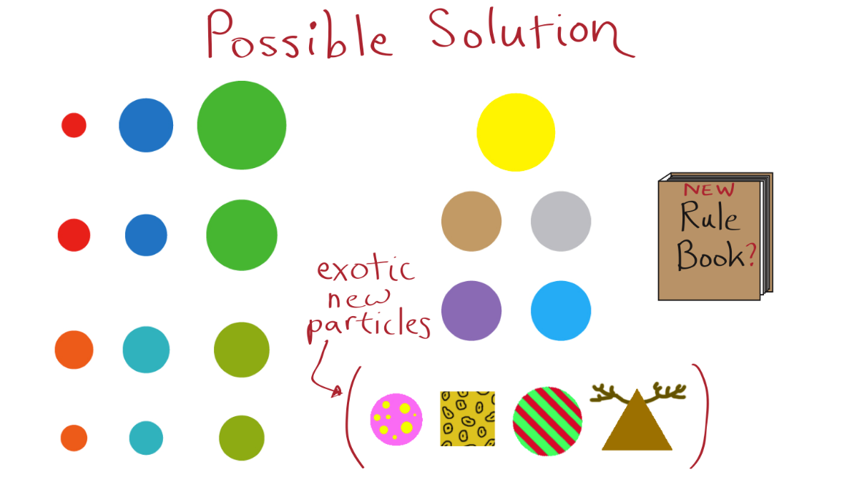
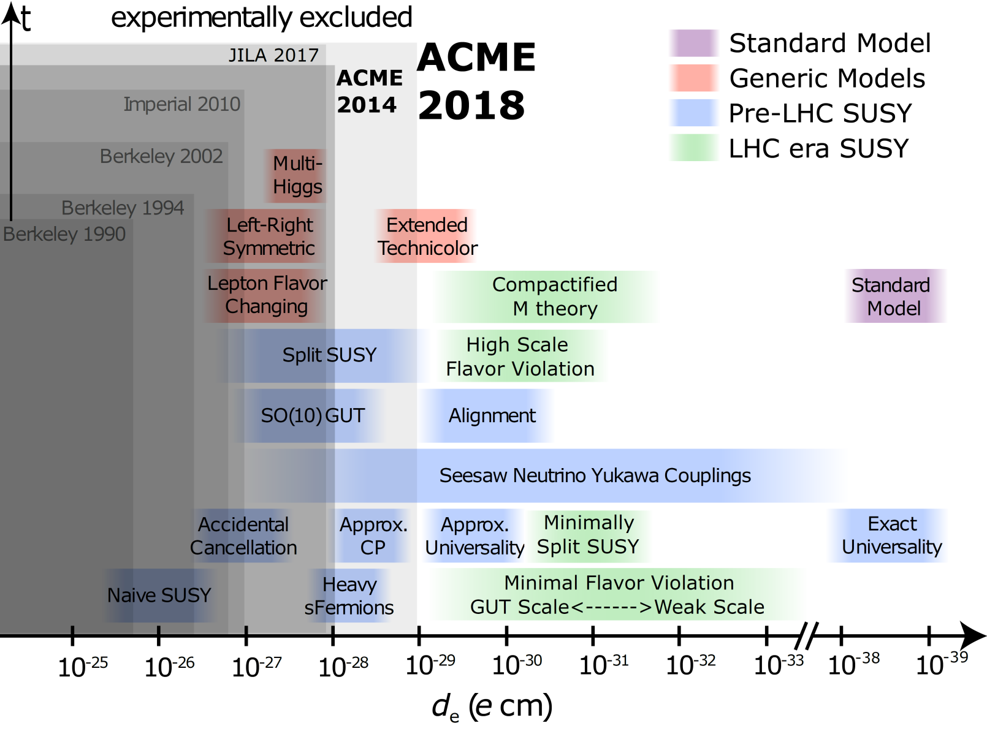
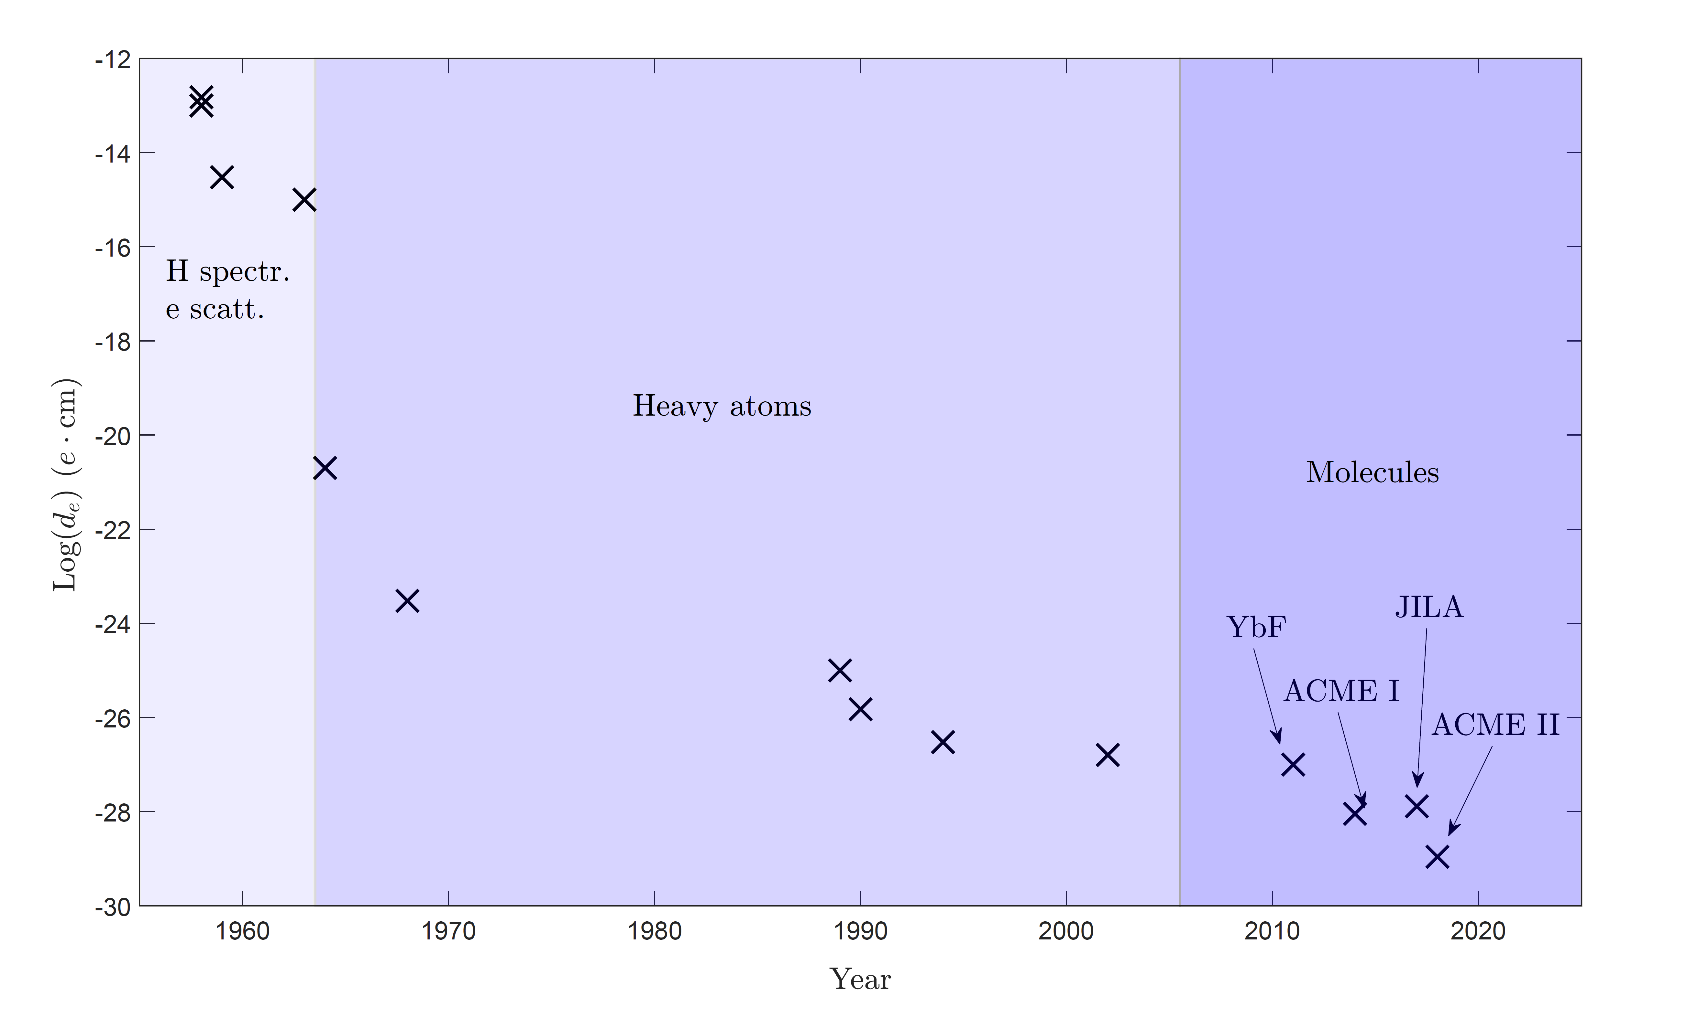

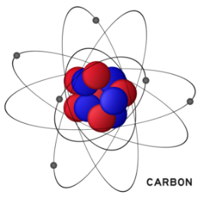
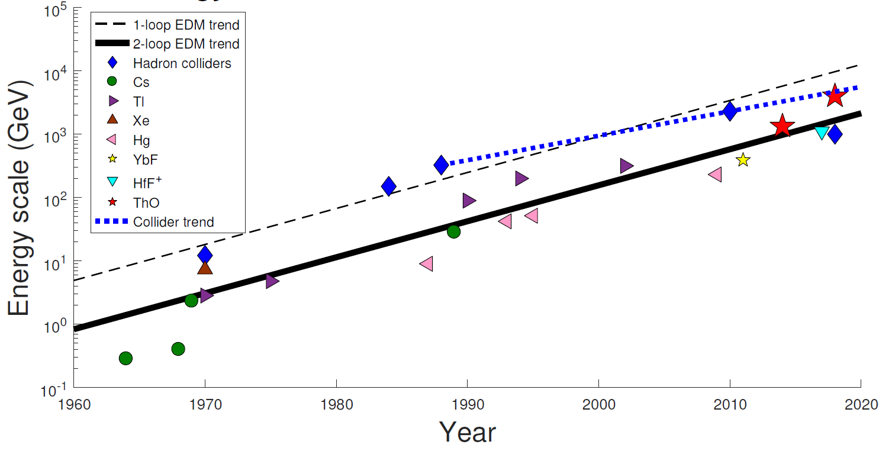
The Symmetric Electron and the Asymmetric Universe
ACME II Collaboration: Vitaly Andreev, Daniel G. Ang, David DeMille, John M. Doyle, Gerald Gabrielse, Jonathan Haefner,
Nicholas R. Hutzler, Zack Lasner, Cole Meisenhelder, Brendon R. O’Leary, Cristian D. Panda, Adam D. West, Elizabeth P. West,* Xing Wu
Abstract: One of the most striking unanswered questions in cosmology is why the aftermath of the big bang left us a universe composed predominantly of matter. Our current understanding of nature’s laws suggests that the big bang should have produced matter and antimatter particles in virtually equal numbers. These would have annihilated each other, leaving a universe of pure energy incapable of sustaining life.
The precise nature of the physical processes that generated the existing matter-antimatter asymmetry remains obscure; however, in 1967, Andrei Sakharov described some general conditions any such process must satisfy. Sakharov showed that any mechanism that breaks the symmetry between matter and antimatter must also break certain other symmetries, including the symmetry between positive and negative charges and the time-reversal symmetry of physical laws. These broken symmetries should produce measurable effects that could elucidate the mechanisms that gave rise to our matter universe.
I will describe a physics experiment at Harvard that investigates one such effect by measuring the spherical symmetry of the electron with unprecedented precision [1]. The results of this experiment have set stringent limits on many theories attempting to explain the matter-antimatter asymmetry, deepening the mystery surrounding the early moments of creation.
Electron EDM Search: Motivation & History
ACME Experiment: Apparatus & Method
Mystery of the Matter-Antimatter Asymmetry
(G)
(H)
(I)
(J)
(A)
(B)
(C)
γ
511 keV
time
ThO Beam Source
e⁻_{R}
e⁺_{L}
Electron EDM testbed: polar molecular radical thorium monoxide (ThO)
  Strong (80 GV/cm) internal electric field
Different energy shifts for electric dipole moment aligned vs. anti-aligned with internal E-field (Fig. G)
Measure energy shifts using Ramsey spin-precession experiment with a cold molecular beam (Norman Ramsey 1916 – 2011, Nobel Prize 1989)
Apparatus (Fig. I,K; Ref. [1 – 3]):
  Cryogenic buffer gas beam of ThO (Fig. H)
  Magnetically shielded interaction region with uniform electric and magnetic fields (Fig. J)
  State preparation and readout lasers and photon detectors
Total budget < annual electricity budget of Large Hadron Collider (LHC)
(K)
Electric Field Plates &
Light Collection Lenses
Whale image credit: Shirt.Woot
γ
511 keV
Image credit:RIA Novosti, CC-BY-SA 3.0
Matter
Antimatter
Andrei Sakharov
Electron/anti-electron annihilation
Matter & antimatter are identical except for opposite charge
Universe is made of matter (Fig. A), rather than antimatter or an equal mixture of both – why?
Baryogenesis hypothesis: For every billion matter-antimatter partners produced in the big bang, one matter particle survived annihilation – how?
Sakharov conditions (Fig. B, 1967): Matter-favoring mechanism must violate charge reversal × parity (reflection) = CP symmetry (Fig. C)
3 m
Connection to Electron Asymmetry & Search for the Electric Dipole Moment
Whole Apparatus
(D)
Incomplete!
(E)
Hinds – Electron EDM Experiment
T-reversal
Results & Interpretation
(rewind)
Theory Exclusion Plot
Constraints on Baryogenesis in Minimal Supersymmetry
ACME II (2018) [1]:
≈4×10⁻¹⁷ of classical electron radius (Fig. L)
Severely constrains many classes of theories beyond the Standard Model (Fig. M) and weak-force-scale baryogenesis (Fig. N)
2-loop level energy reach exceeds that of the LHC for CP-violating new physics (Fig. O)
(M)
(N)
?
Ref. [4]
Electron with Spin and EDM Under Time Reversal
Old (Thallium)
Not enough CP violation in the Standard Model of particle physics (SM) to produce necessary part-per-billion matter excess
Need new types of particles and new interactions (Fig. D) to account for existence of the universe!
CPT → CP ≡ T: Charge × parity × time-reversal symmetry is conserved, so CP violation implies T-violation
A charge asymmetry (EDM = electric dipole moment) of a fundamental particle would violate T ≡ CP (Fig. E)
  Signature of CP-violating new physics!
  Evidence for baryogenesis
  Electron EDM → Standard Model background-free
  No EDM yet observed (Fig. F)
(F)
History of Electron EDM Upper Bounds
Wino Phase
Bino Phase
Excluded
Region
ACME II x100
ACME II
(L)
Wino Mass (GeV)
Bino Mass (GeV)
Electron EDM Symmetry Comparison
Conclusions & Future
Energy Reach of EDM and Collider Experiments
(O)
ACME III: Plans to improve signal-to-noise by 100× → sensitive to EDM at 10⁻³⁰ e cm
Other electron EDM searches competing with ACME: JILA, Imperial, EDM³, PolyEDM…
Complementary nucleon/diamagnetic EDM searches
New fundamental physics awaits discovery: Revealing its nature requires a multi-pronged approach including colliders, astrophysical observation, and precision measurements like ACME.
ACME
Supersymmetry
e⁻
This poster
-44
Standard Model
Carbon atom image credit: Toppr.com
*Presenter contact: epwest@physics.ucla.edu
[4] Y. Li, S. Profumo, and M. Ramsey-Musolf, Phys. Lett. B 673, 95 (2009), https://doi.org/10.1016/j.physletb.2009.02.004.
Further reading:
[6] N. Fortson, P. Sandars, and S. Barr, Physics Today 56, 33 (2003), https://doi.org/10.1063/1.1595052.
[7] Y. Nakai and M. Reece, Physics Today Commentary & Reviews, (Nov. 2018), https://doi.org/DOI:10.1063/PT.6.3.20181114a.
[8] A. A. Petrov, American Scientist 107, 94 (2019), https://doi.org/DOI:10.1511/2019.107.2.94.
[9] I. B. Khriplovich, S. Lamoreaux, CP Violation Without Strangeness (Springer-Verlag, Berlin, 1997).
References:
[1] ACME Collaboration et al., Nature 562, 355 (2018), https://doi.org/10.1038/s41586-018-0599-8.
[2] ACME Collaboration et al., Science 343, 33 (2014), https://doi.org/10.1126/science.1248213.
[3] ACME Collaboration et al., New J. Phys. 19, 073029 (2017), https://doi.org/10.1088/1367-2630/aa708e.

