Slide 1
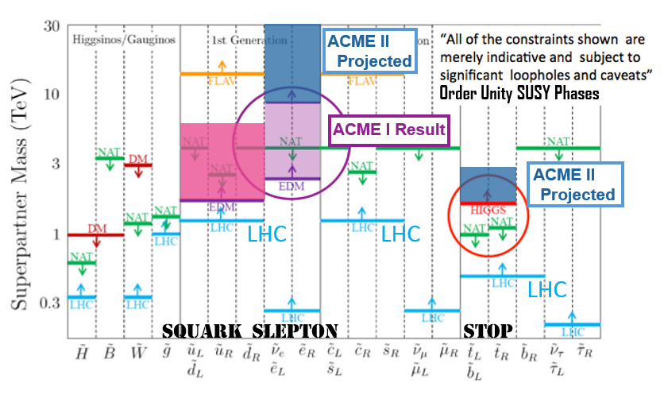
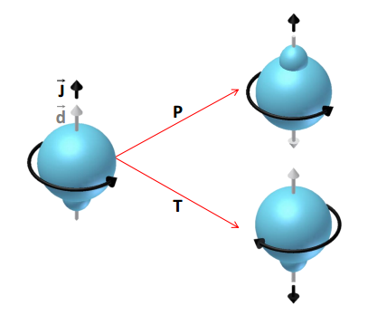
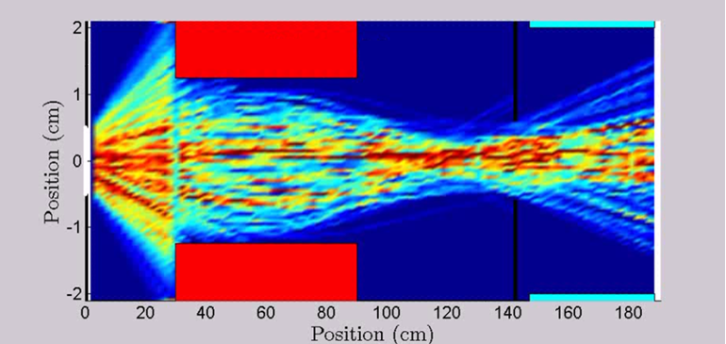
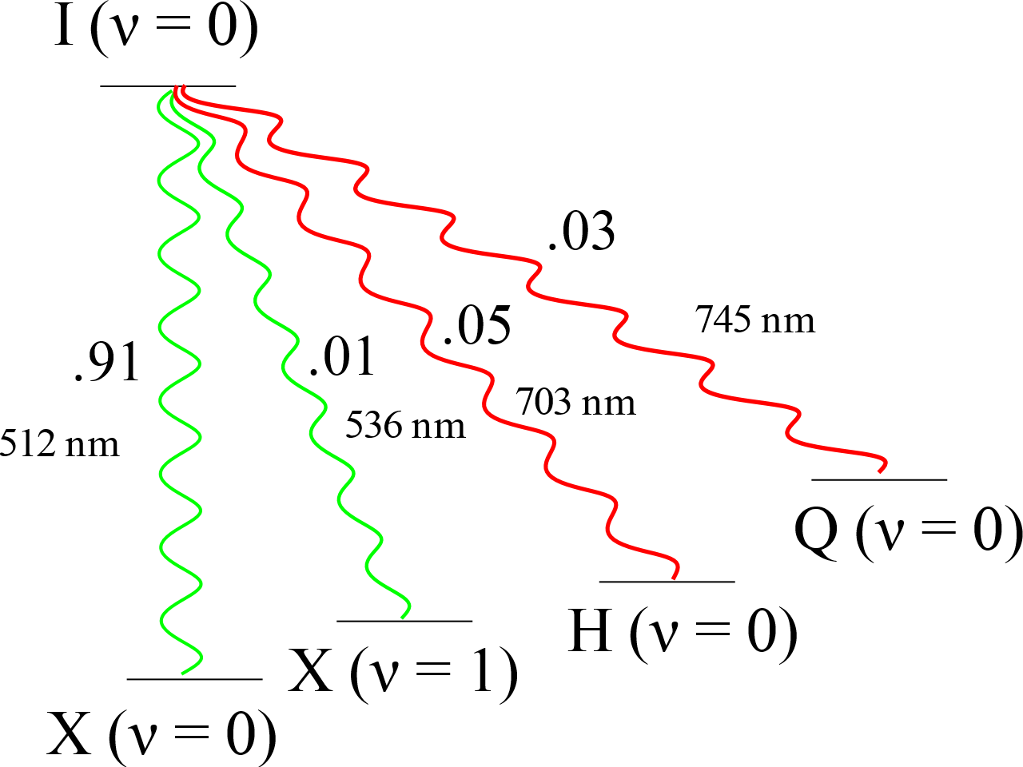
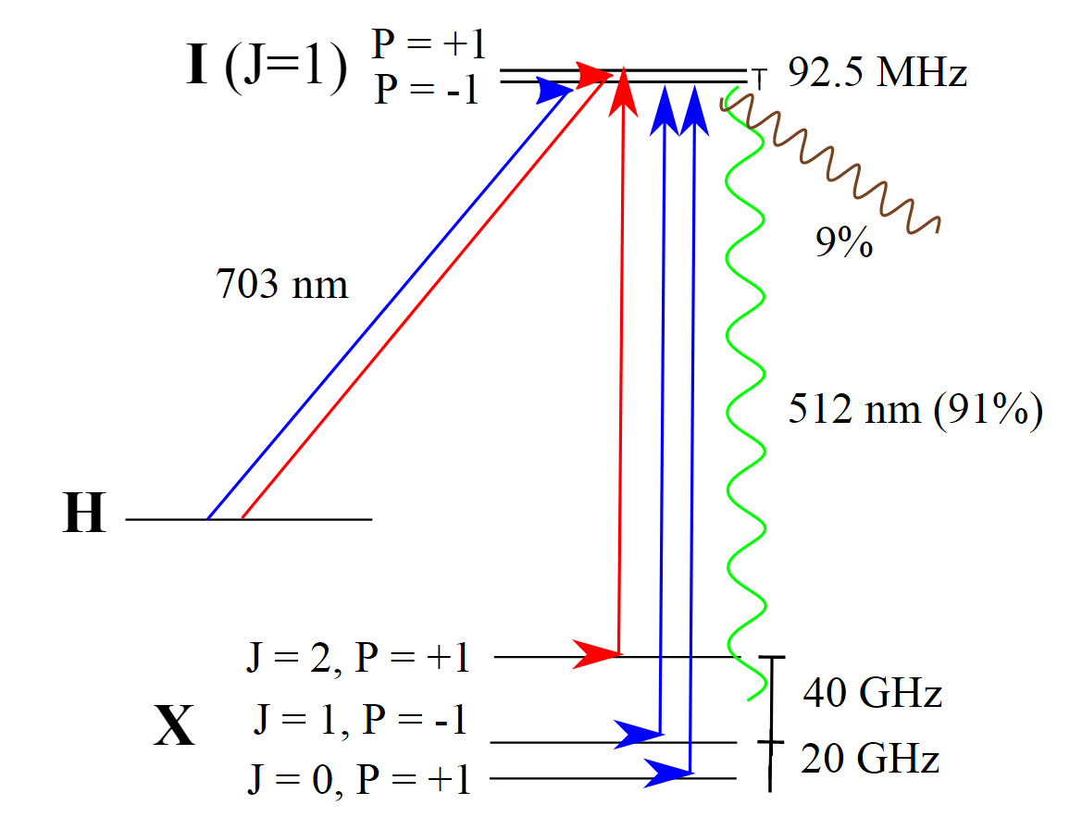
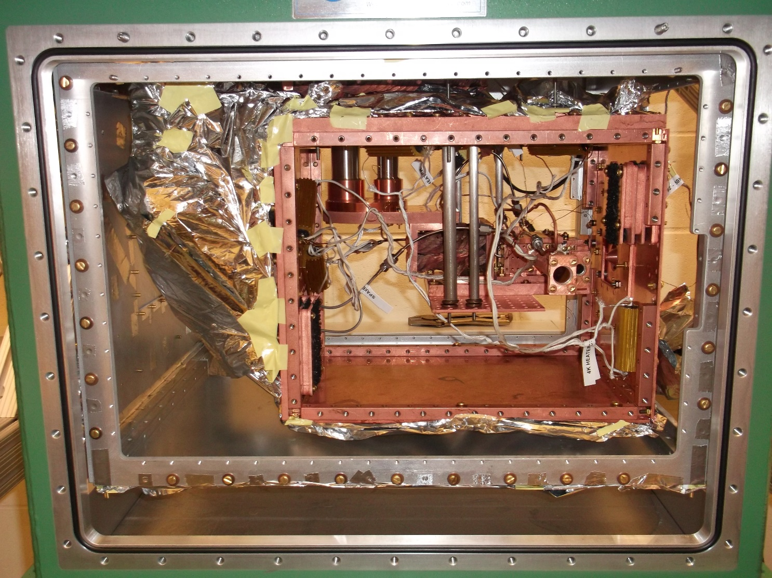
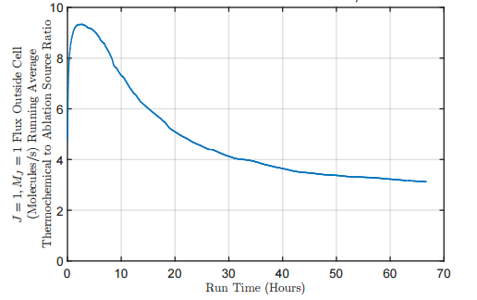
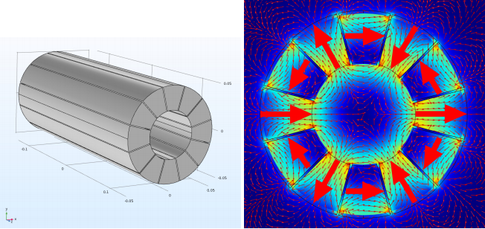
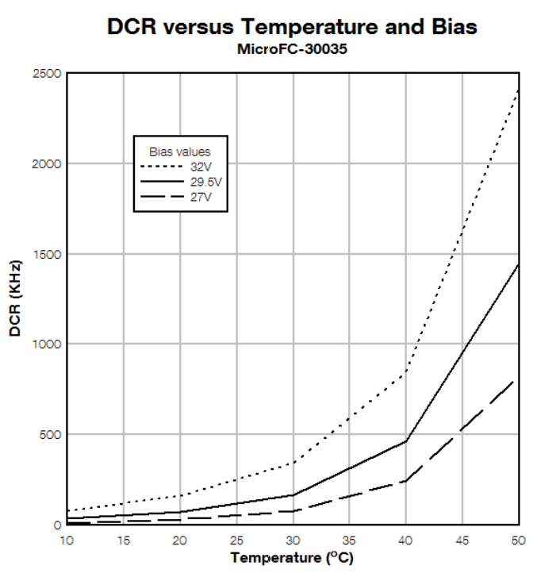
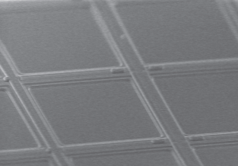
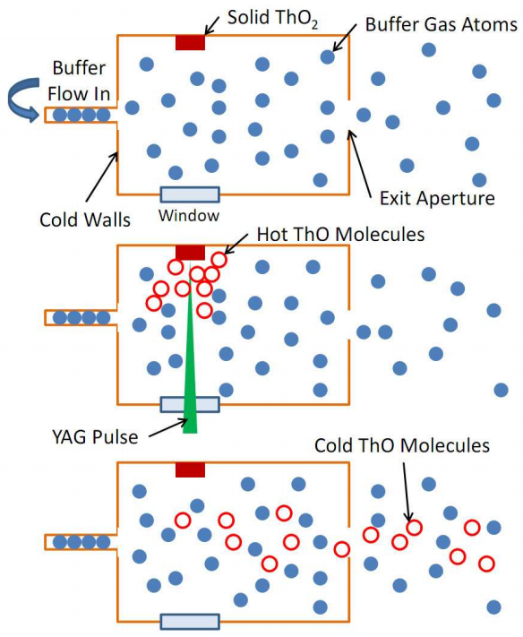
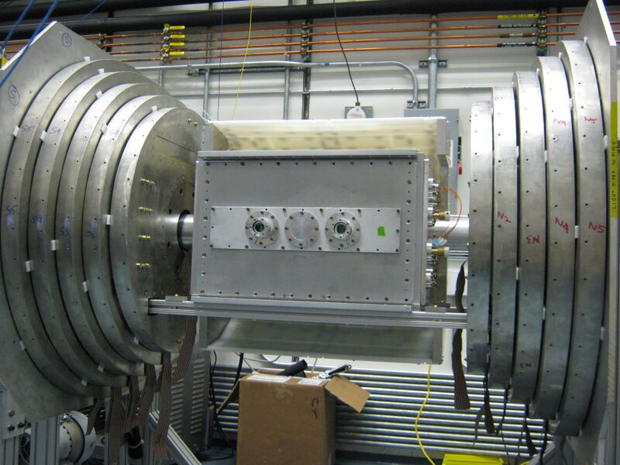
Future Improvements to the ACME Electric Dipole Moment Experiment
ACME Collaboration:
Daniel Ang¹, Jacob Baron¹, David DeMille², John Doyle¹, Gerald Gabrielse¹, Jonathan Haefner¹, Nicholas Hutzler¹, Zack Lasner², Cole Meisenhelder¹, Cristian Panda¹, Adam West², Elizabeth West¹, Xing Wu^{1,2}
Affiliation: ¹Harvard University, ²Yale University
Abstract
In 2014, the ACME collaboration set a new upper bound on the electric dipole moment of the electron using a beam of cold ThO at the 10⁻²⁸ e cm level. We discuss studies into further improvements to the ACME experiment, with the eventual goal of sensitivity at the 10⁻³⁰ e cm level, a factor of 100 smaller than the first-generation experiment. Methods focus primarily on improving statistics, and include the use of an electrostatic or magnetic molecular beam focusing lens, optical cycling to improve detection, and the use of a new thermochemical beam source to increase molecular flux.
Motivation
Focusing molecule beam
Optical cycling
$$H_{d}=−{\vec{d}}_{e}⋅\vec{ℇ}$$
Permanent EDMs violate time reversal (T) and parity (P) symmetry.
Many theories beyond the Standard Model predict T-violation and associated EDMs at current experimental precision
A number of parameters set the uncertainty in an eEDM measurement, most intrinsic to the atom or molecule. What we now work to optimize is the molecule detection number, which contributes to the uncertainty as:
Motivation
Motivation
Molecules exiting the beam source have a high divergence – most miss the interaction region, failing to enter the gap between field plates
To counter this we can focus the molecules, potentially using an electric or magnetic lens
Currently, only detect fluorescence from ~5% of all available molecules. One future goal is to become molecule shot-noise limited
This may be achievable through optical cycling: optically pumping the precessed molecules on an approximately closed transition to multiply the number of emitted photons
In principle, optical cycling can increase the amount of signal by a factor of 20
We expect a gain in signal of a factor of ~10 without a large number of repump lasers
Electrostatic lens
Could focus ThO with electrostatic potentials
Control and minimize possible x-ray production (see [6])
Could expect factor of ~2 in signal (molecular flux)
Experimental Scheme
Franck-Condon factors and branching to other states limit the number of photons that can be extracted before molecule falls into a dark state
$I−X$ transition (512 nm) has a branching ratio of ~91% ([5])
Without repumps, can cycle ~10 photons
Preliminary tests show that commercially available diode laser systems have sufficient power to saturate the cycling molecular transition.
A permanent electric dipole of a fundamental particle violates both T- and P-symmetry
LHC, ACME, and naturalness bounds on superpartner masses (see [8])
$$δd_{e}\text{∝}\frac{1}{\sqrt{N}}$$
Simulation of molecule focusing with electrostatic lens. Red is lens, black is collimator
Thermochemical beam source
Magnetic lens
Alternatively, could focus by acting on magnetic dipole
Focus in a metastable state with high magnetic moment, since ground and EDM-sensitive states both have very small magnetic moments
Permanent-magnet Halbach array for hexapole configuration is commercially available
Expect up to a factor of ~5 in signal
Branching ratios of 𝐼(𝜈=0) to other states, based on [5]. Electronic only.
Schematic for optical cycling, assuming no repump lasers.
Prospective hexapole lens and associated magnetic field
Silicon Photomultipliers
Comparison of thermochemical vs. ablation signal over time, see [3]
Improve detected molecule solid angle
Could replace PMTs for more efficient fluorescence detection at 512 nm
PMTS ~25% efficient. SiPMs nearly 50%, giving factor of ~2 in signal
Large dark current exponentially suppressed at low temperatures
Expect operation at -20 C suppresses dark current well below fluorescence signal
Th+ThO₂
Exchange ablation source for a thermochemical beam source
Uses heat from a high-power laser to drive a chemical reaction to create ThO
Preliminary tests give a factor of ~6 in signal compared to current source.
Targets degrade quickly relative to ablation source
Investigate designs for fast and convenient target replacement, such as introducing an airlock, in order to increase the amount of time spent in the ideal regime.
We have demonstrated cancellation of ambient magnetic fields using passive field coils
Removing some shielding would allow interaction region to move closer to source
Increases usable solid angle slightly, as well as simplicity of apparatus
SiPM surface microcell structure [7]
SiPM dark count rate as a function of temperature [7]
Continuum (ionized molecule)
50 W “long pulse” fiber laser
State-selective ion detection
$\sim$15 W time-averaged power
Space needed with shielding
As an alternative to fluorescence detection, we are investigating a scheme that uses state-selective ionization in order to measure the spin components of the precession phase with much higher efficiency. This is still in the early development stage, but this would involve selectively promoting the two detection quadratures of the spin-aligned state to a highly excited state, then exciting that state to the continuum and detecting the resultant ions.
See [3] for further detail
Space needed without shielding
U
Ablation beam source optimization
Beam velocity measurement
Higher molecule yield feasible using new beam source with greater cooling power
Will test higher repetition rate for laser ablation, multiple simultaneous ablation spots
Optimizations of the buffer gas beam cell via improved cell geometry for improved beam flow dynamics
Airlock designs could be implemented for ablation source to increase duty cycle
Currently measure velocity averaged over ~1 minute
Fluctuations in beam velocity introduce fluctuations in precession time, which in turn introduce noise in phase which scales as shown
Can suppress error by running at very low magnetic fields
Better to be able to run at large magnetic fields to probe a broad class of systematic errors
Potential velocity fluctuation corrections include
measuring the velocities of the Th atoms produced alongside the ThO in ablation
promoting some ThO molecules to states with high magnetic moment to amplify measured precession fluctuations
measuring molecules at enhanced spin precession rates in very high field.
X
J = 1
J = 2
$$φ \text{∝} t \text{∝} 1/V$$
$$δφ\sim φ\frac{δV}{V}$$
V = velocity
t = precession time
References
More information: www.electronedm.org
Birefringence reduction and systematics
[1] ACME I result: J Baron et al.,Science 343, p. 269-272 (2014)
[2] ACME I detailed report: J Baron et al., arXiv:1612.09318
[3] Elizabeth Petrik West thesis: E P West, A Thermochemical Cryogenic Buffer Gas Beam Source of ThO for Measuring the Electric Dipole Moment of the Electron
[3] For further detail on thermochemical source, see Elizabeth West talk: DAMOP 2017 talk M7.00003
[4] For further detail on current generation: DAMOP 2017 poster K1.00032
[5] Branching ratios for cycling: Kokkin, Steimle, DeMille, Phys. Rev. A 90 (6 Dec. 2014), p. 062503.
[6] X-ray production hazard: A West et al., Health Physics 112, 33-41 (2017)
[7] Silicon Photomultiplier basics: An Introduction to the Silicon Photomultiplier, SensL Documentation Library
[8] Naturalness and Supersymmetry: J Feng, https://arxiv.org/pdf/1302.6587.pdf
A major part of the third generation and beyond of ACME will include accounting for subtle systematics that appear when precision is increased. Many systematics are mediated by birefringence, and so measures such as ensuring high-quality windows will be essential. Improved mechanical engineering of field plates and vacuum window supports will also help to reduce stress and the associated birefringence.

