Slide 1
TableShield

Slide 2
Goal is to allow for unmasked interactions- dining, studying….
Harvard is a community. We seek a technical solution to the challenge of allowing unmasked interactions.
Current guidelines allow for masked people to share space as long as they are at least 6 feet apart.
We believe we have a design that provides viral isolation that is superior to the masked+6 feet situation, that allows 4 people to share a table.

Slide 3
Need to suppress 3 transmission modes
Droplet dispersal – droplets travel as projectiles through the air, physical barrier (sneeze guard or masks) needed.
Aerosol dispersal – smaller particulates that are entrained in the air, filtration needed.
Surface contamination – deposition of the above on surfaces, surface-to-hand-to-face route. Surface cleaning needed.

Slide 4
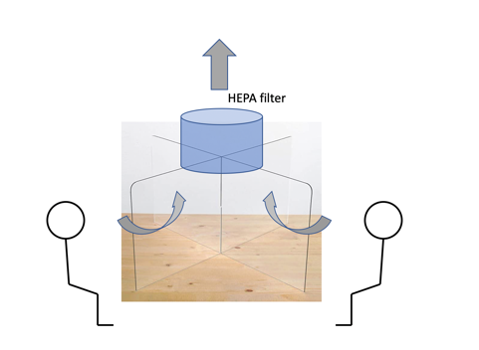
TableShield concept
Augment sneeze guard partitions with local HEPA filtration.
Draws exhalations through high efficiency particulate filter.
Perform surface cleaning between groups.

Slide 5
TableShield prototype 1
6 inch diameter axial fan draws air through hole in top plate
Exhaust is vertical
48 inches

Slide 6
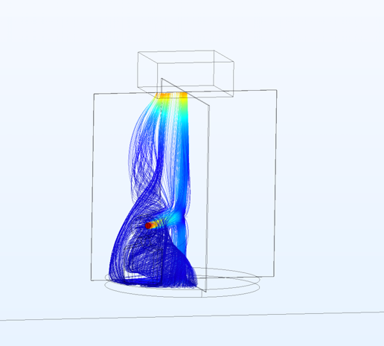
TableShield airflow simulations are promising (J. Doyle and L. Anderegg, Harvard physics)
COMSOL airflow stream simulations look very promising.
Physical measurements on prototypes under way.

Slide 7
Technical plan and schedule
Comparison will be to masked interaction at 6 foot separation.
IF we can show aerosol isolation that is superior to that, we consider this a viable method to allow few-hour shared-space mask-off interactions.
Dec 1 – Dec 15 iterative testing of prototypes, get quotes
Dec 18 design review (EH&S, College, HUHS)
Dec 20 procurements issued
Jan 4 - 11 local assembly
Jan 12-18 schedule contingency
Jan 18-22 distribution

Slide 8
Budget estimate- $1300 per unit, installed
48 inch table $100
need to standardize so all TableShields are the same
https://chiavarisales.com/shop/banquet-tables/square-banquet-tables/48-square-heavy-duty-plywood-banquet-table-metal-edge/
Sneeze guard 68 x 68 x 24 $300
Procurement
HEPA filter and fan unit, top plate $500
Labor – 2 hours per unit, $100/hour $200
Contingency $200

Slide 10
How many? How much money?
Phase 1) Scheduled study spaces, selected break rooms
Cabot science library 10
Smith center 20
break rooms 20
total 50, 65K$
Phase 2) Residential houses
12 Houses, 10 per house 120, 156K$

